Slide 1
Understanding COVID 19 through Ayurveda and meditation

Slide 2
What is TM?
It’s a simple, natural, effortless technique practiced 20 minutes twice each day while sitting comfortably with the eyes closed.
The TM technique allows your active mind to easily settle inward, through quieter levels of thought, until you experience the most silent and peaceful level of your own awareness — pure consciousness.

Slide 3
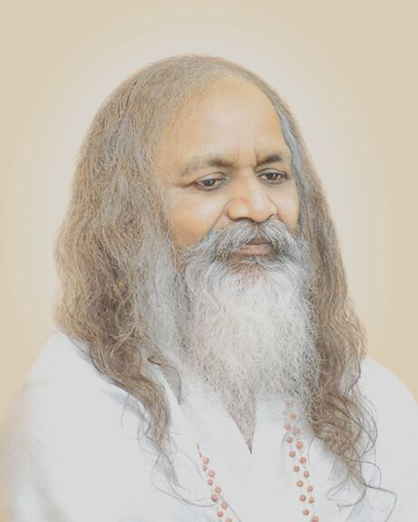

Slide 4
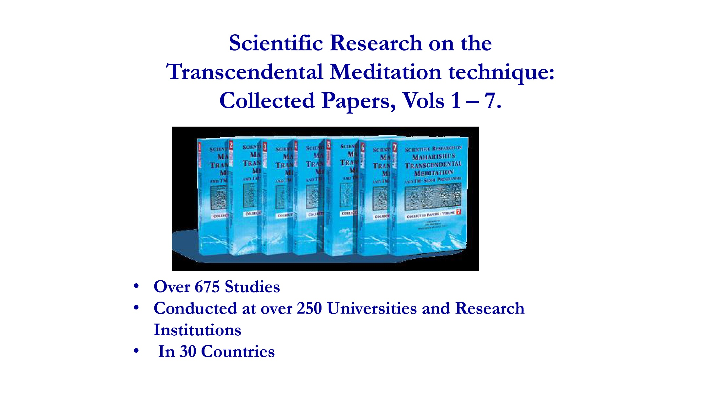

Slide 5
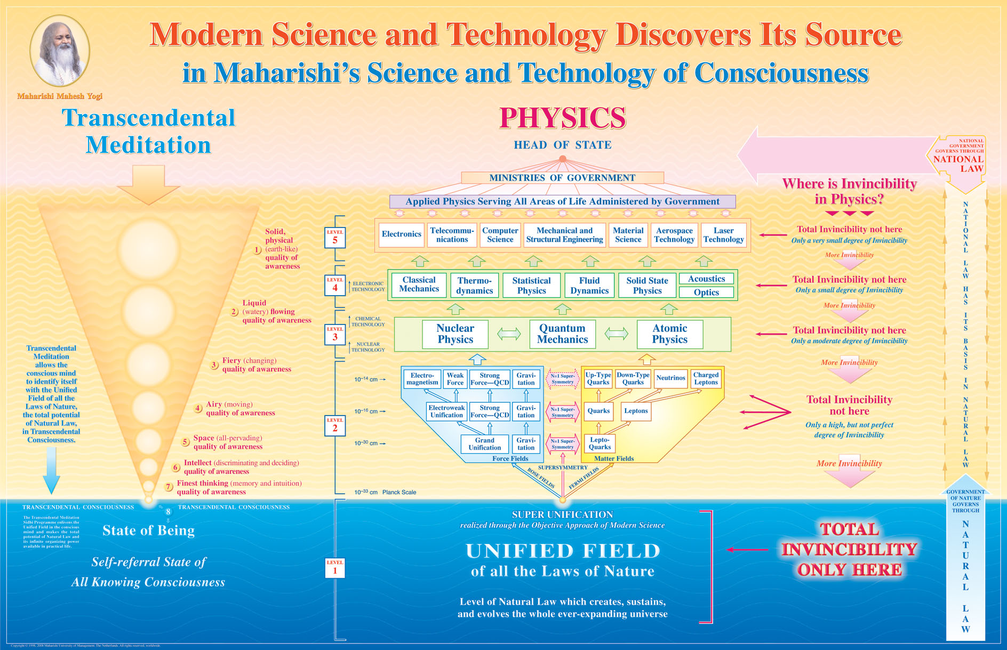

Slide 6
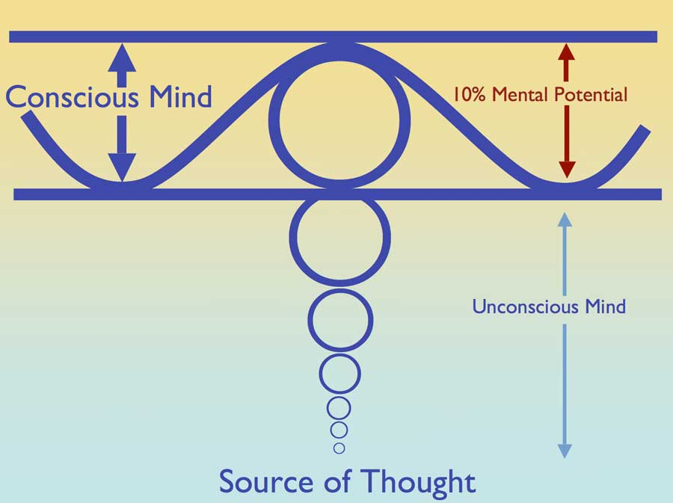

Slide 7
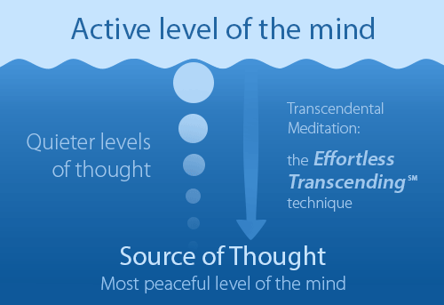
Notes:
Duh kontaktira izvor misli, čisto polje ESSI-a na sistematičan i nenaporan način.
Duh doživljava neograničenu čistu svijest na spontan, lak, prirodan način.

Slide 8
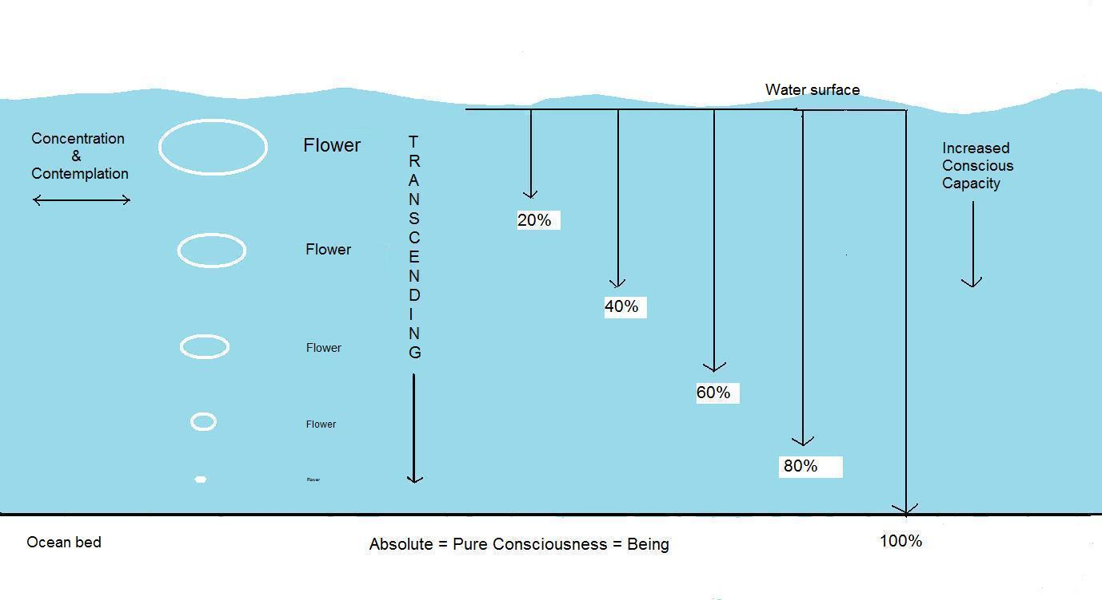

Slide 9
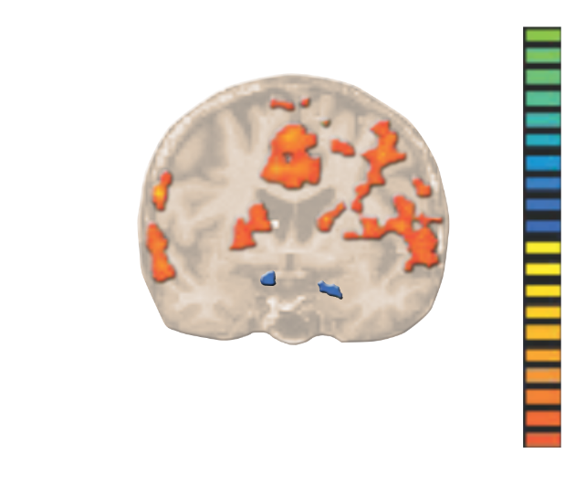
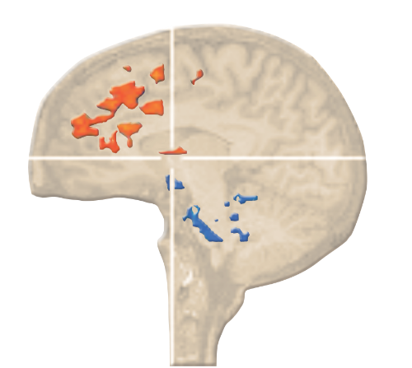
fMRI: Restoration of balanced brain functioning. Chronic and/ or traumatic stress shuts down the prefrontal cortex or “higher brain” and causes chronic excitation of the amygdala “fear centre”. TM practice deactivates the amygdala and surrounding subcortical structures (blue), and stimulates activity in the prefrontal cortex (orange) and through that, fosters higher moral behaviour.
Notes:
fMRI: Restoration of balanced brain functioning. Chronic and/ or traumatic stress shuts down the prefrontal cortex or “higher brain” and causes chronic excitation of the amygdala “fear centre”. TM practice deactivates the amygdala and surrounding subcortical structures (blue), and stimulates activity in the prefrontal cortex (orange) and through that, fosters higher moral behaviour.

Slide 10
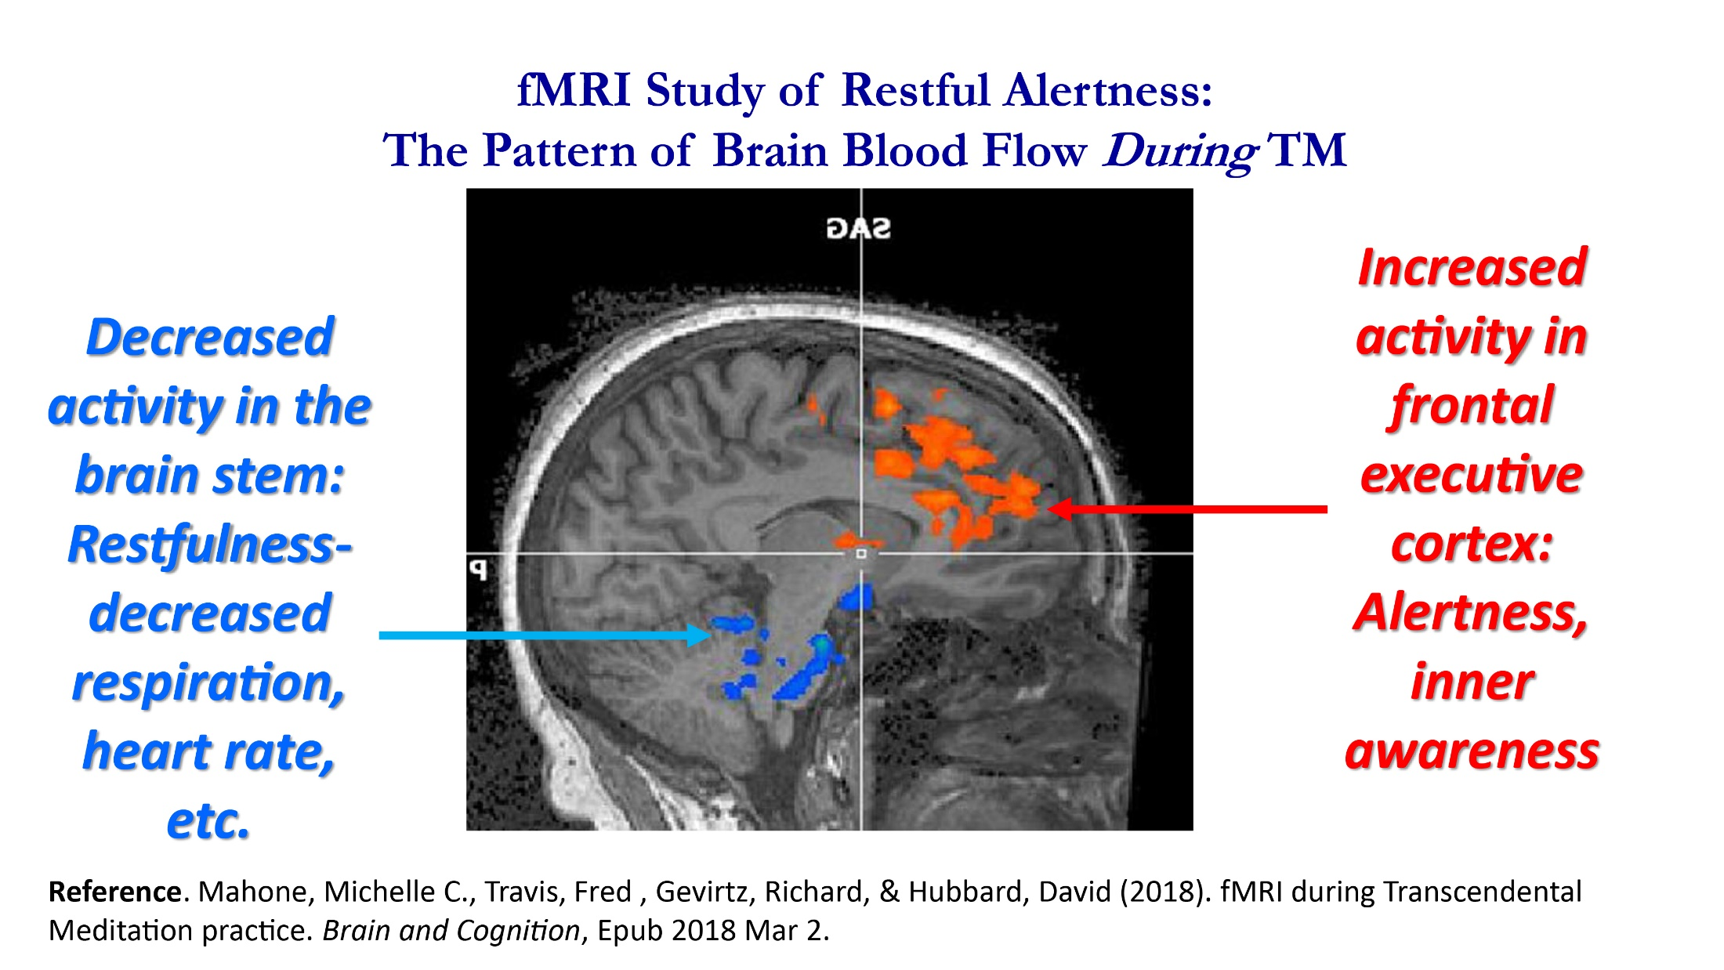

Slide 11
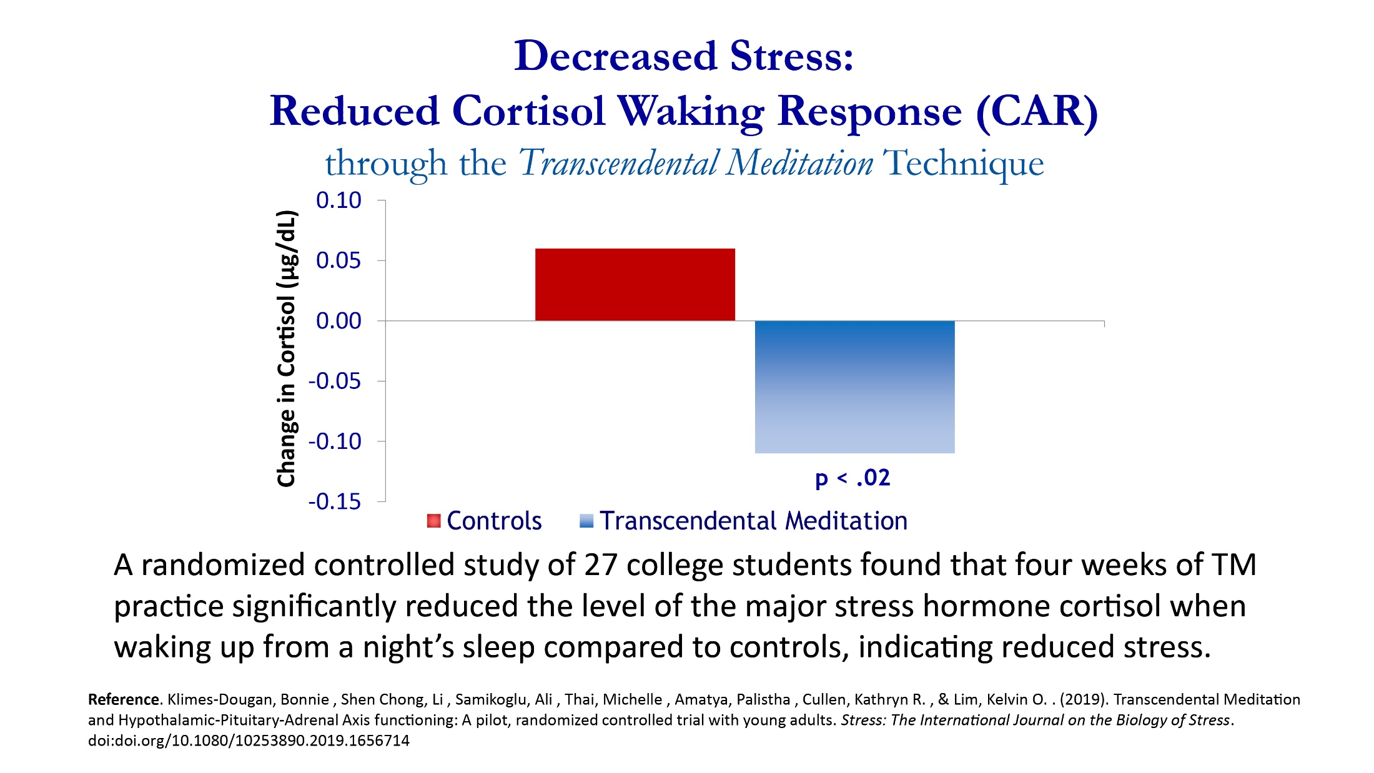

Slide 12
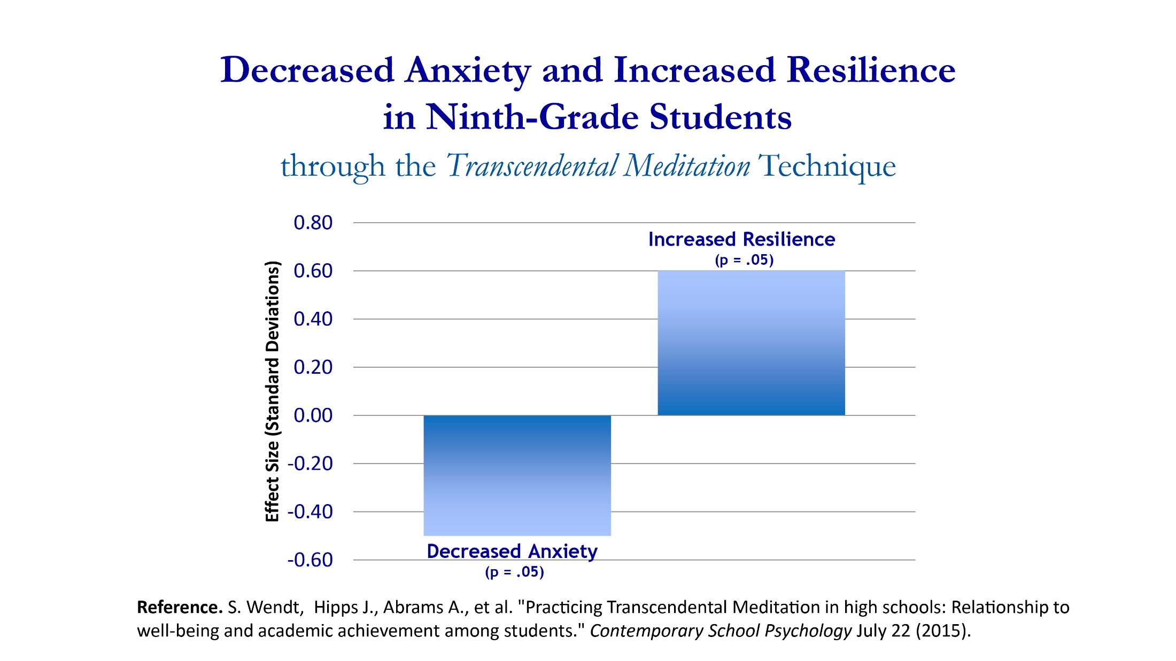

Slide 13
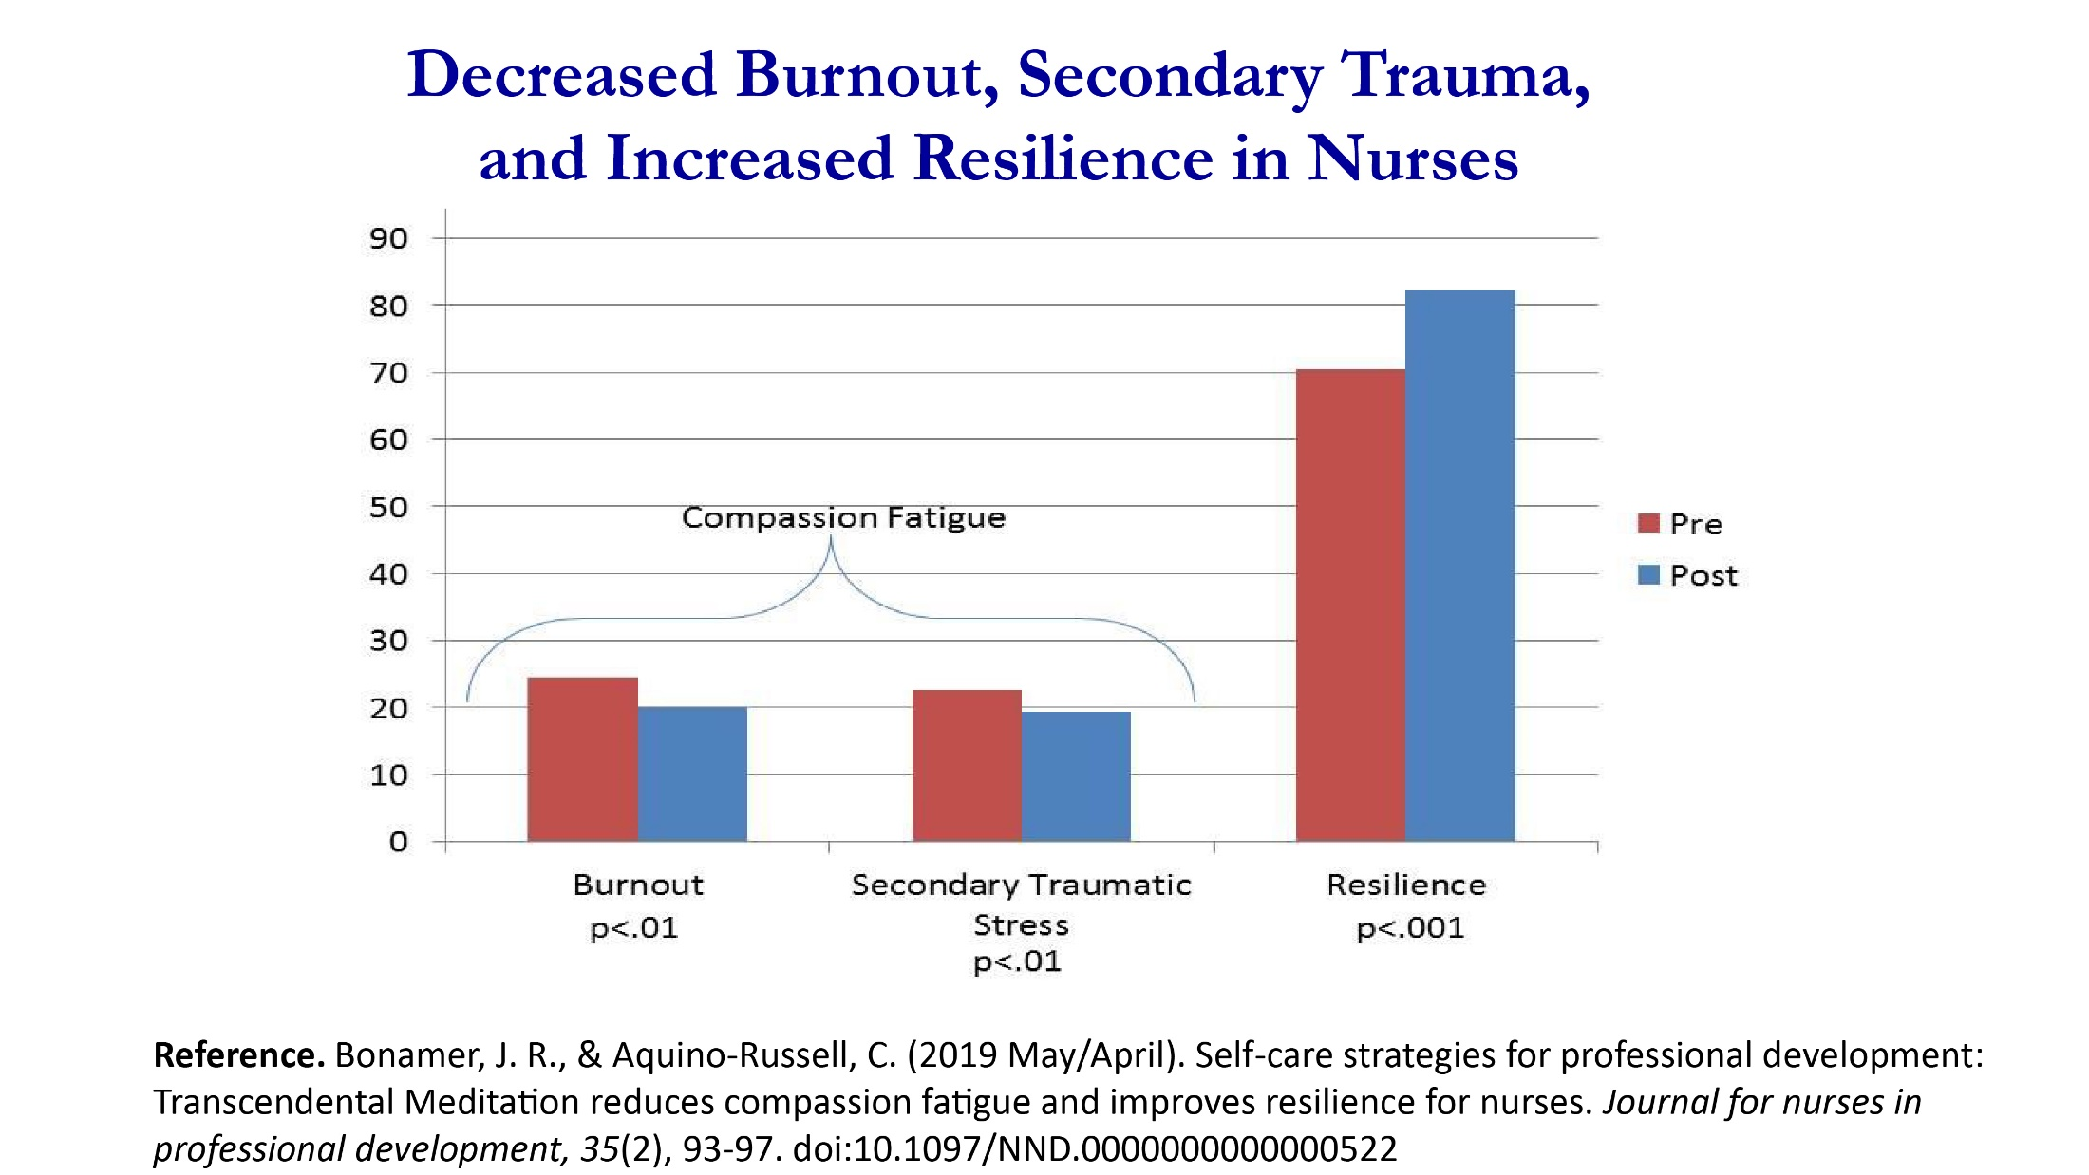

Slide 14
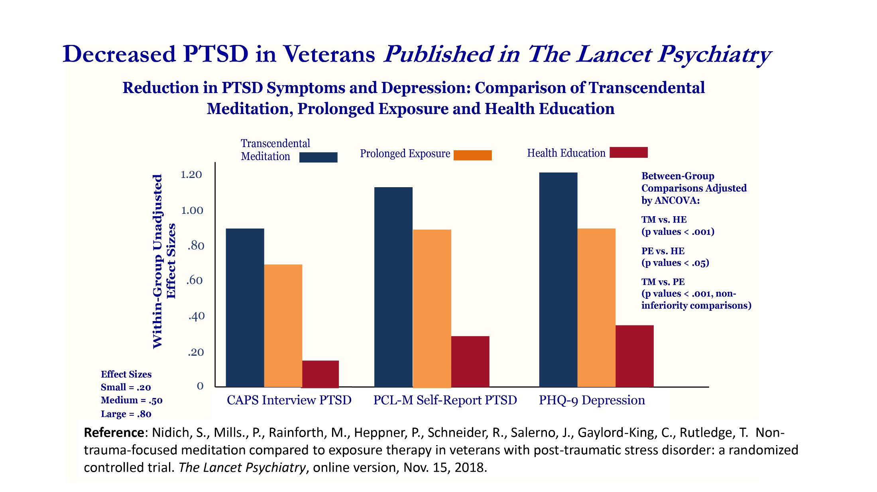

Slide 15


Slide 16
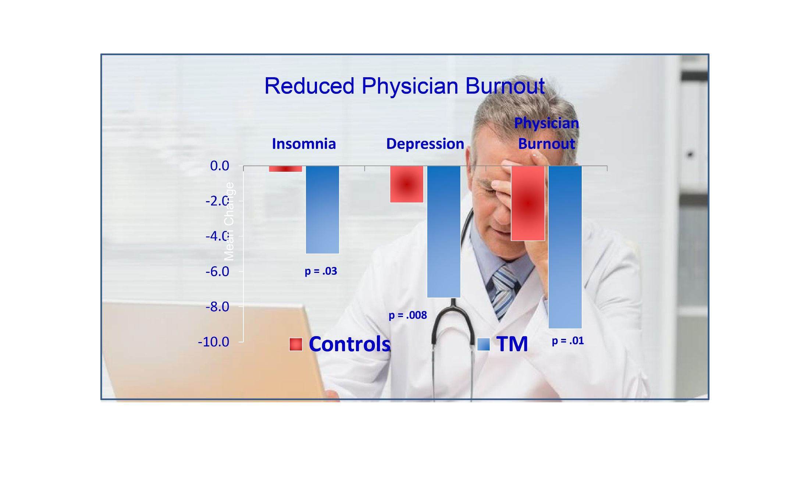

Slide 17
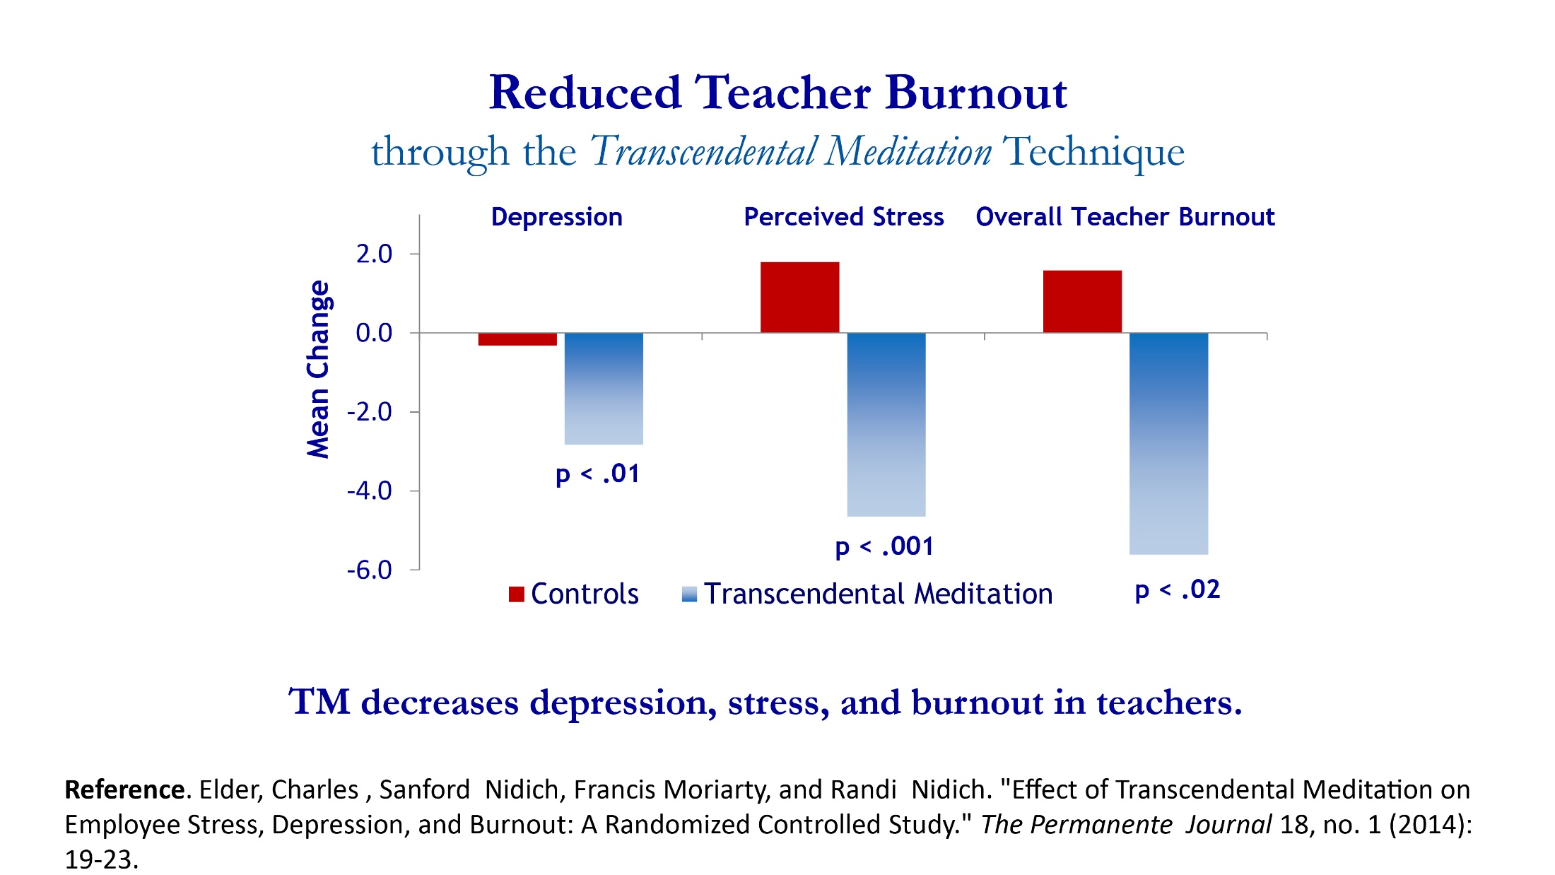

Slide 18
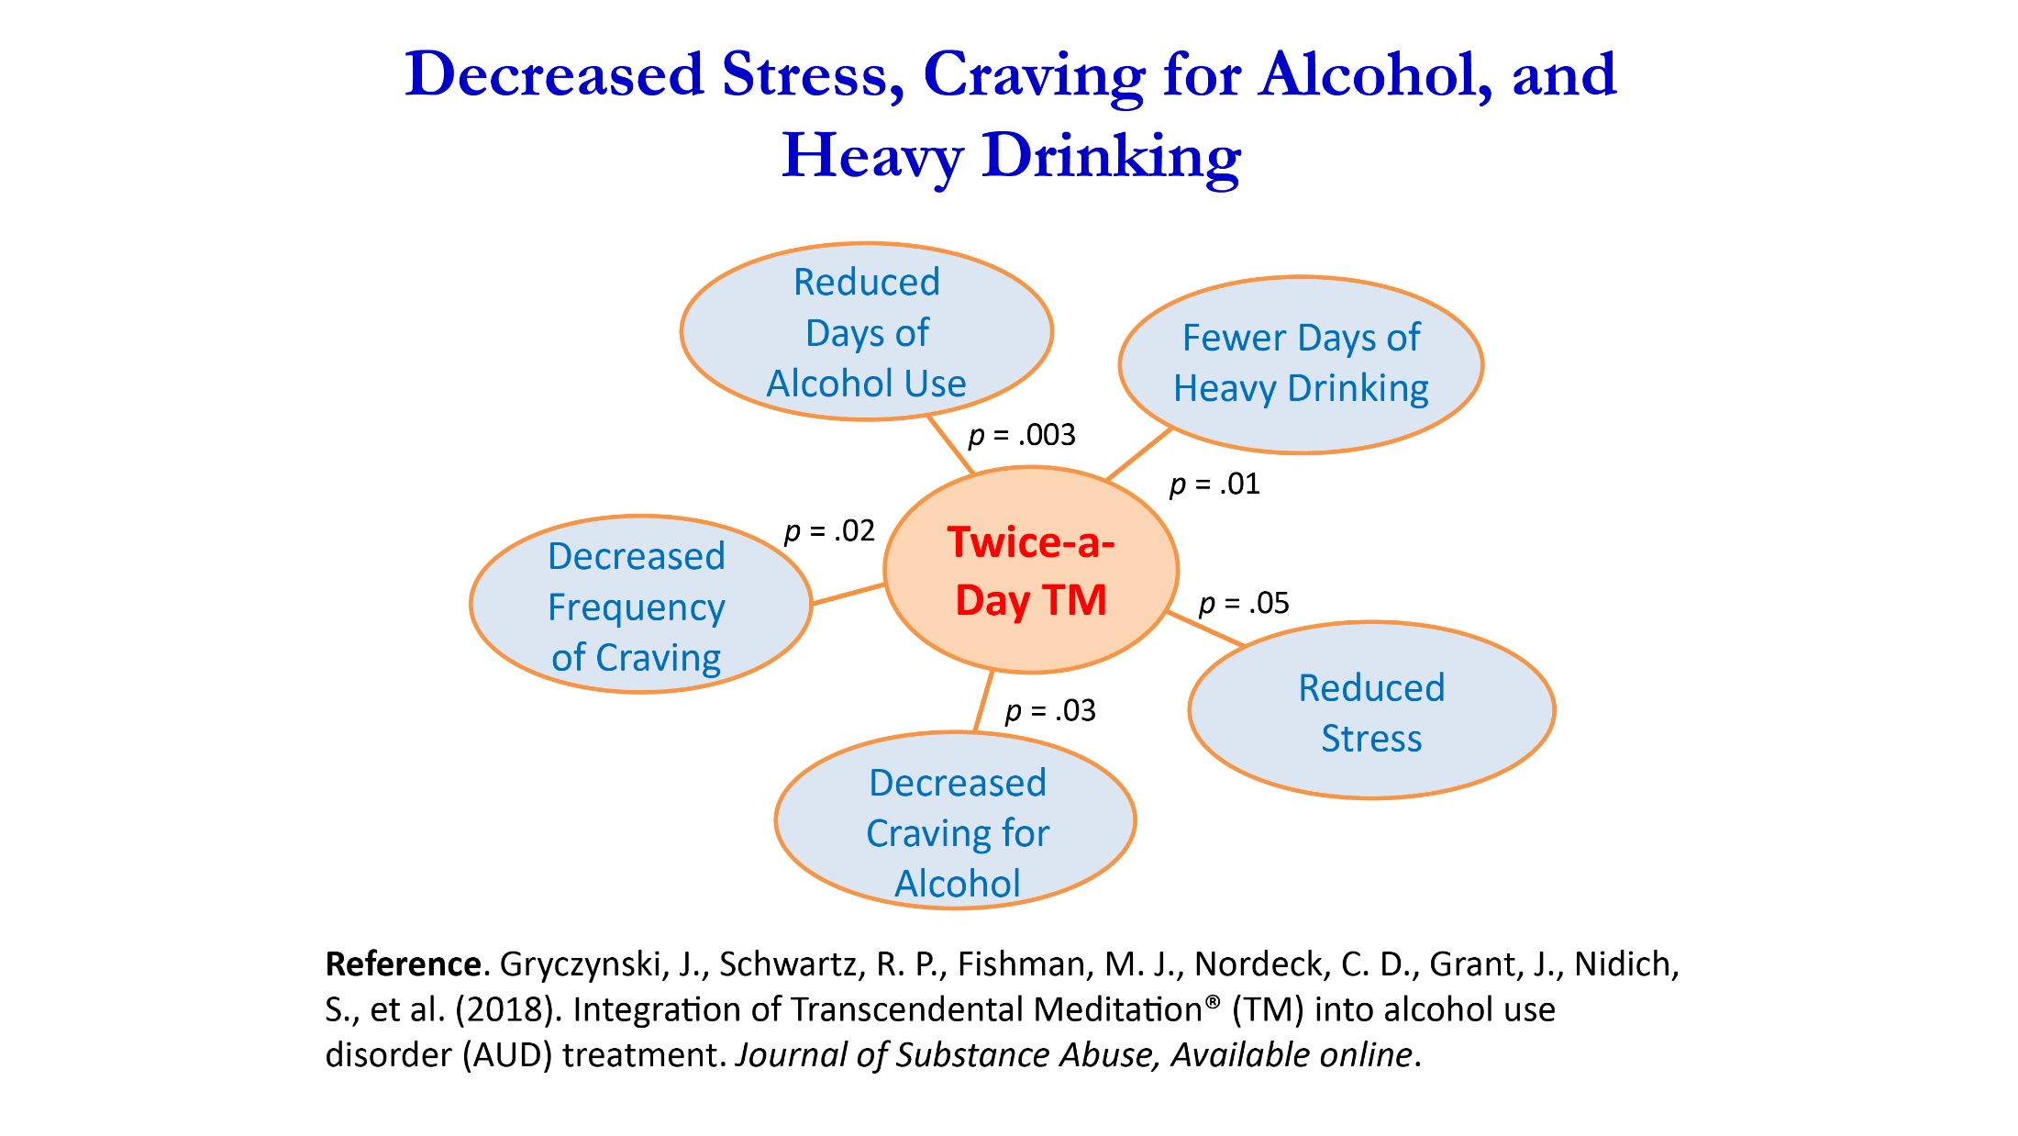

Slide 19
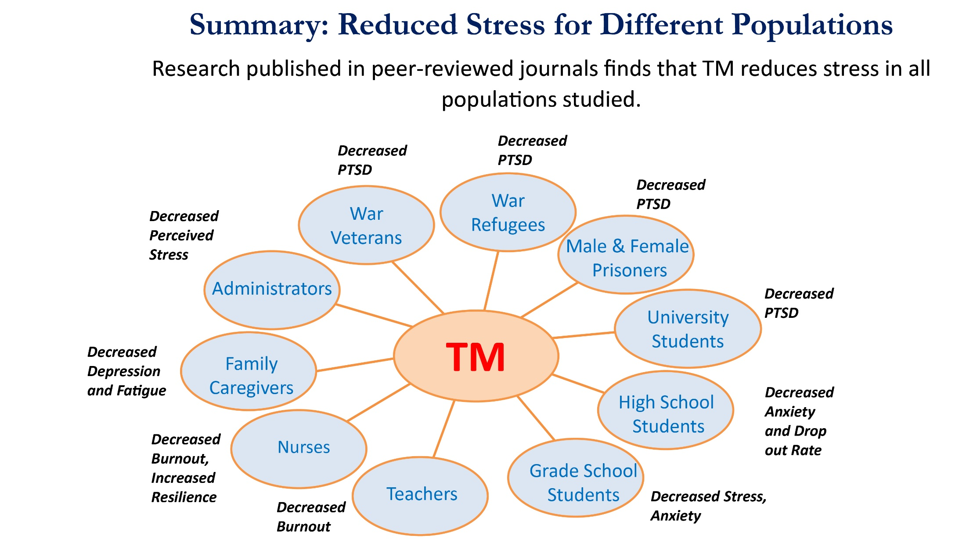

Slide 20
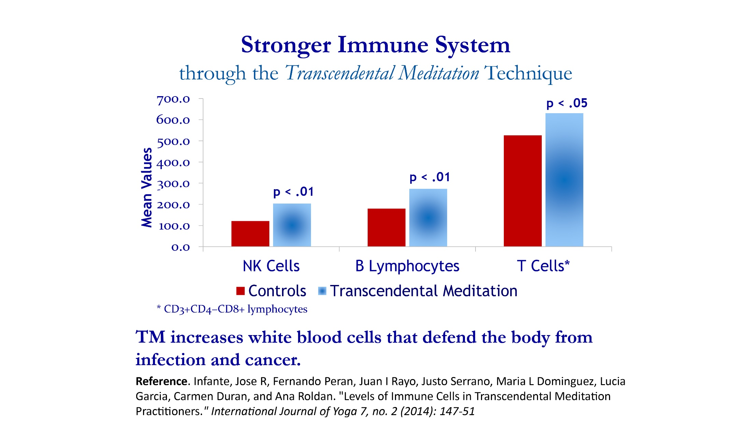

Slide 21
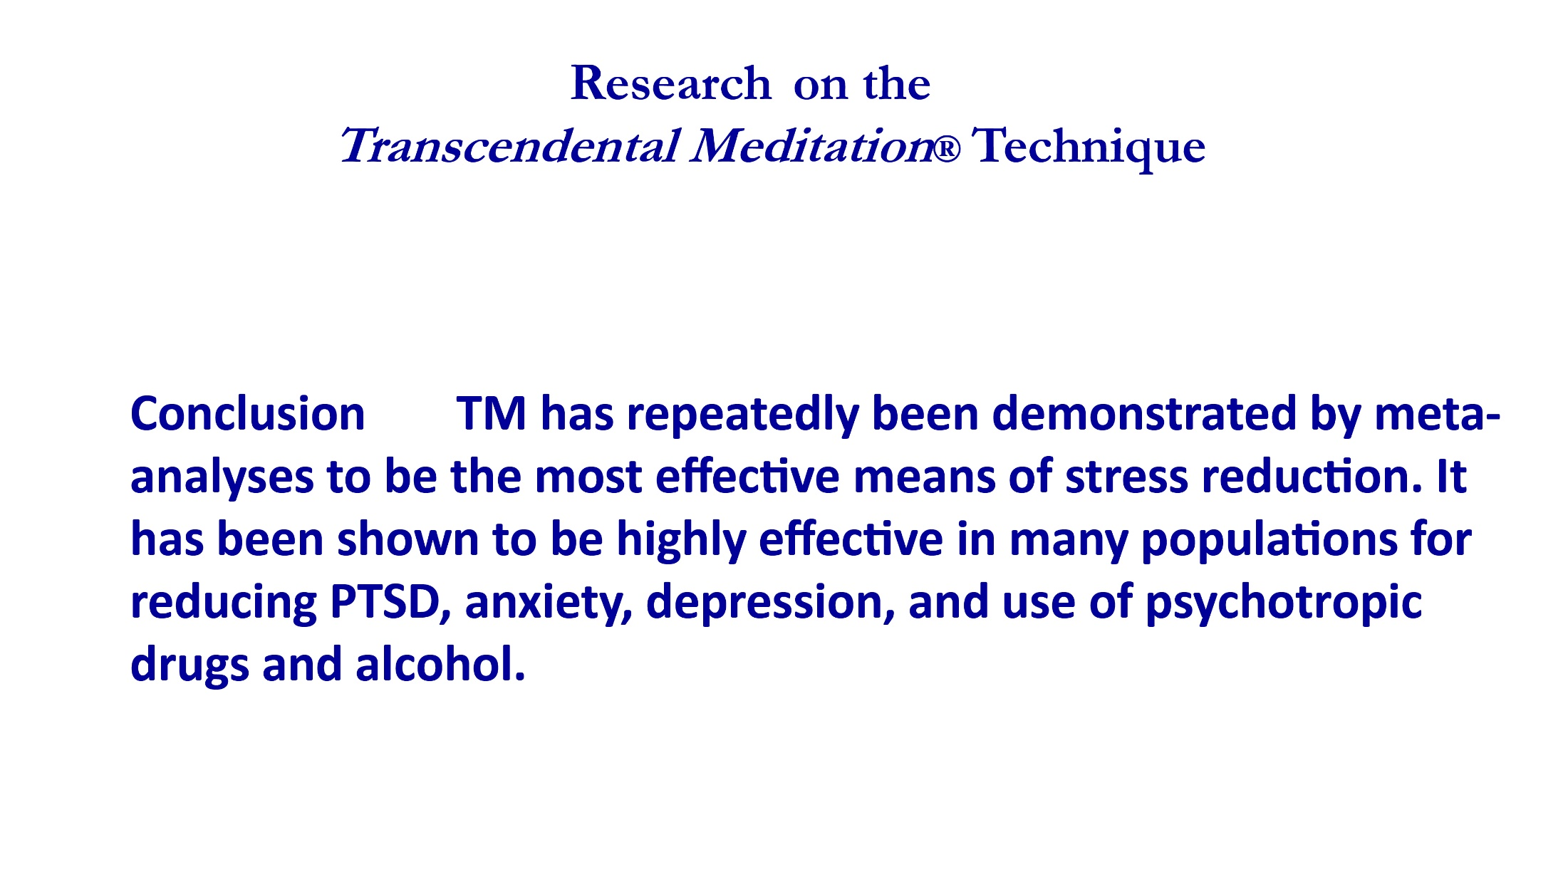

Slide 22


Slide 23
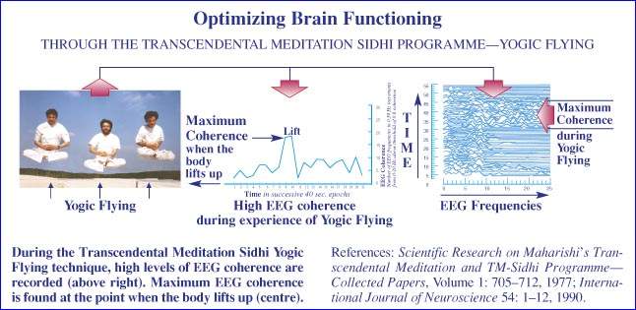

Slide 24
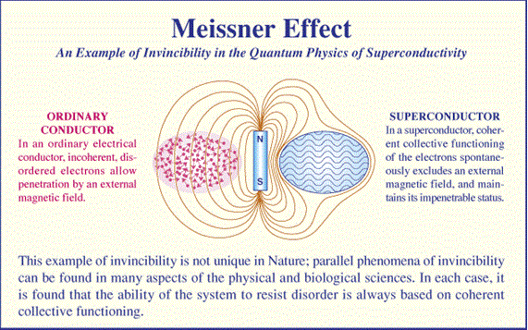

Slide 25
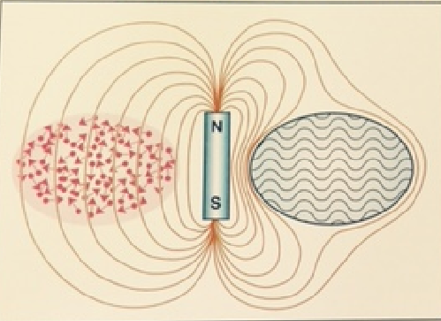

A disease-free society
Perfect health
Individually - Collective health

Slide 26
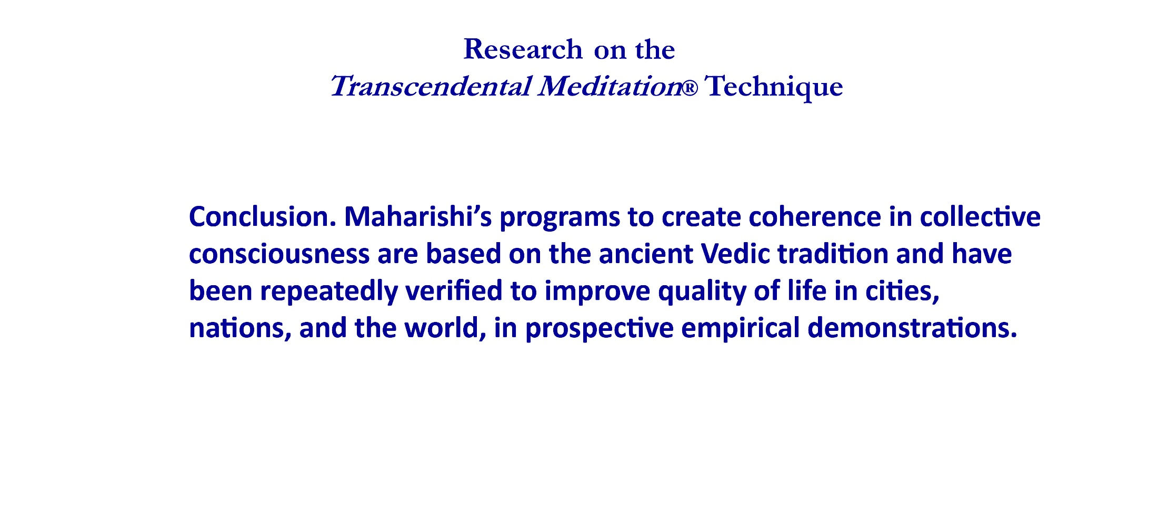

Slide 27
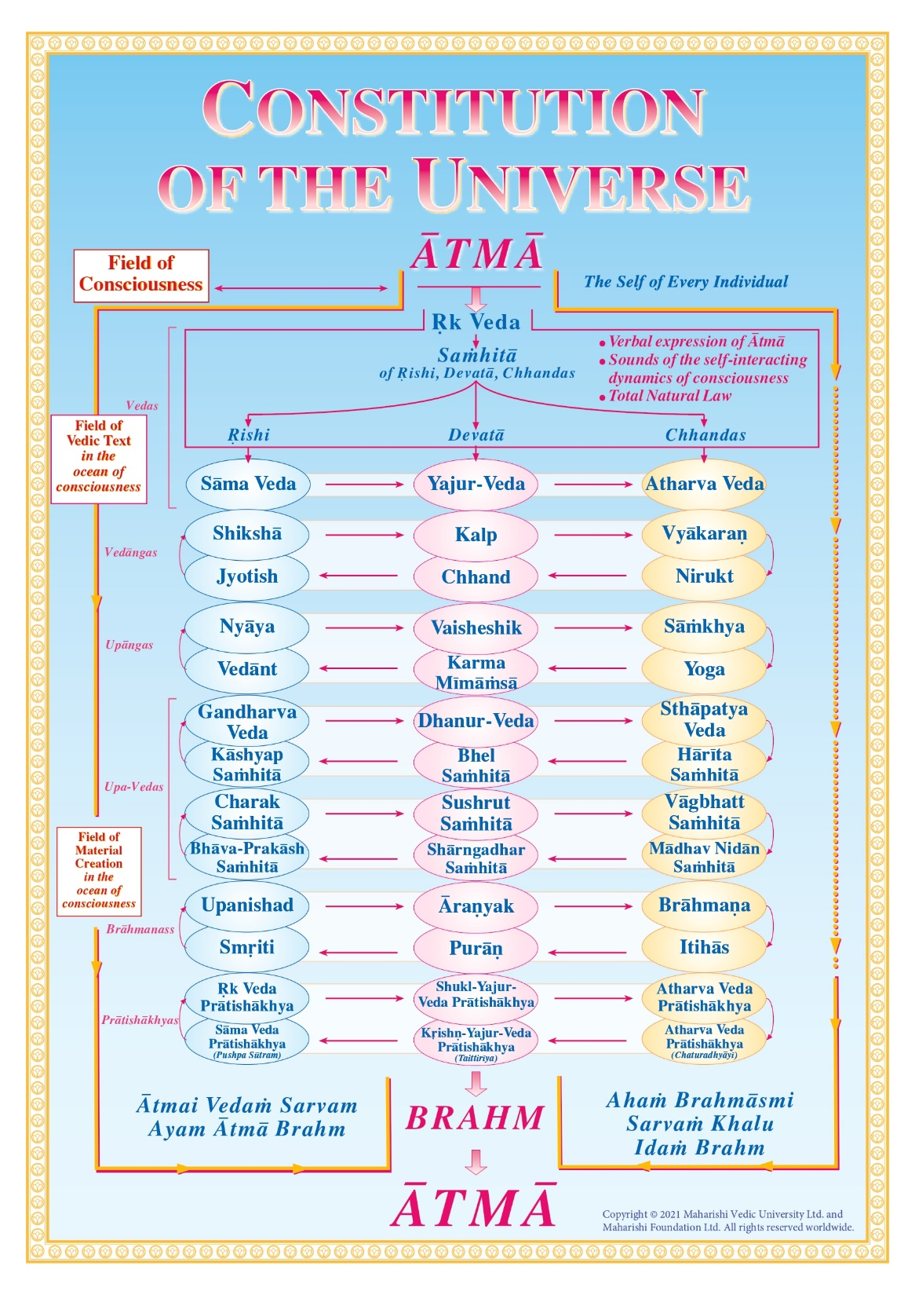

Slide 28
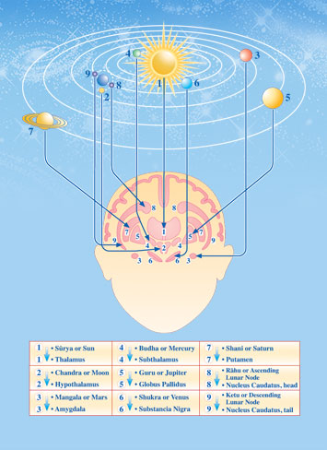

Slide 29
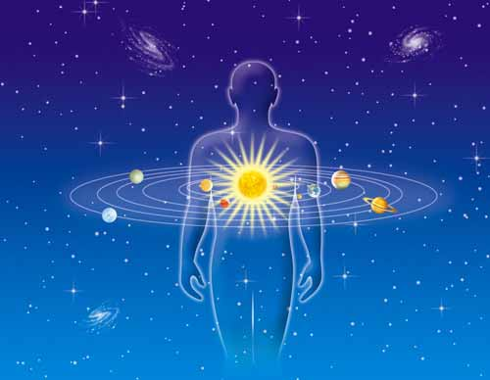
When the total intelligence of Natural Law—Veda—is lively in the individual physiology, there is perfect synchrony between the functioning of the body as a whole, and between individual intelligence and Cosmic intelligence. With this complete integration, all thought and action are spontaneously in harmony with Natural Law and the individual enjoys perfect health. (Maharishi Mahesh Yogi, 1995a)

