Slide 1
AYURVEDA FOR
LONGIVITY
Prof. (Dr) Rama Kanta Sharma, MD,PhD
Principal,Government of Ayurvedic College & Hospital
Assam,India
Email: ramakanta.sharma@rediffmail.com

Slide 2
What do we mean by
AYURVEDA?

Slide 3
Ayurveda is the science of life.
Ayurveda describe that equilibrium state of three basic constituents of the human body.
Proper digestive function
Proper functioning of all the systems of our body.
Happy state of mind and soul.
Prime Aim
Maintenance of Health
Cure of Diseases
Main Source
Medicinal Plants
Integral Part
Yoga for longevity

Slide 4
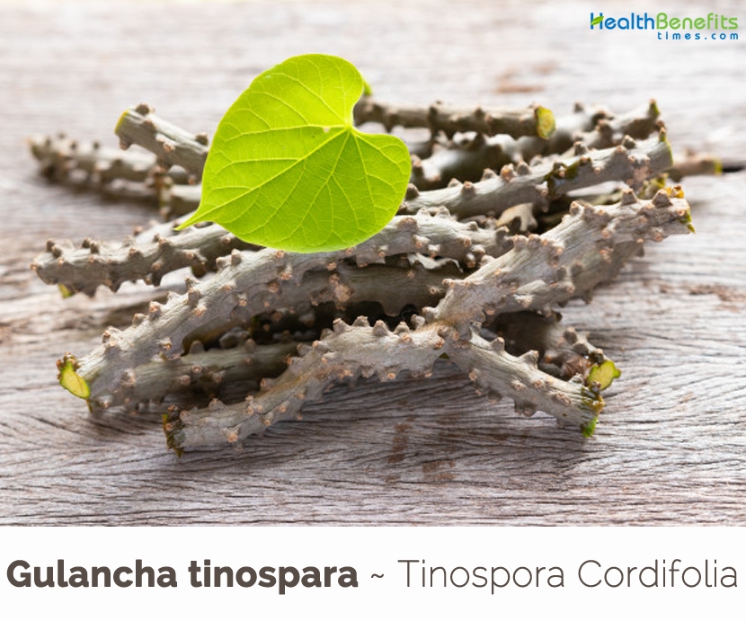
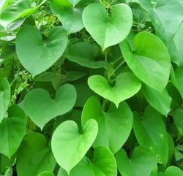
IMMUNOMODULATOR
Heart-leaved moonseed/Giloy
Tinospora cordifolia;Menispermaceae

Slide 5
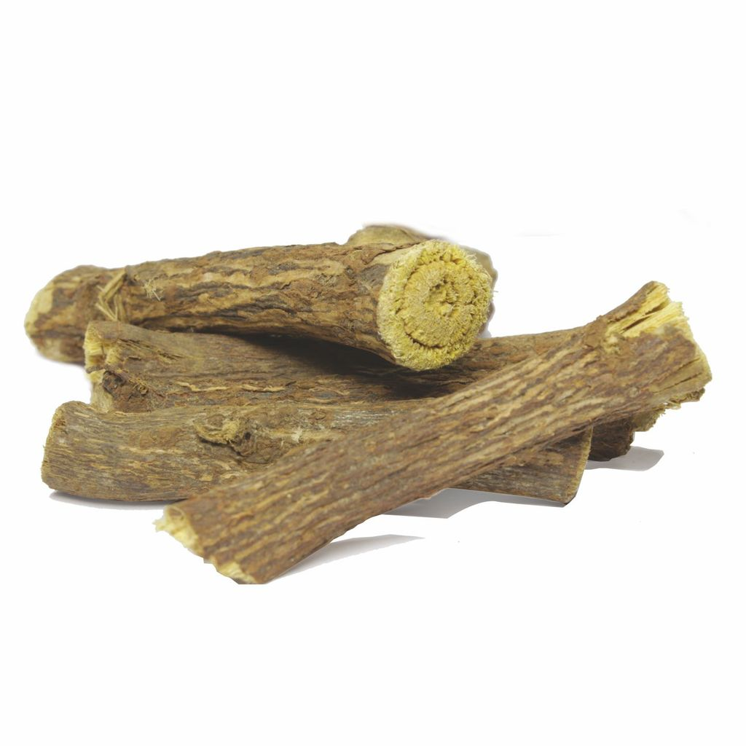
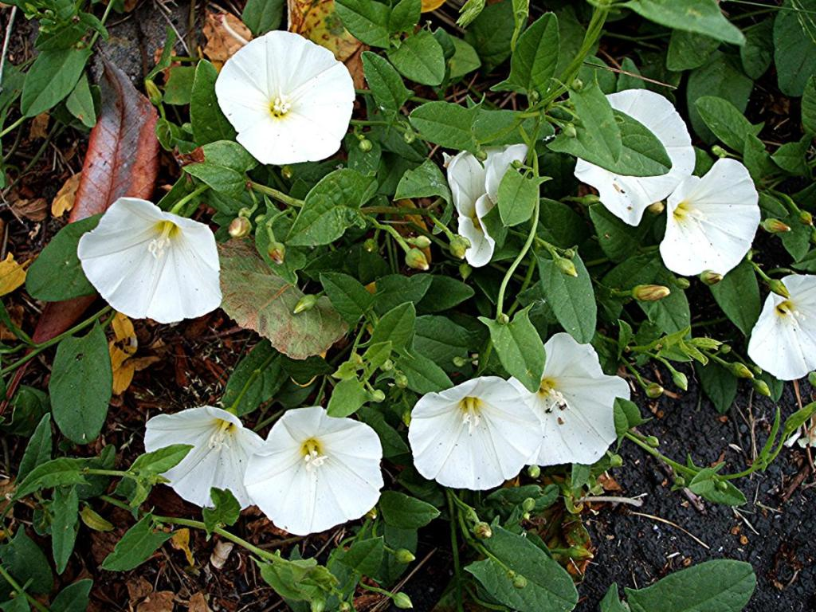
IMMUNOMODULATOR
Aloe weed/Speed wheel
Convolvulus pluricaulis ; Convolvulaceae
Liquorice
Glycyrrhiza glabra ; Fabaceae

Slide 6
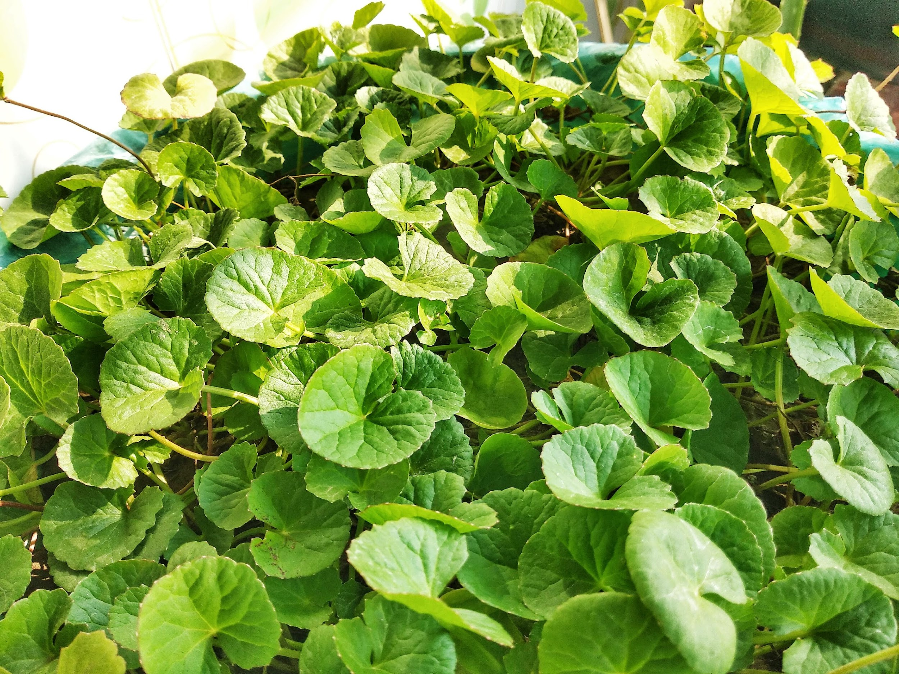
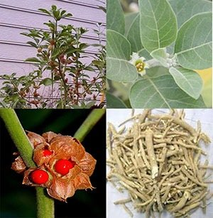
IMMUNOMODULATOR
Indian Pennywort
Centella asiatica ; Apiaceae
Winter Cherry
Withania somnifera ; Solanaceae

Slide 7
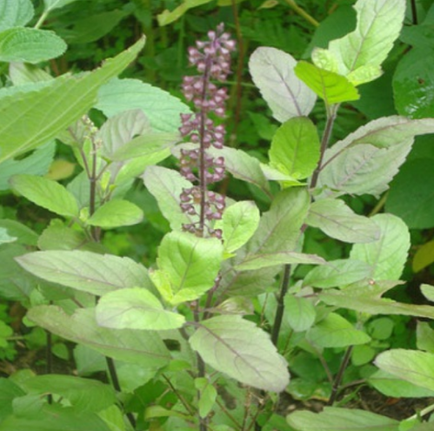
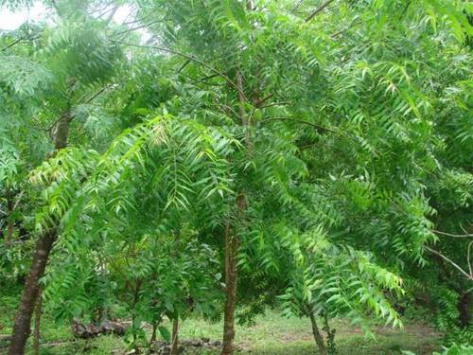
IMMUNOMODULATOR
Holy Basil
Ocimum sanctum ;Lamiaceae
Neem/Margosa
Azadirachta indica ;Meliaceae

Slide 8
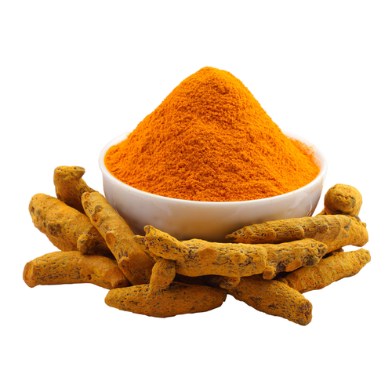
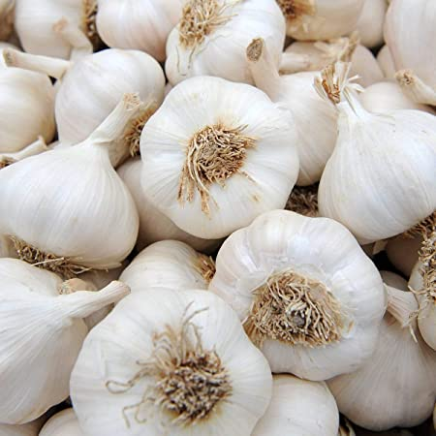
IMMUNOMODULATOR
Turmeric
Curcuma longa ; Zingiberaceae
Garlic
Allium sativum ;Amaryllidaceae

Slide 9
Musculoskeletal Disorder
Osteoarthritis
Rheumatoid-Arthritis
Polyarthritis
Gouty-Arthritis
Cervical spondylitis
Lumbar spondylitis
Muscle strains and low back injuries
Tendinitis

Slide 10
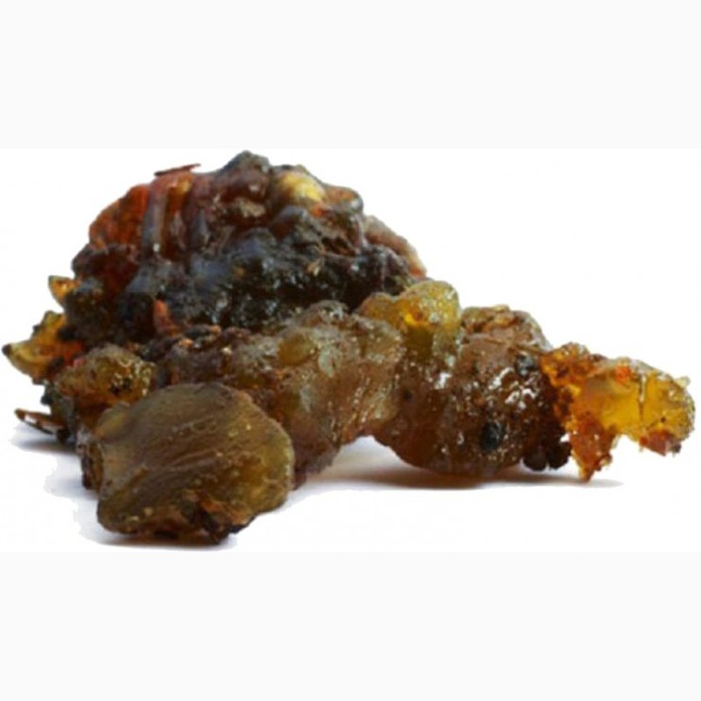
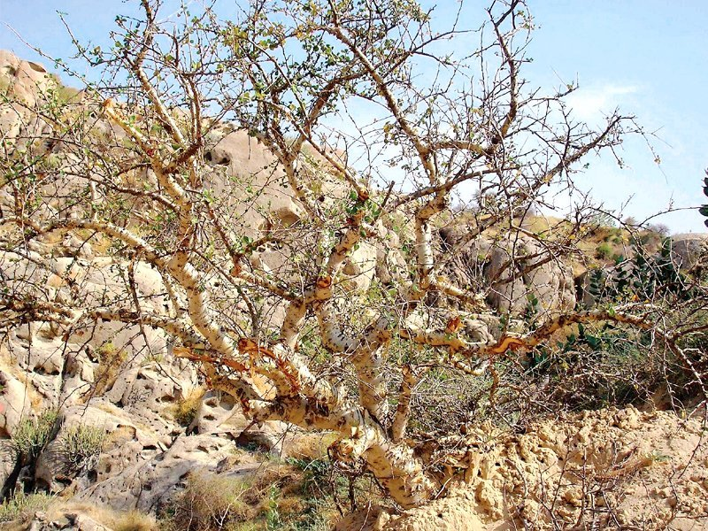
Analgesic & Anti-inflammatory
Indian bdellium tree
Commiphora wightii ;Burseraceae

Slide 11
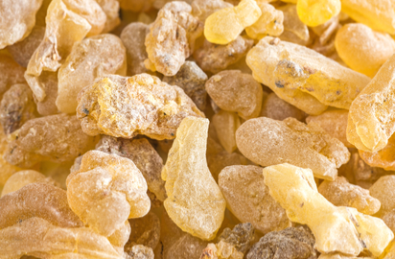
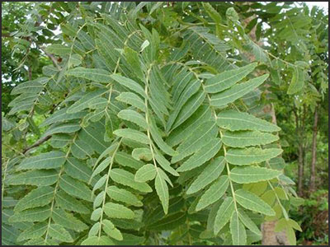
Analgesic & Anti-inflammatory
Indian oli banum
Boswellia serrata ;Burseraceae

Slide 12
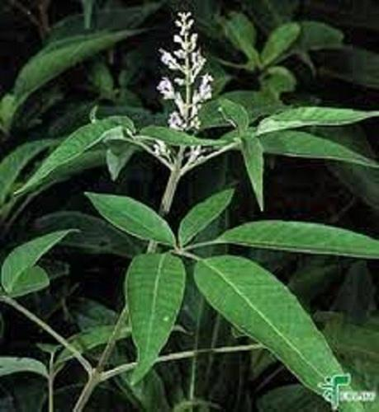
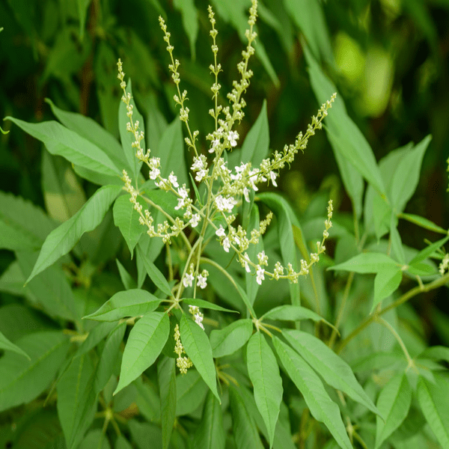
Analgesic & Anti-inflammatory
Chinese chastetree
Vitex; negundo Lamiaceae

Slide 13
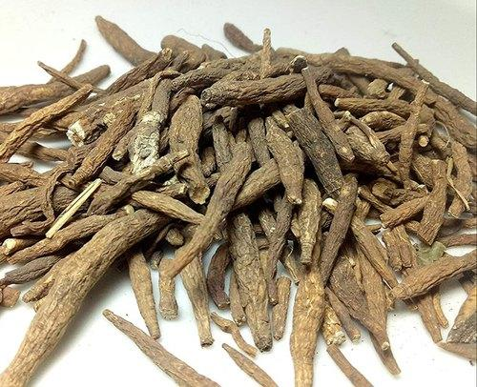
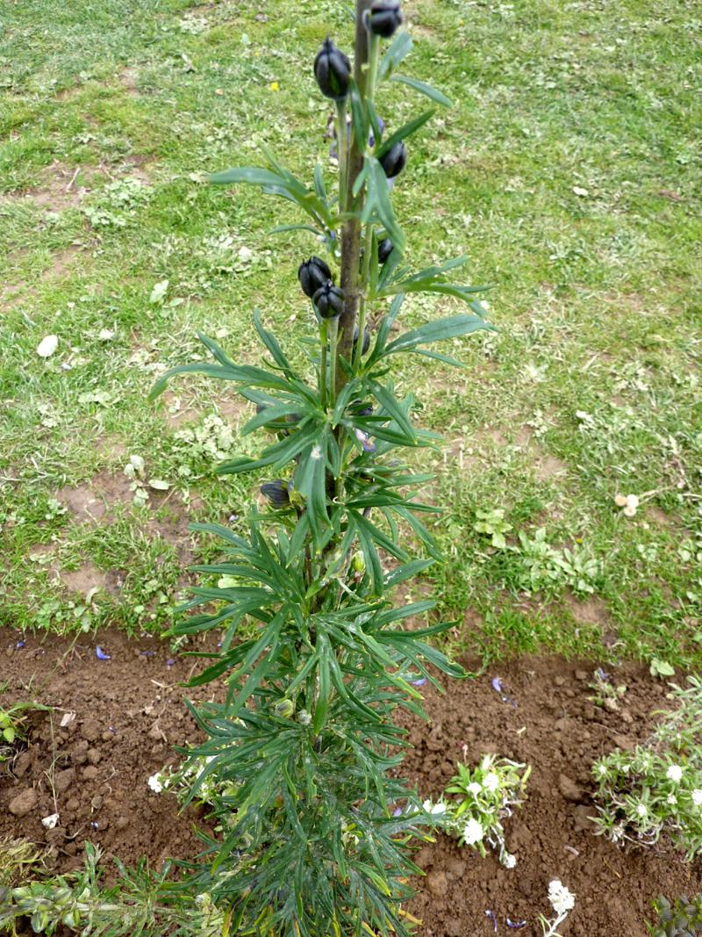
Analgesic & Anti-inflammatory
Monks hood
Aconitum chasmanthum ; Ranunculaceae

Slide 14
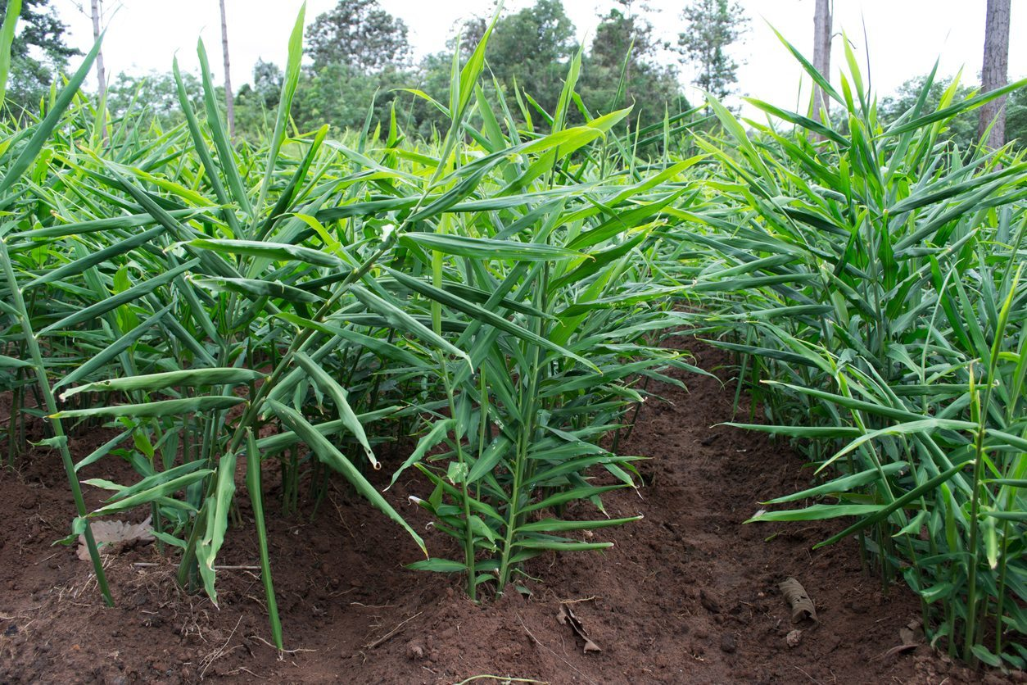
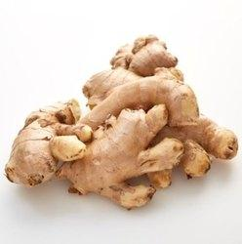
Analgesic & Anti-inflammatory
Ginger
Zingib officinale ; Zingiberaceae

Slide 15
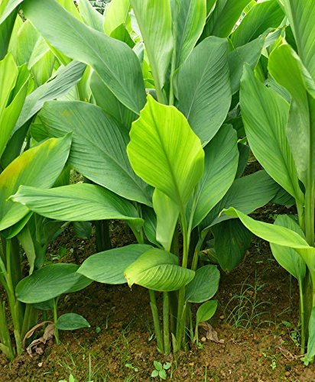
Analgesic & Anti-inflammatory
Turmeric
Curcuma longa ; Zingiberaceae

Slide 16
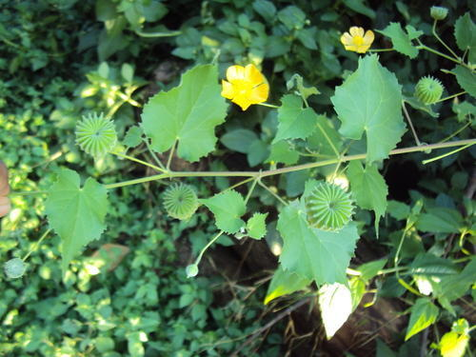
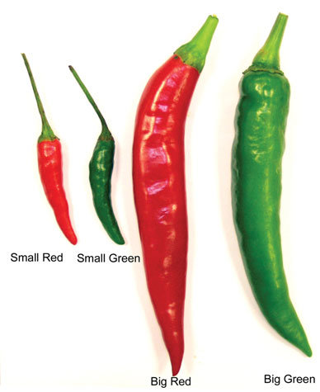
Analgesic & Anti-inflammatory
Capsicum
Capsicum annuum ; Solanaceae
Indian abutilon
Abutilon indicum ; Malvaceae

Slide 17
366 Million
Total no.of people are projected to be diabetic by the end of 2030 globally.
The prevalence of diabetes for all Age groups worldwide was estimated to be 4.4% in 2030.

Slide 18
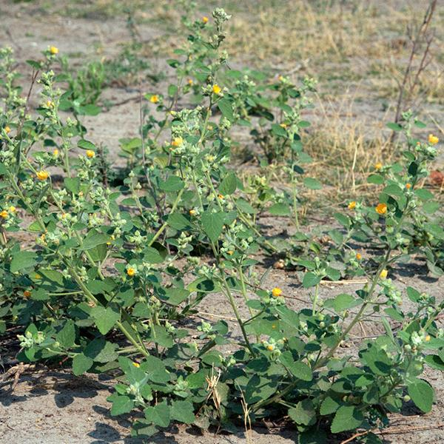
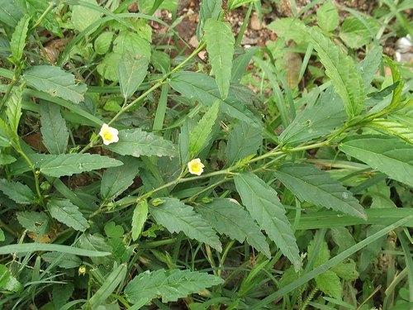
Analgesic & Anti-inflammatory
Country mallow
Sida cordifolia ; Malvaceae
Common wireweed
Sida acuta ; Malvaceae

Slide 19
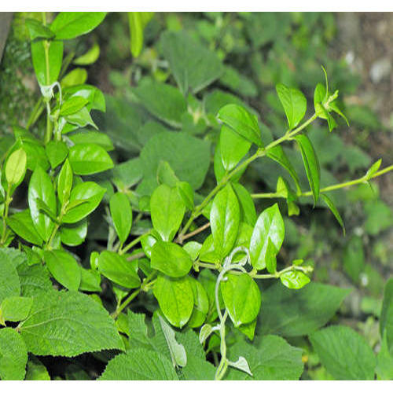
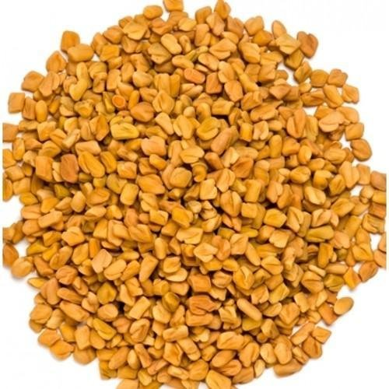
HYPO-GLYCAEMIC
Australian cowplant
Gymnema sylvestre ; Apocynaceae
Fenugreek
Trigonella foenum-graecum ; Fabaceae

Slide 20
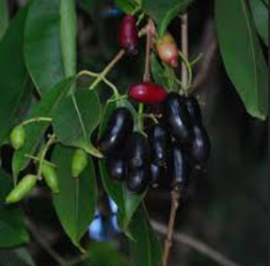
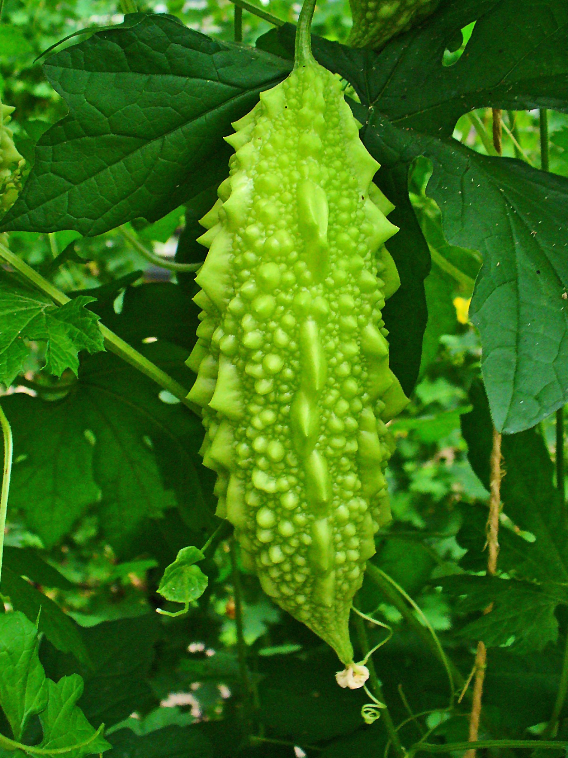
HYPOGLYCEMIC
Indian blackberry
Syzygium cumini ; Myrtaceae
Bitter gourd
Momorica charantia ; Cucurbitaceae

Slide 21
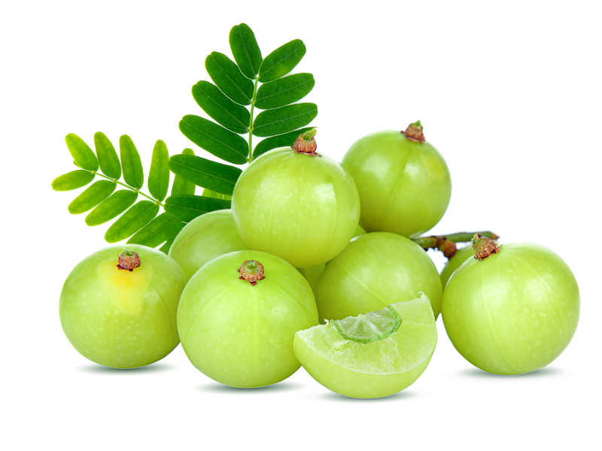
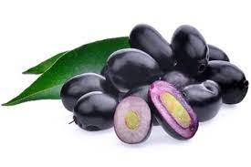
Scientific Findings

Slide 22
1 in 13 suffers from Anxiety
-WHO
The WHO reports that anxiety disorders are the most common mental disorders along with other disorder worldwide.
Insufficient sleep is a global problem that is becoming increasingly common in today's society.
Compared to a few decade ago, significant changes in sleep culture have been observed worldwide.
Other Most Common Disorders
Specific Phobia
Major depressive disorder
Social Phobia

Slide 23
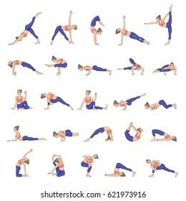
YOGA ASANA

Slide 24
Yoga Therapy
The best gift for staying fit, flexible and younger LIFE STYLE.
This gift is known as ‘Yoga’. If you practice yoga regular.
Yoga is a holistic approach.
Works on the body, mind and spirit simultaneously.

Slide 25
BENEFIT OF YOGA
A preventive methodology
Managing numerous common diseases
Asthma, Diabetes,Hypertension etc.

Slide 26


