Slide 1

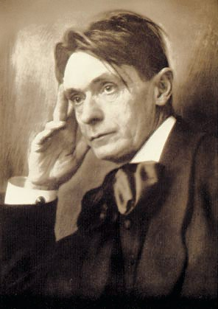
Growing biodynamically for health and vitality
mr. sc. Dijana Posavec, dipl. ing.
Centar dr. Rudolfa Steinera
1st International Yoga and Ayurveda Conference 3.10.2021., Zagreb

Slide 2
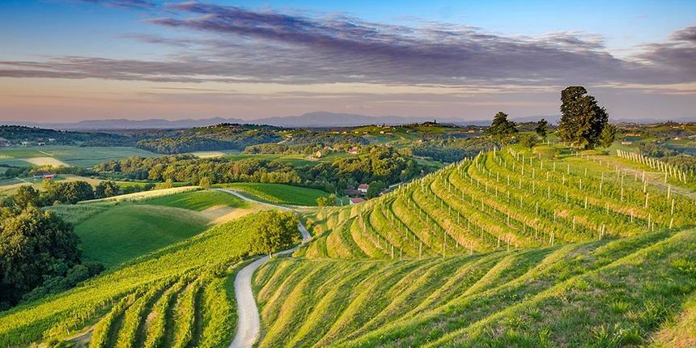
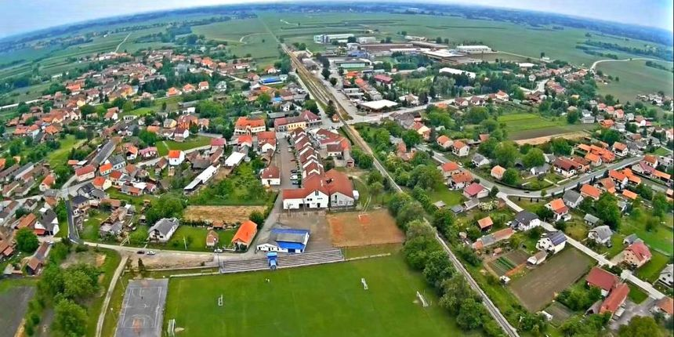
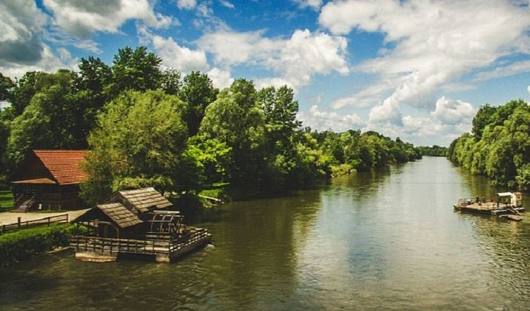
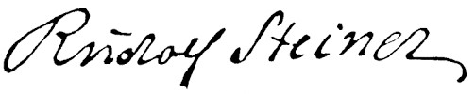
LAND WHERE RUDOLF STEINER WAS BORN
Rudolf Steiner says about the place of his birth in his speech to the Russians: „I myself was born in a Slavic region, in an area completaly foreign to the whole milieu and character of the place where my ancestors came from. In addition to the Germanic and Slavic elements, there is a third, Celtic.”
(April 11, 1912 Helsinki)

Slide 3
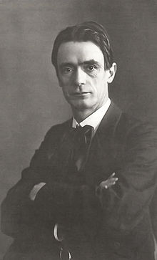
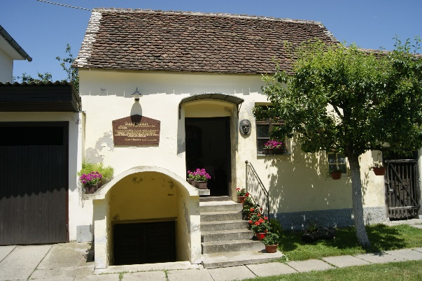
dr. Rudolf Steiner
The story of a man who changes the world.
For the better.
Born on February 27, 1861 in Donji Kraljevec (Međimurje County).
He completed his studies in mathematics and natural sciences at the Vienna University of Technology, where he also studied philosophy, literature, psychology and medicine.
In a magnificent opus of 365 books, articles, and over 7,500 lectures, Dr. Rudolf Steiner presented his teachings.
A genius of his time (1861.-1925.)

Slide 4
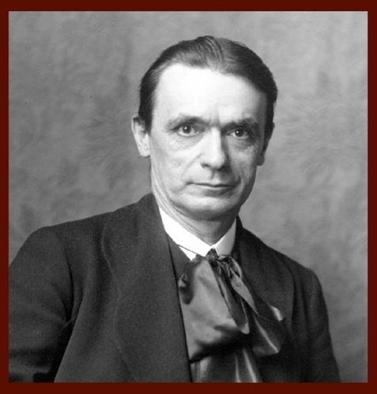
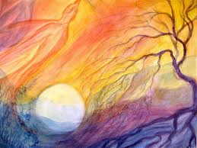
DR. RUDOLF STEINER - inheritance
BIODYNAMIC AGRICULTURE
ANTROPOSOPHICAL MEDICINE
ORGANIC ARHITECTURE
EURYTHMY
WALDORF PEDAGOGY
He founded anthroposophy, eurythmy, Waldorf pedagogy, organic architecture, anthroposophical medicine, biodynamic agriculture, influenced the performing and fine arts… on the assumption that there is a spiritual background behind any physical form and he proved it scientifically!
He wanted to make it understandable to all people that our daily physical world is based on the spiritual world.

Slide 5
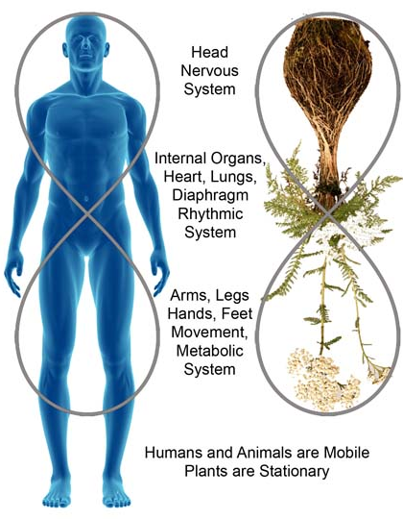
BIODYNAMIC AGRICULTURE
Innovative value-added agricultural

Slide 6

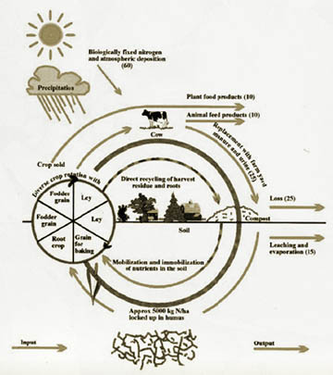
A system of organic (ecological) agriculture that recognizes the biological and chemical values of the soil and treats the farm as a living system that creates healthy living soil!
Dr. Rudolf Steiner presented biodynamic agriculture as a concept of sustainable management that follows natural rhythms at a lecture in Koblerwitz in 1924 titled "Agricultural Course". Why?
Biodynamic agricultural production is a holistic approach to agriculture and respects the principle: "one economy - one organism".
The basic work in biodynamics is the creation of humus and the revitalization of the soil.
This type of agriculture is self-sustainable,
everything that a farm needs
it only produces.

Slide 7
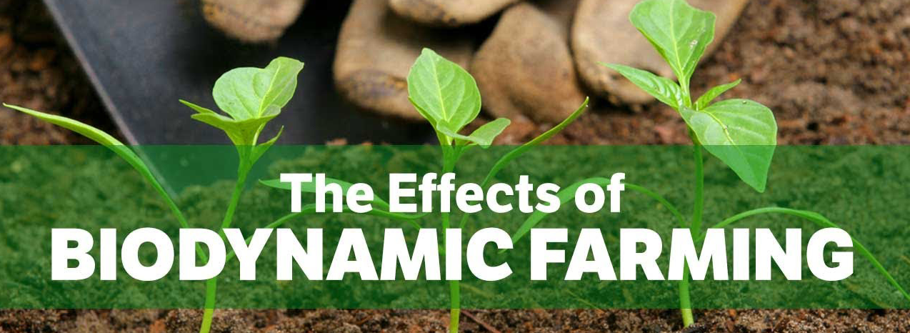
A Biodynamic Farm Is a Living Organism
Biodynamics Cultivates Biodiversity
Biodynamics Brings Plants and Animals Together
Compost Is Enlivened with Biodynamic Preparations
Biodynamic Farmers Cultivate Awareness
Biodynamic Sprays Enhance Soil and Plant Health
Biodynamics Treats Animals with Respect
Biodynamics Works in Rhythm with Earth and Cosmos
Biodynamics Approaches Pests and Diseases Holistically
Biodynamics Offers Regenerative Solutions for the Future
Biodynamics Supports Integrity and Diversity in Seeds and Breeds

Slide 8
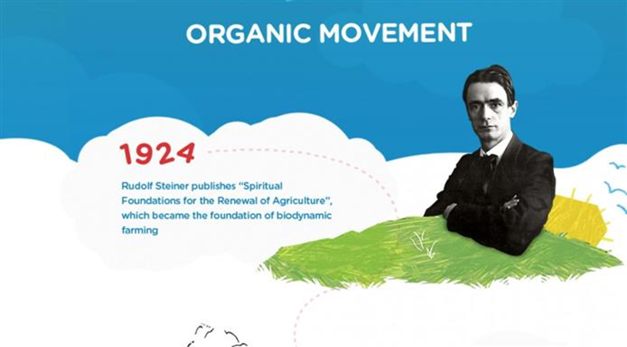
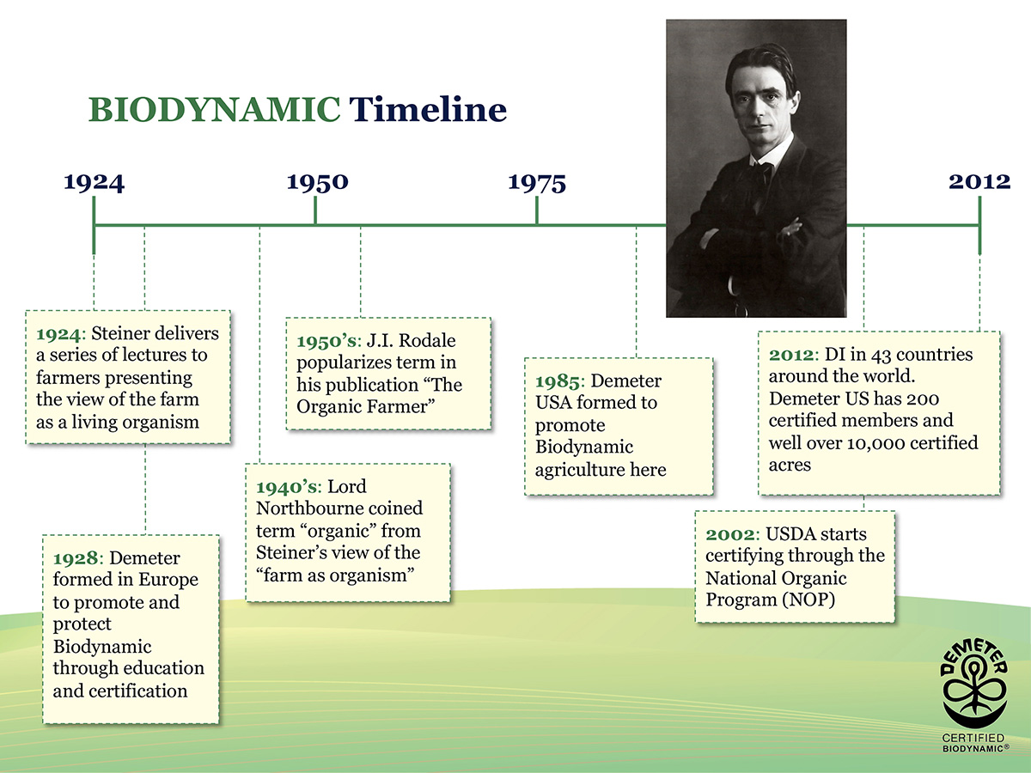

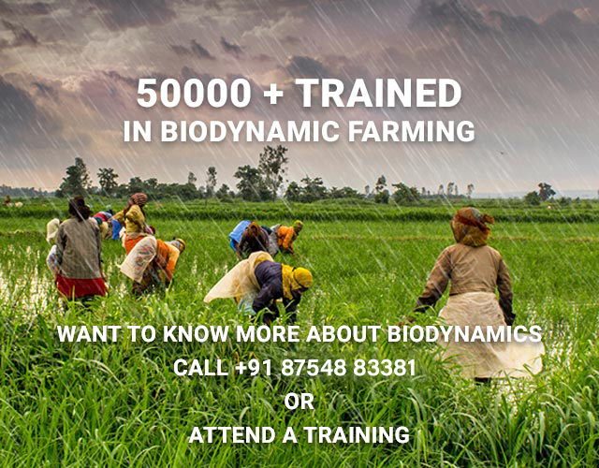
Biodynamic Association of India

Slide 9
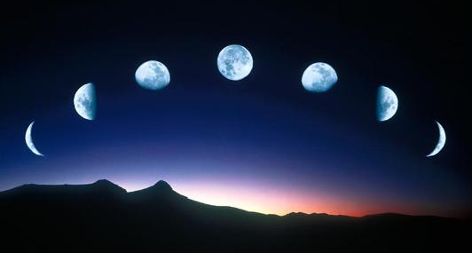
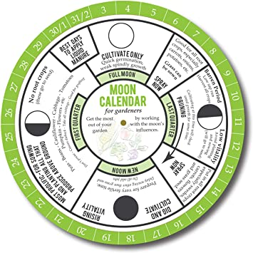
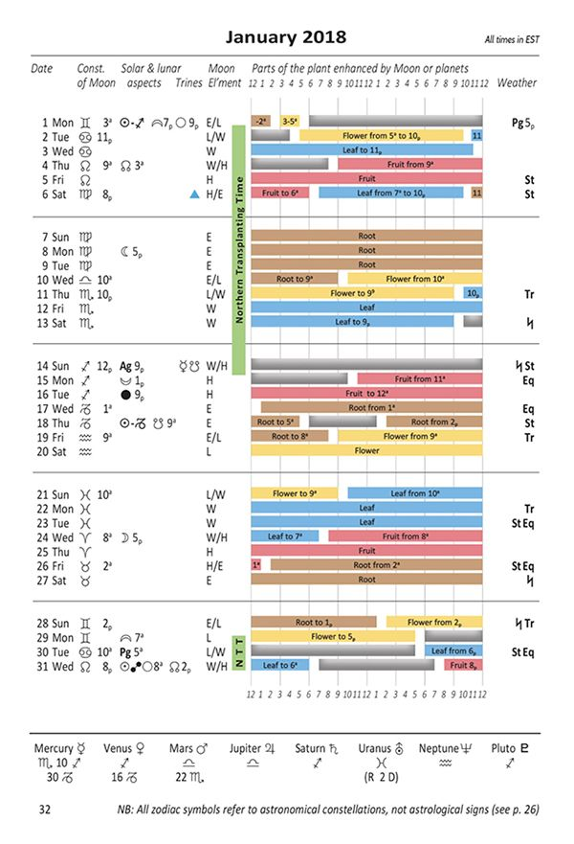
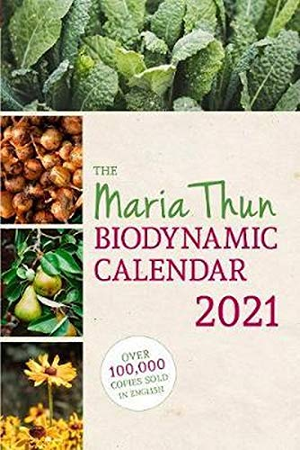
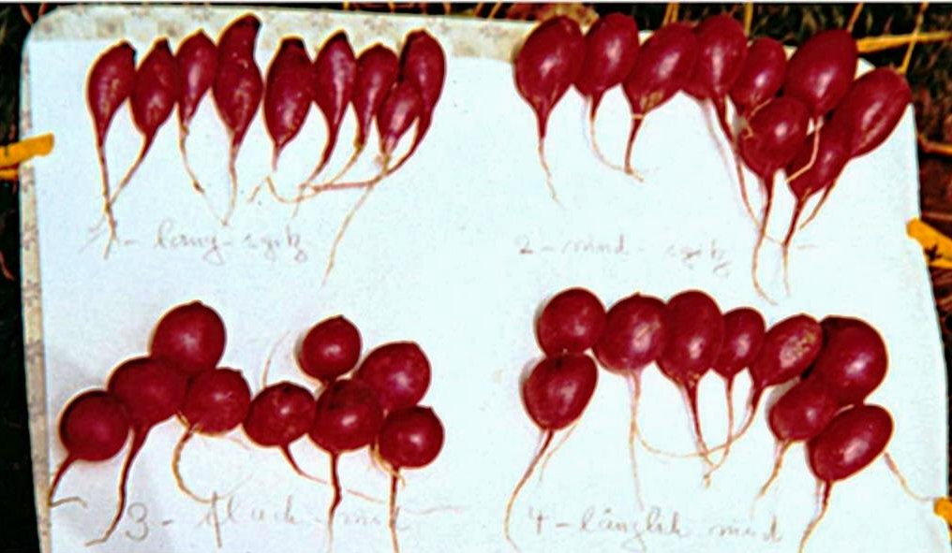
MOON CALENDAR
as an aid in BD agricultural production
Based on the research of stellar constellations, a calendar of suitable days for sowing, transplanting, caring for and storing plants, and working with bees is made.

Slide 10
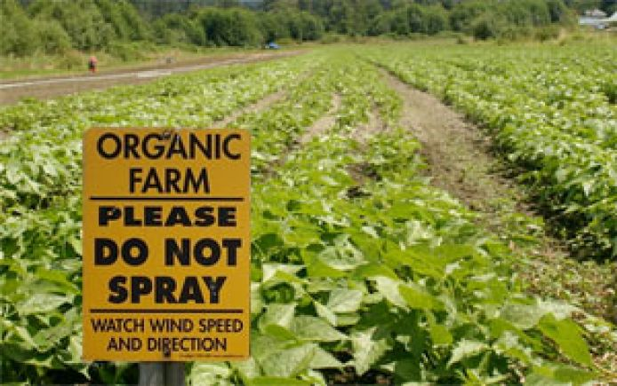
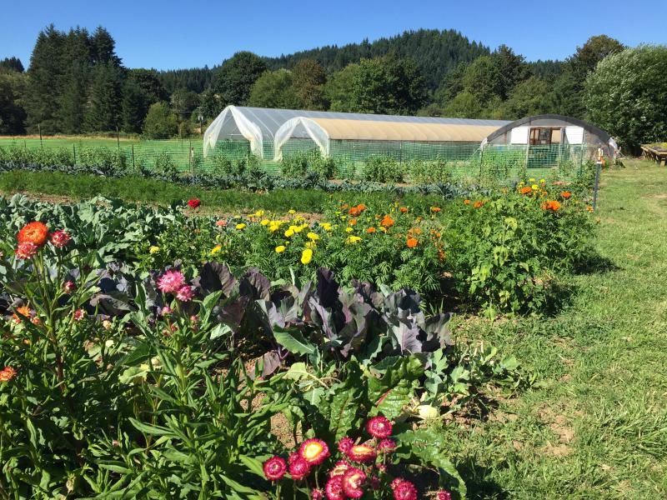
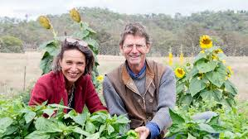
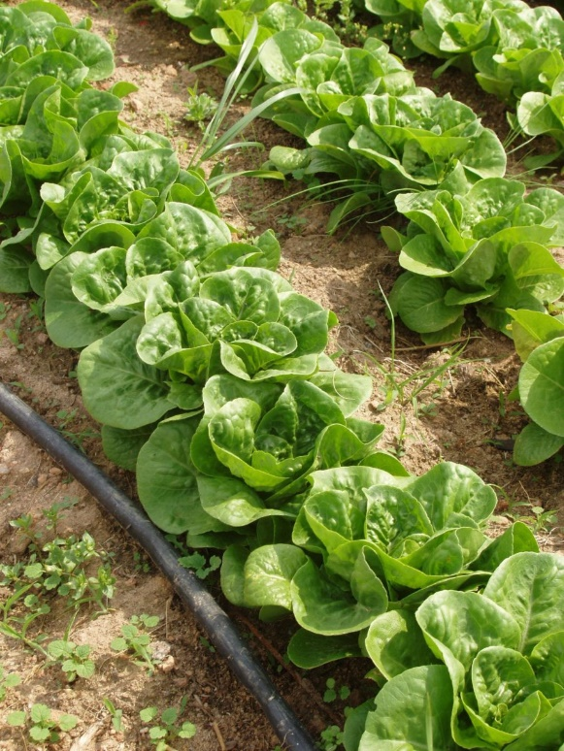
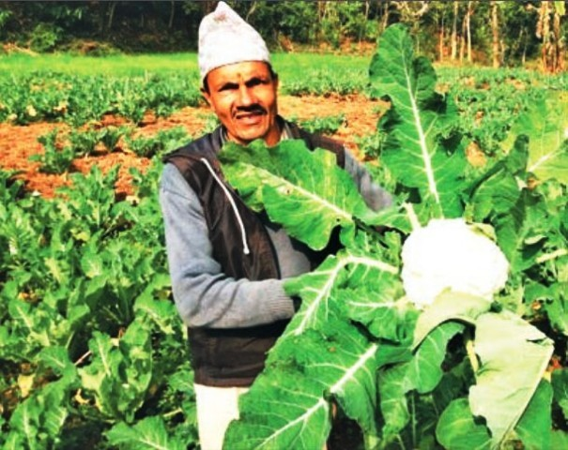
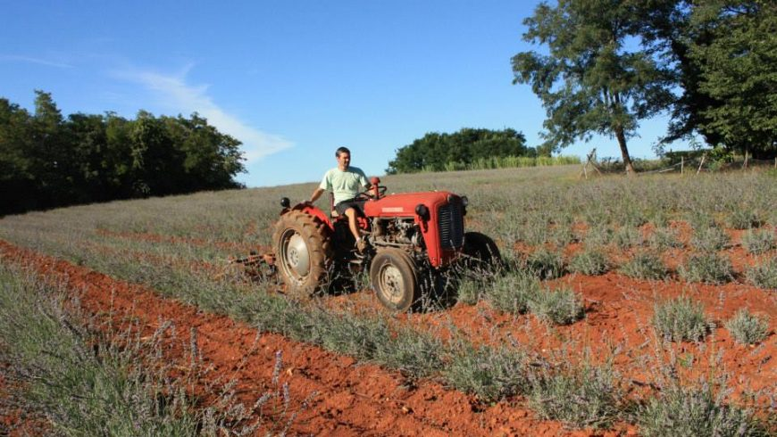
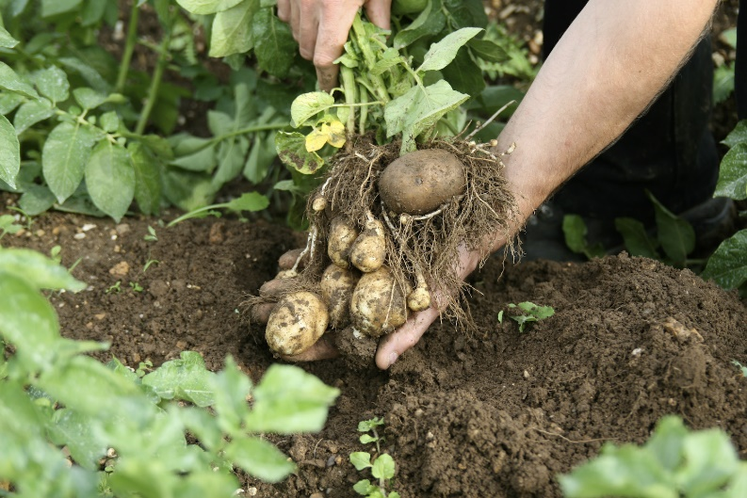

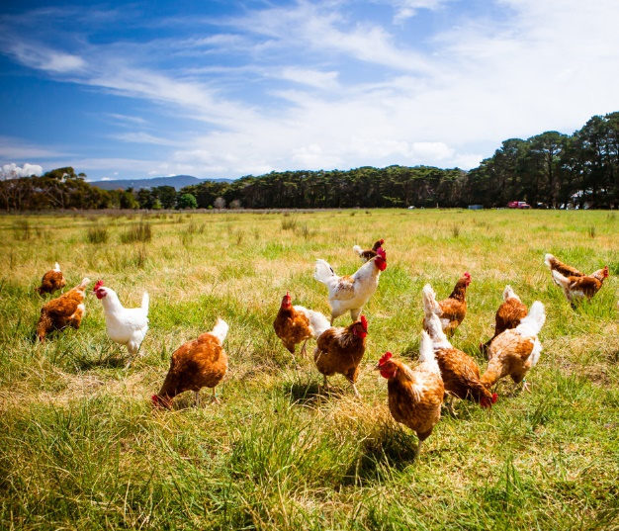
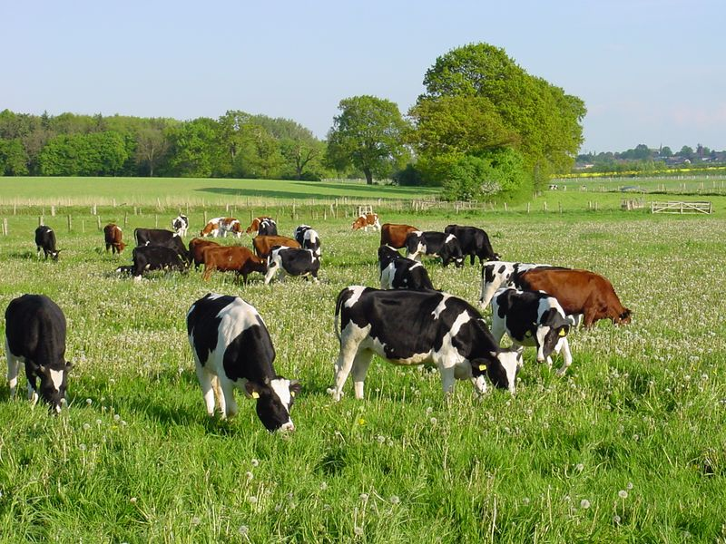
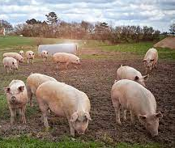
ECOLOGICAL FOOD GROWING

Slide 11
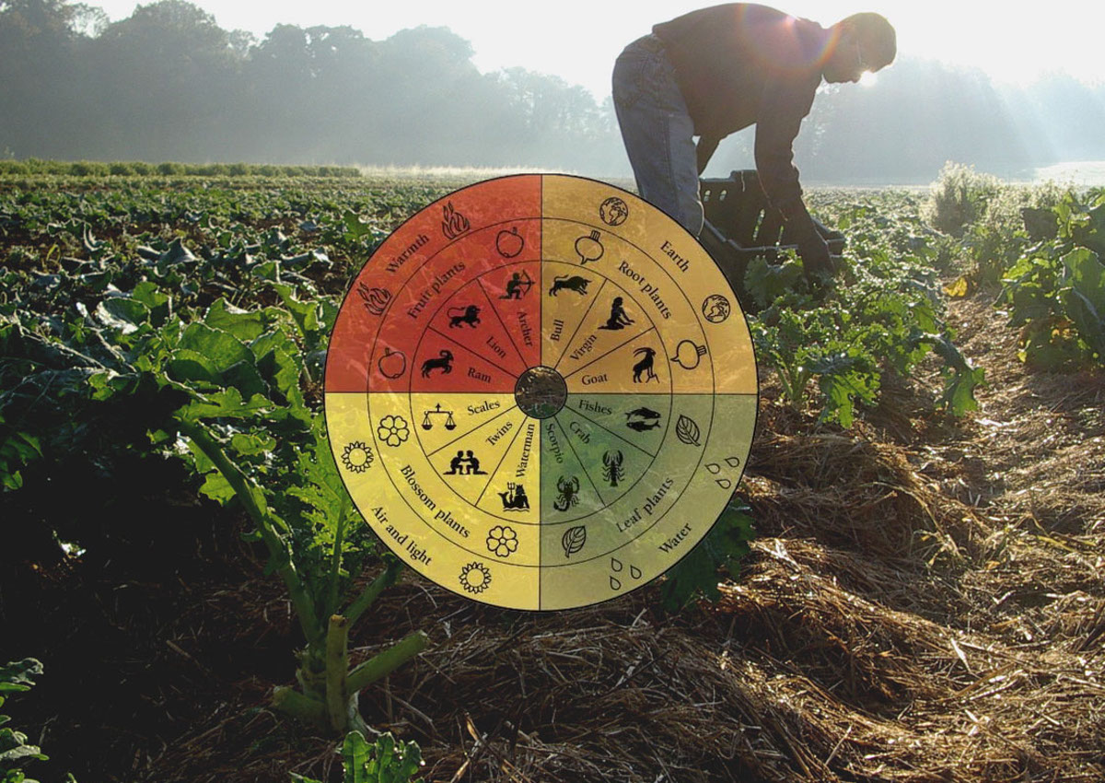
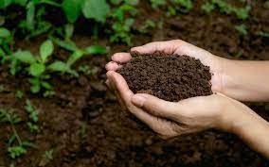
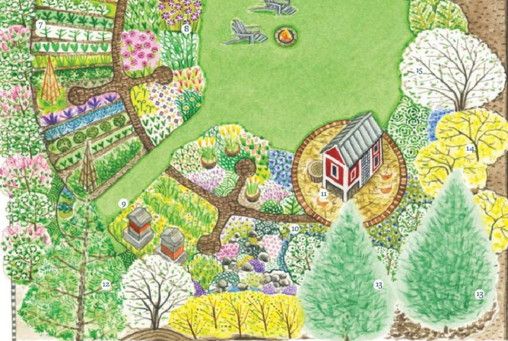
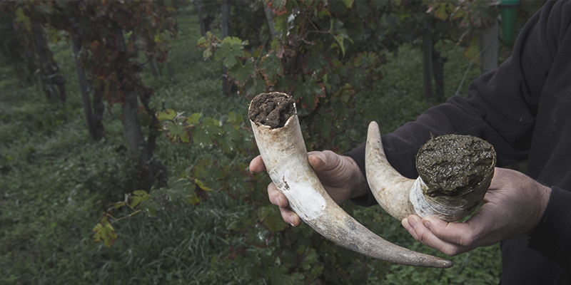
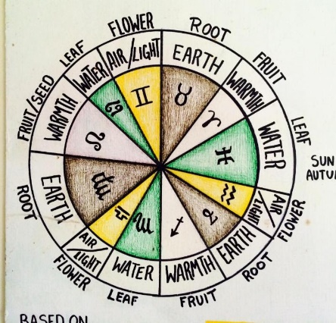

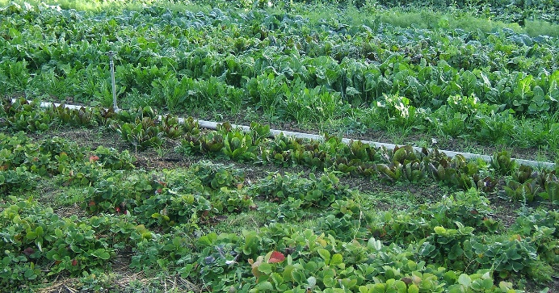
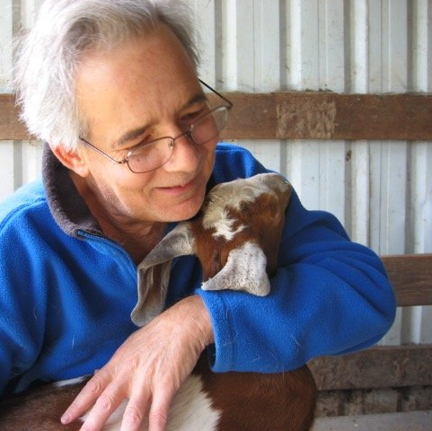
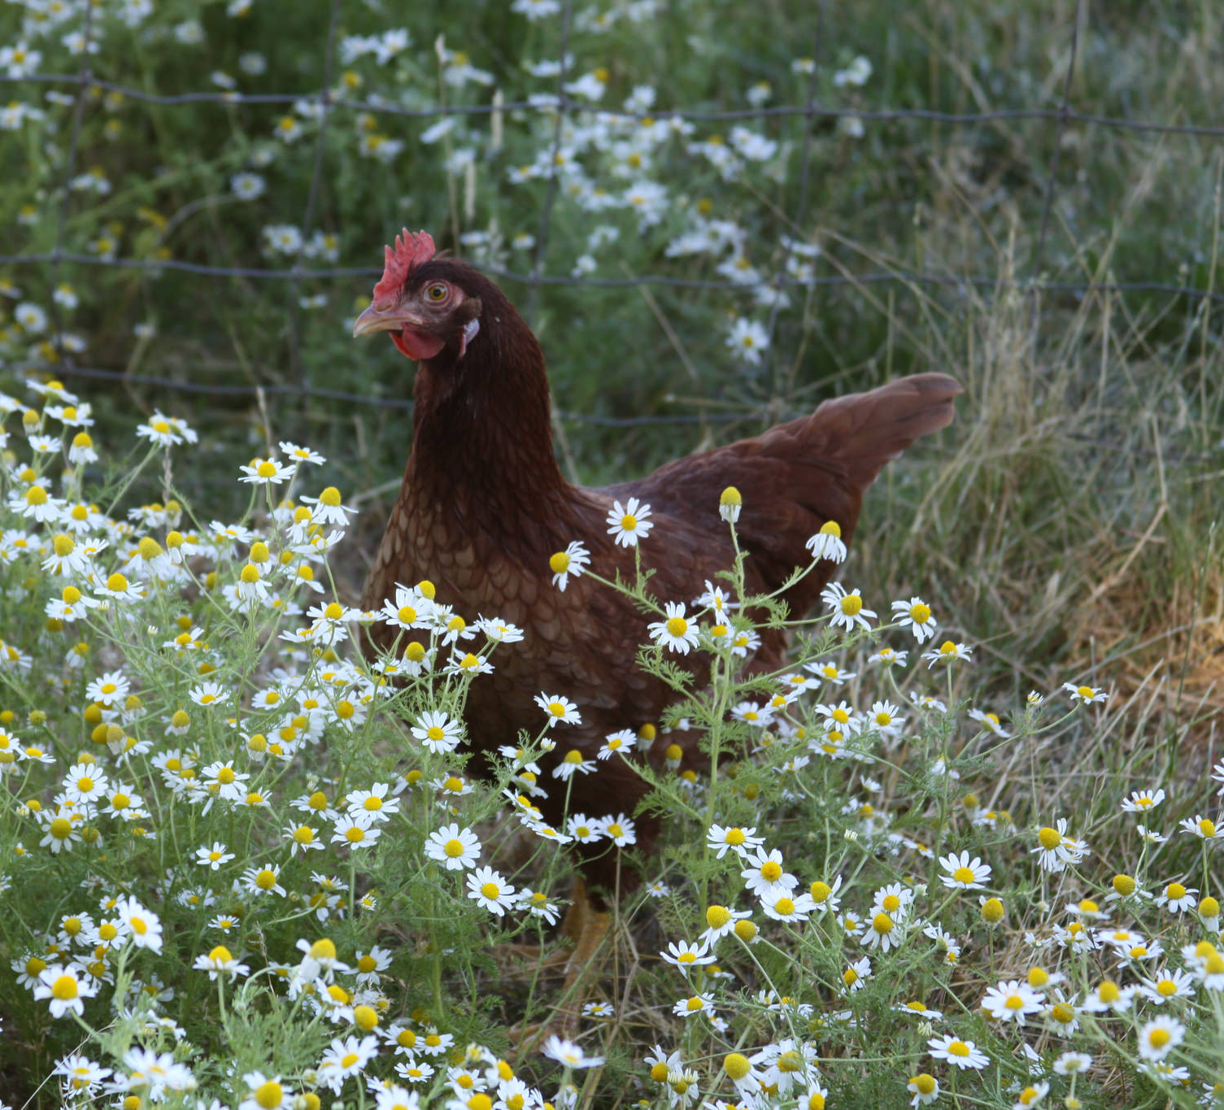
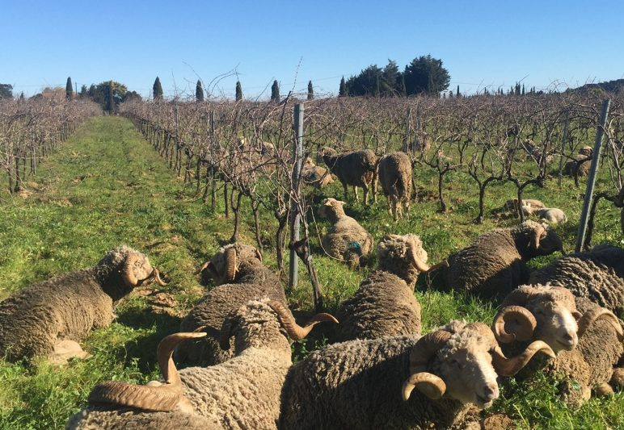
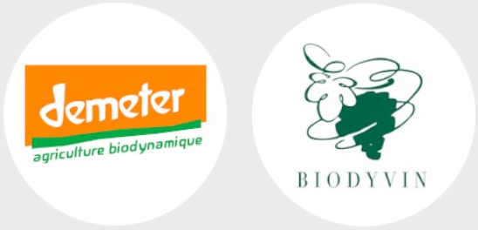
BIODYNAMIC FOOD GROWING

Slide 12
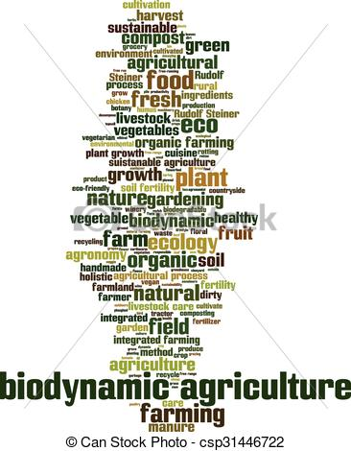
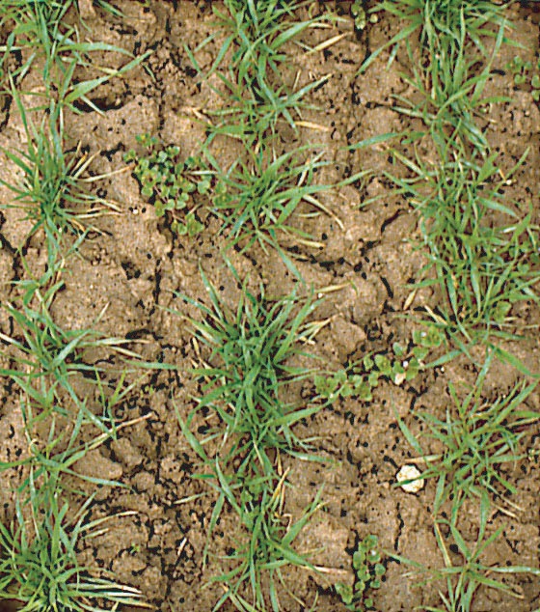
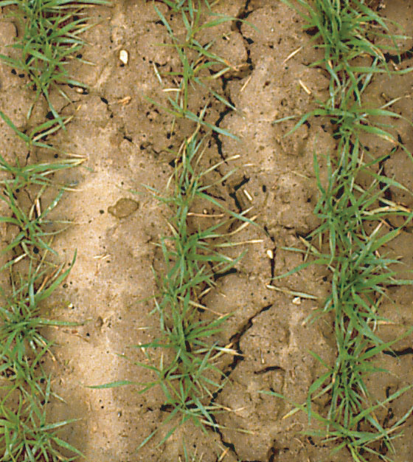
INFLUENCE OF BIODYNAMIC PREPARATIONS ON THE SOIL
“From any side, from any angle, all the interests of human life creep into agriculture”
dr. Rudolf Steiner, 1924.
Organic mass
holds soil particles together
Better soil structure
reduced soil compaction and erosion
Biodynamic plot
Conventional plot

Slide 13
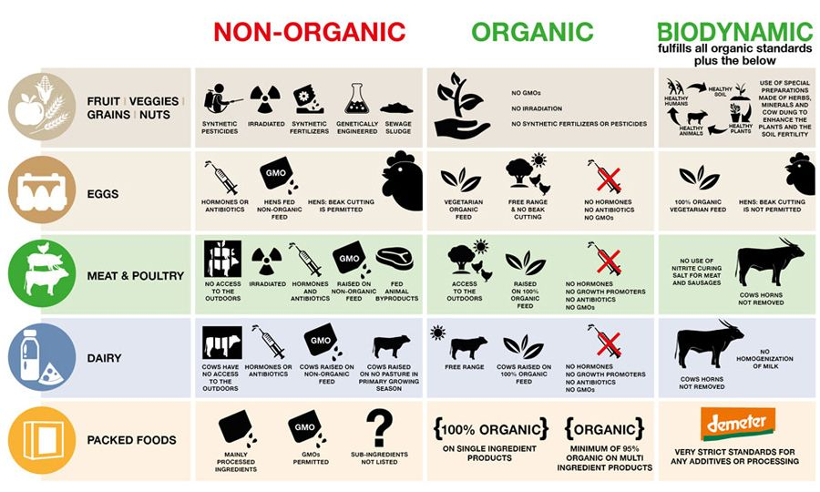

Slide 14
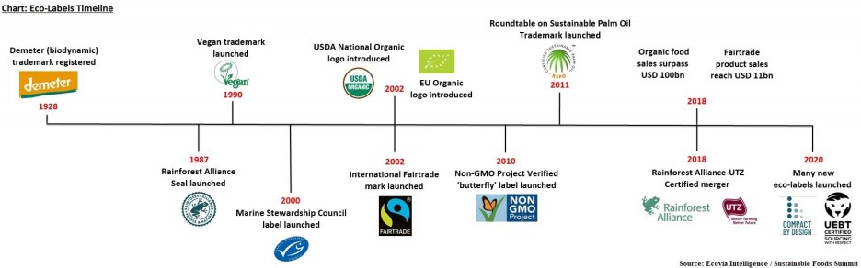

















ORGANIC LABEL WORLDWIDE

Slide 15



Food quality produced in a biodynamic way
THE FIRST CERTIFIED PRODUCTION IN THE WORLD!
The Demeter certificate (1928), with a 93-year tradition, guarantees that the product is obtained according to high principles of biodynamic production and processing, as well as according to strict regulations for ecological (organic) production.
Today, almost 100 years after Steiner’s Agricultural Course, about 5,300 farms in more than 60 countries around the world produce food according to Demeter biodynamic principles.
Demeter is a brand that characterizes food of the highest quality. Indicates crops and products produced in accordance with the principles of biodynamics and strict production and processing guidelines for the acquisition and use of the Demeter brand.
Only 13 additives are allowed for food marked Demeter.
Comparison: * Conventional - 1350 supplements * EU environmental - 47 supplements
Info: http://www.demeter.net/

Slide 16
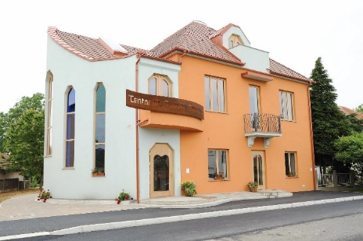

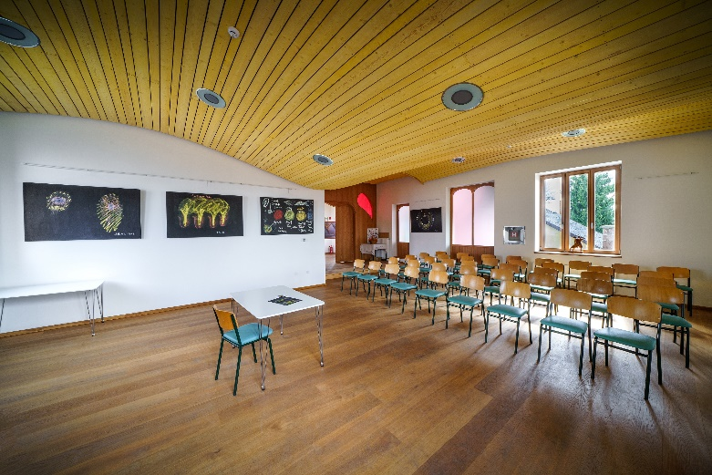
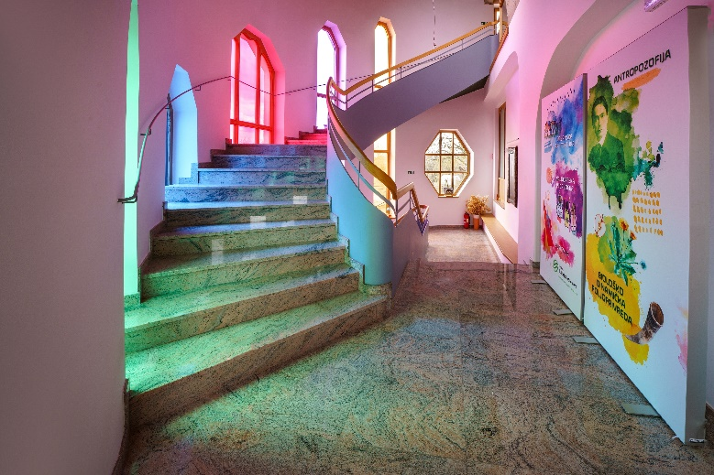
The Center of Dr. Rudolf Steiner was founded in 2007 as a public institution.
Founders are Medjimurje County and Municipality of Donji Kraljevec.
TODAY: The National Center for Biodynamic Agriculture of the Republic of Croatia, which cooperates with the Ministry of Agriculture, the Ministry of Tourism, schools and scientific institutions, counties, cities and municipalities, implements national and international projects…
OBJECTIVE: The strategic goal of the Center is to become the leading educational and certification center of practical biodynamic agriculture in cooperation with IBDA (International Biodynamic Association).
MISSION: spreading knowledge, experience and practice about biodynamic agriculture as the agriculture of the future, and sensitizing and educating consumers about the value and quality of biodynamic food!

Slide 17
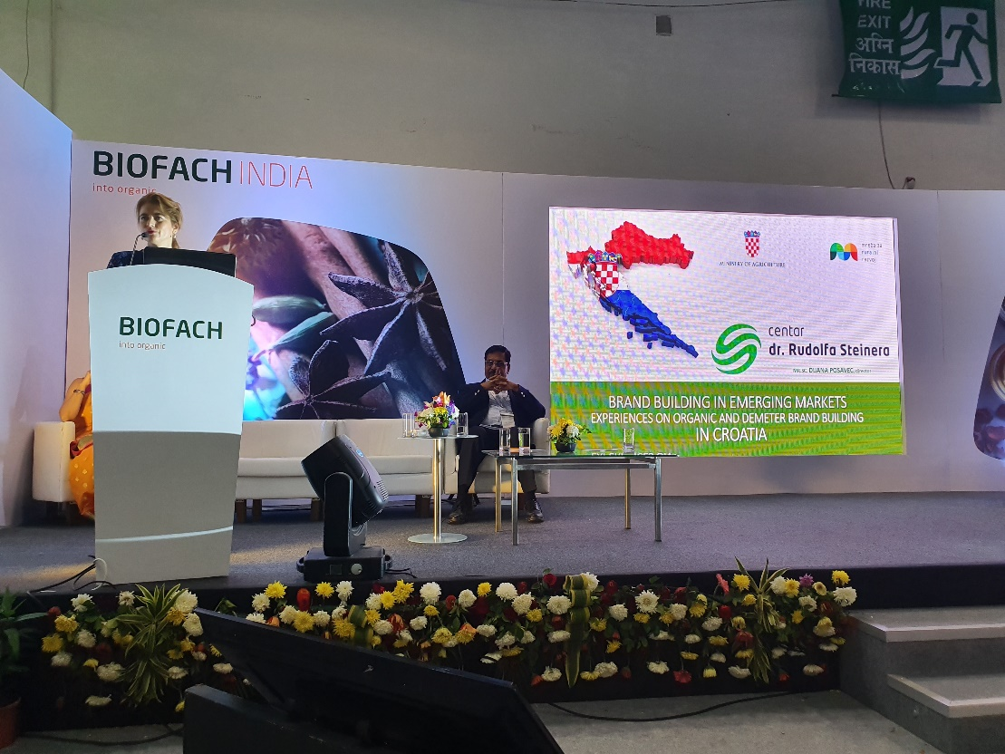
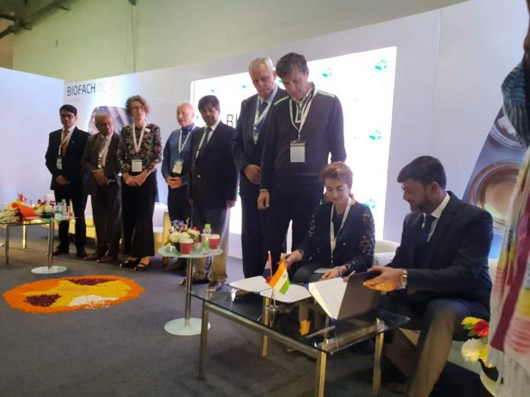
BIOFACH INDIA 2019
Sikkim IFFCO Organics inks pact with US, Croatian firms to promote organic items
The Times of India, November 8 2019

Slide 18


"I am sure that one day agricultural practices that destroy the soil, eliminate biodiversity and jeopardize the sustainability of the food system considered a barbaric act in the future ”
Jadranka Boban Peić, BioVega
Thank you!
Centar dr. Rudolfa Steinera
mr. sc. Dijana Posavec, dipl.ing.

