Slide 1


AYURVEDIC PREVENTION AND TREATMENT OF
NON COMMUNICABLE DISEASES
-A FOCUS ON CROATIA
Professor.Dr.SureshSwarnapuri BAMS,MD,RAS
President-Association EuropeAyurvedaAcademy-France
Executive Director- Association Ayurveda Academy-UK.

Slide 2
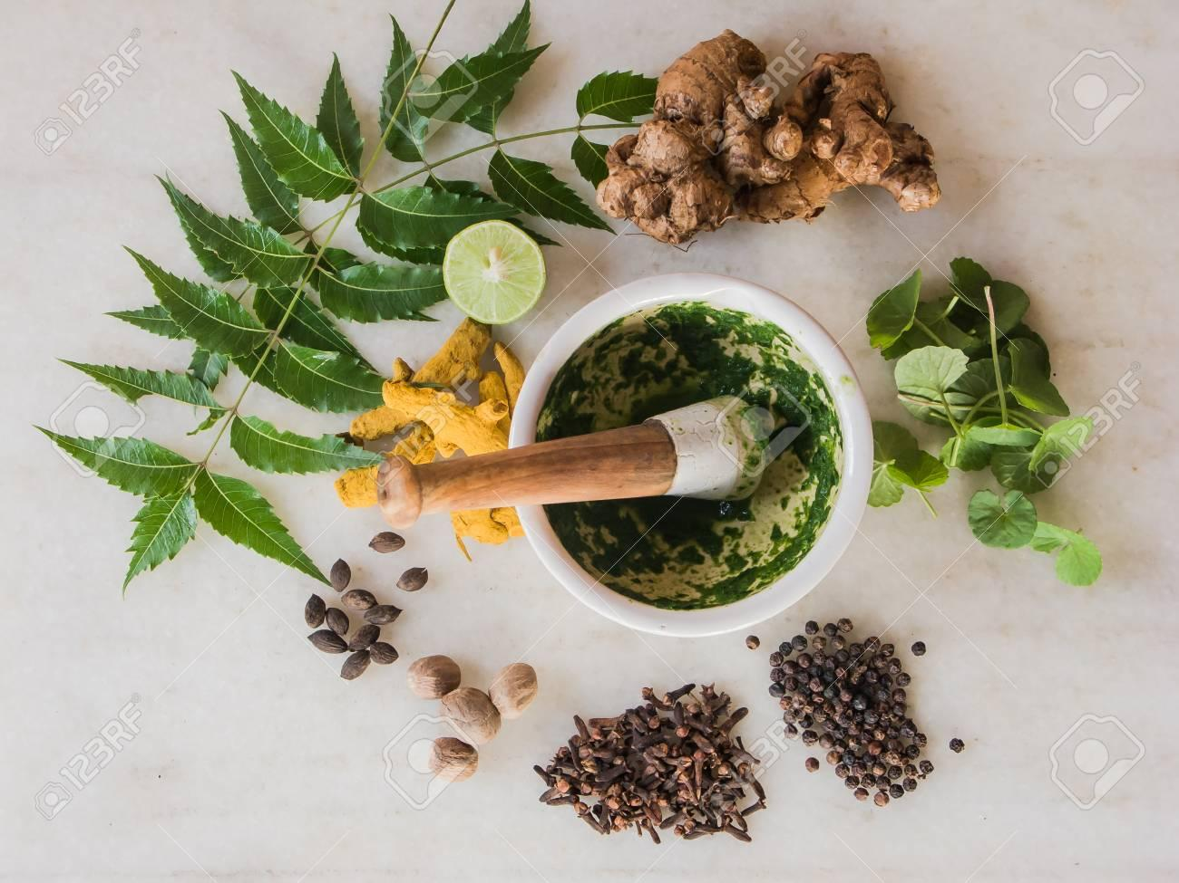
NCDs or Lifestyle diseases are different from other diseases because they are potentially preventable and can lowered with change in diet, lifestyle and environment

Slide 3
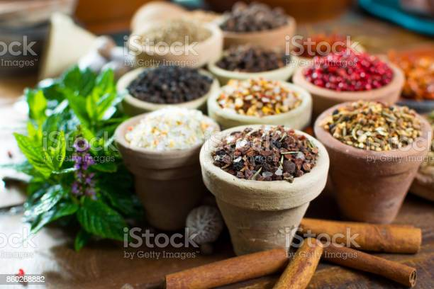
According to WHO fact sheets lifestyle diseases like cardiovascular diseases, diabetes, obesity, cancer, osteoporosis, respiratory diseases and Gastrointestinal diseases account for 59 percent of the 56.5 million deaths annually and 45.9 percent of the global burden of disease.

Slide 4
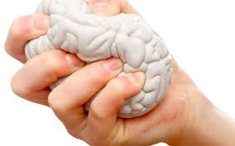
Healthy body depends on healthy mind .Balanced equilibrium in mind and body is important. Psychosomatic disorders /diseases involve both mind and body. There is a mental aspect to every physical disease and there can be a physical aspect in a mental illness.

Slide 5
A case study of crohns disease and itspost operative rehabilatation
NAME—Andrea sekolovic
Age-40years
Country-Croatia
City-zagreb

Slide 6
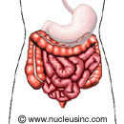
ANDREA SEKULOVIC HISTORY
1991-1995—Andrea at the age of 17 was noticed and detected crohns disease and got hospitalized many time with pain abdomen and loose stools and had steroids lead to liver enlargement
2002-after repeated episodes of diarrhoea,frequent temperatures-was advised-temporary colostomy
2009-she was on ayurveda treatment started improvements in 2 months
2014-2015-was treated also for migraine,joint pains,her crohns is under control with no relapse

Slide 7
APPRECIATION LETTER
. My name is Andreja. I live in Croatia. I am 41. My problems with my disease began in 1991, then I was 17 and I knew nothing about Crohn's, and the doctors were not sure about my disease. I was diagnosed with Crohn's colitis. From 1991 to 1995 I was in hospital every now and then, which means 2 months in hospital, 1 month at home taking the therapy . corticosteroids which didn’t help me, salofalk and imuran which destroyed my blood count and my liver was enlarged.
My menstrual cycle was disturbed. My disease started with high temperature, frequent diarrheas, blood and pus in the stool, loss of weight from 76 kg to 39 kg. And that continued for years. I didn’t feel better, just worse and worse. Then I developed painful fistulas so I was not able to sit, eat or go out because I was not able to control my stool all the time. My sphincter was damaged.
In 2002 the doctors decided to do the temporary colostomy. But my condition got worse. The colon was completely destroyed. In 2003 I had an operation again.
The total colostomy was don, the colon was taken out and ileostomy was inserted. Fortunately, the small intestine was not damaged. Recovery lasted a long time. I was in depression, I did not go out of the house, I had frequent arrhythmia, migraine, I put on 40 kg.
Then one day I heard that an Ayurvedic doctor, dr Suresh, was coming to Croatia. I called and made an appointment. That was in 2009.
I came in a very bad condition, fat, bloated, with pains in my stomach, arthritis. Dr Suresh prescribed me the diet plan, which changed my life for the better, the herbal medicines to which I positively responded in 2 months, pranayama – kapalabhati and anuloma-viloma, without which I can’t imagine even one single day.
After 2 months I came for control and I was a new person. After 4 months I lost some weight, completely recovered. And I didn’t visit dr Suresh until 2011 because of financial reason. I neglected my health little bit so I looked for his help again. I visited him again last year and now I have no migrenas, joint pain, depression, no sign of my disease...I am a new person
I enjoy my life, following, of course, the diet instructions and healthy life principles. Since 2009 I don’t take any medicines, nor imuran or corticosteroids. My iron has increased to 26, CRP decreased from 97 to 5.
I cannot wait to visti dr Suresh so that he can see my improvement thanks to him, and me too. I feel fantastic. I lost my weight, from 97 to 74 kg. I am very happy and satisfied.
Andreaj

Slide 8
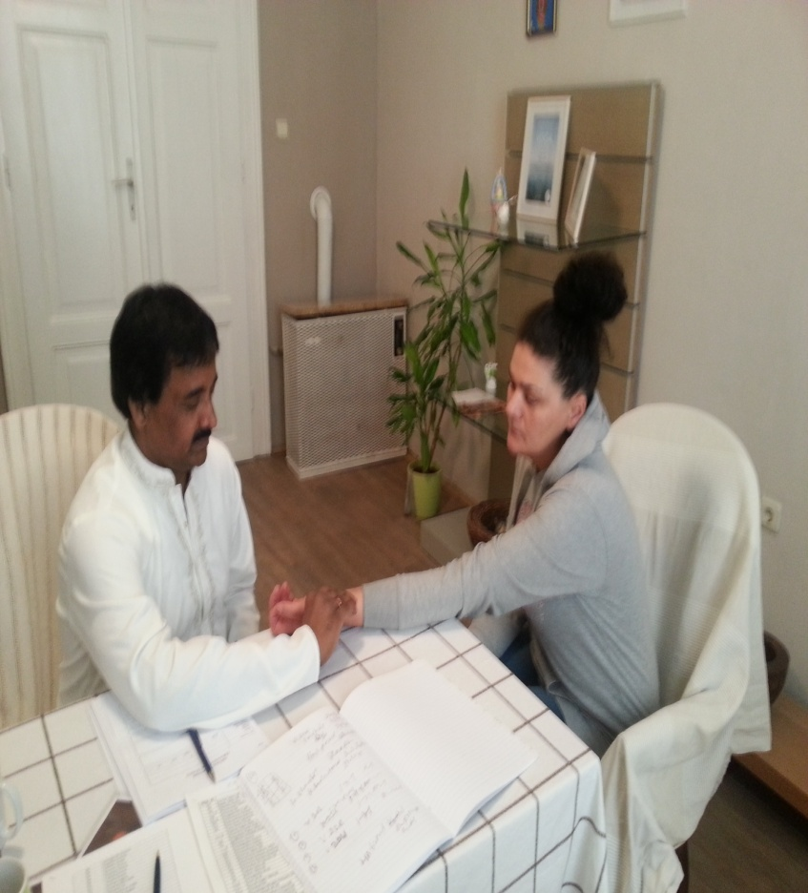
PUSLE DIAGNOSIS

Slide 9
CROHNS DIEASE-AYURVEDA-ASPECTS PART-1
1.GRAHANI-Anatomical portion from pylorus to caecum,
Grahani roga—organic disintegration due to defective surface or villi
Grahani dosha—functional disintegration due to dysfunctional agni
Grahanyasritha roga grahiniroga/grahinyasritho agnidosho grahani dosha;-su.uth.40/166-174
Grahini roga explains the distrabunces in the dynamics of internal mucosa(pittadara kala)
Grahani dosha is distrubed agni

Slide 10
CROHNS DIEASE—AYURVEDIC ASPECTS PART-2
Grades of agni-samgni-vishamagni-theekhagni-mandagni
Durbalgni-deemagni-athipradheemagni-ch.chi-15/3….50
Nidanaa-ahithashana(unwholesome food) after athisara or dysfunction of agni.
Annavaha srothodushti,agnivaishamya contribute to nidhana of grahini roga
All these factors aggravates grahini organ and produces grahini roga leading frequent loose stools with offensive order ,if stools are hard –vata or if loose –pitta.
Nidhana-agnidushti—grahini dushti—grahini roga
Components of samprapti
Dosha-pachakapitta,samana apana,kledaka,sleshamaka
Dushya-rasa,grahani---ch.sutra-20th
Agni—jatargni
Ama-jatargni mandhajanya
Sanchara-koshta
-Srotha—Anaah srothas

Slide 11
CASE STUDY –AYURVEDA
PHYSICAL EXAMINATION
Externally—
1.P/A—No Ascitis,slight ,no hepatospleenomegaloy
2..slight swelling in the lower extemeties
3.Mild varicosities
5..Respirations rate-normal
6..Blood pressure—140/80mmhg
5.Scan reports –suggests -hepatomegaly
6.Respiratory vital signs—Normal
7.Tenderness over knee joints and elbows with neck slight stiffness

Slide 12
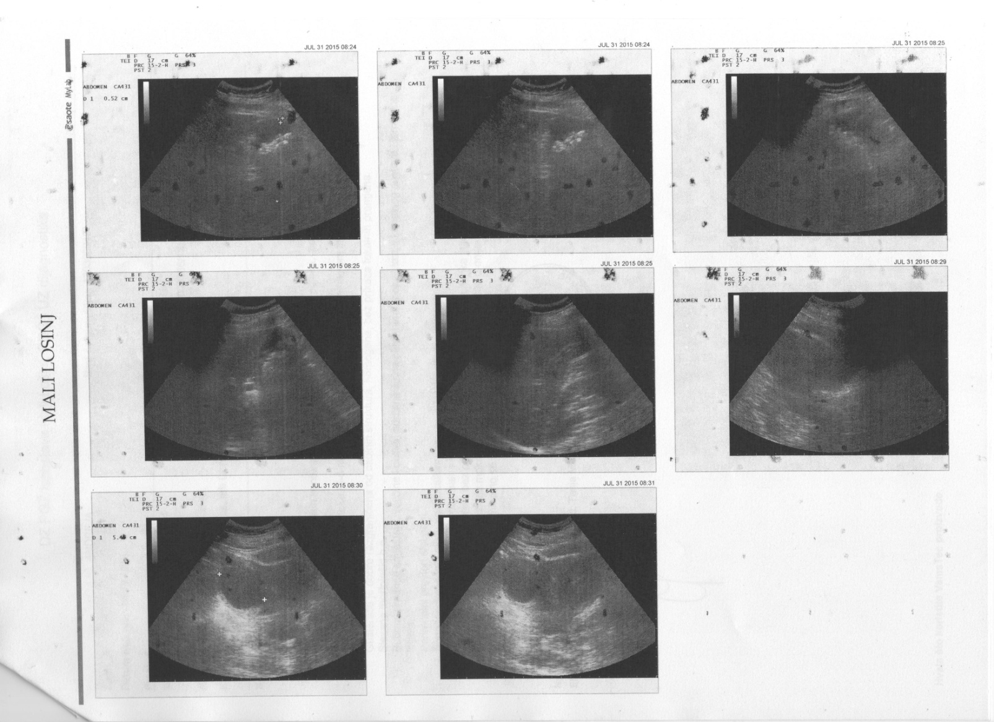
INVESTIGATIONS-1

Slide 13
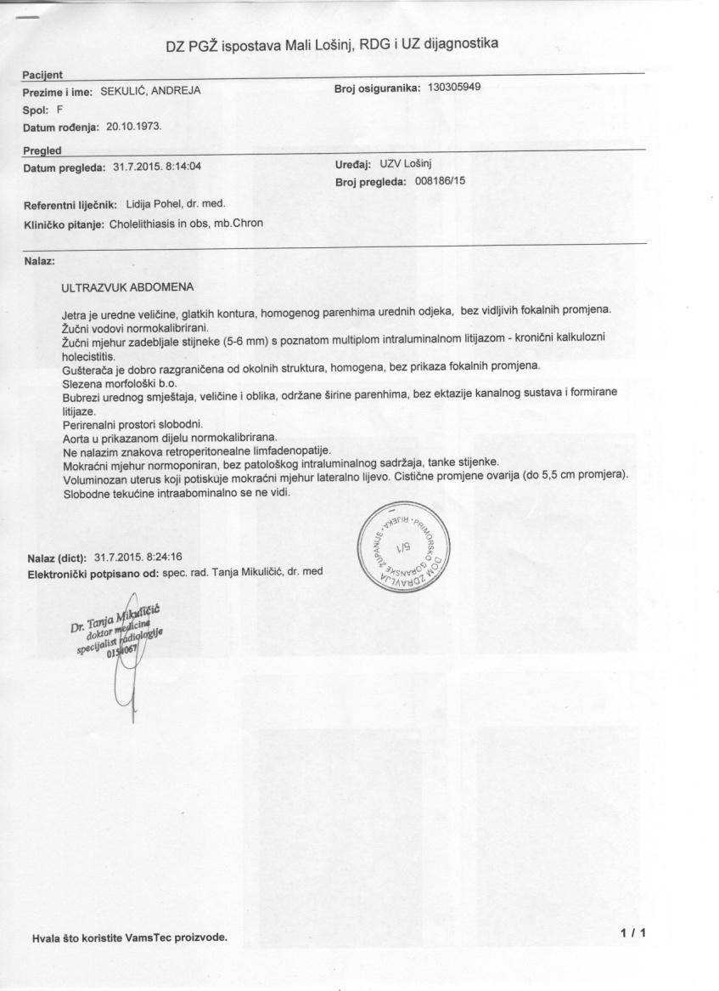
ANDREA ABD SCAN REPORT

Slide 14
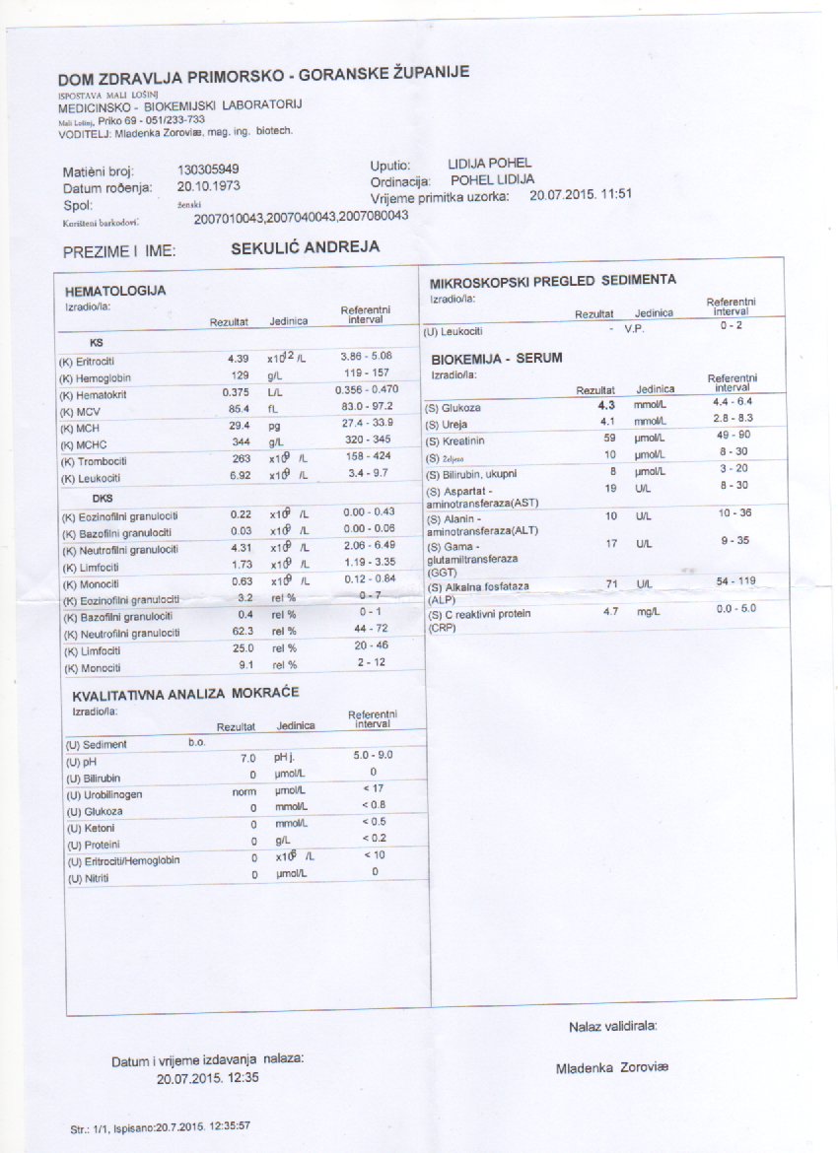
ANDREA BLOOD REPORT

Slide 15
PROVISIONAL DIAGNOSIS
Owing to the symptoms with recurrent dairrhoea with bloody stools and frequent pain abdomen and temperatures ,loss of weght over the period of time,
Arthralgia is also another symptoms are developing during these period
Thirsty ness-all these features pointing towards
Either ulcerative colitis or crohns or diverticulitis are also
Pittaja grahani or sannipatha grahani roga

Slide 16
DIFFERENTIAL DIAGNOSIS – 1
Amebiasis
Appendicitis
Bacterial Gastroenteritis
Behcet Disease
Celiac Disease and HLA-DQ2/DQ8
Diverticulitis
Giardiasis
Intestinal Carcinoid Tumor
Intestinal Tuberculosis
Irritable Bowel Syndrome
Ischemia
Tuberculosis
Ulcerative Colitis
Viral Gastroenteritis

Slide 17
DIFFERENTIAL DIAGNOSIS – -AYURVEDA
VATAJA GRAHINI-1.vataja grahani—ch-chikitsa-15
Marutha kupithe vanhi sanchadhya kuruthe gadhan
Thanmayanna pachyathe dukham shuktrupakam karogatha/
factors vata aggravates envelops agni and slows it down,food becomes hard and produces hyperacidity,thirsty,hunger,pain inguinal ,chest pain,colic pains in intestines,defecates with pain,liquid/dry thin –immature with sound froth
Pittaja grahani –ch.chikitsa-15/65
Agni alpavayadvanthi jalam thamameva analam
Due pitta aggravating factors pitta extinguishes AGNI,this imparts yellowish complextion to the body.defecates yellow or blue loose stools ,burning throat,heart
Kaphaja grahini-ch.chiki-15/67Thasmayannam pachyathe dhukha hrullasa chardhi arochaka/
Asyopadaiha madurya kasa shtichana peenasa
Indigestion ,nausea,heaviness/abdomen,loose stools,debility
SANNIPATAJA

Slide 18
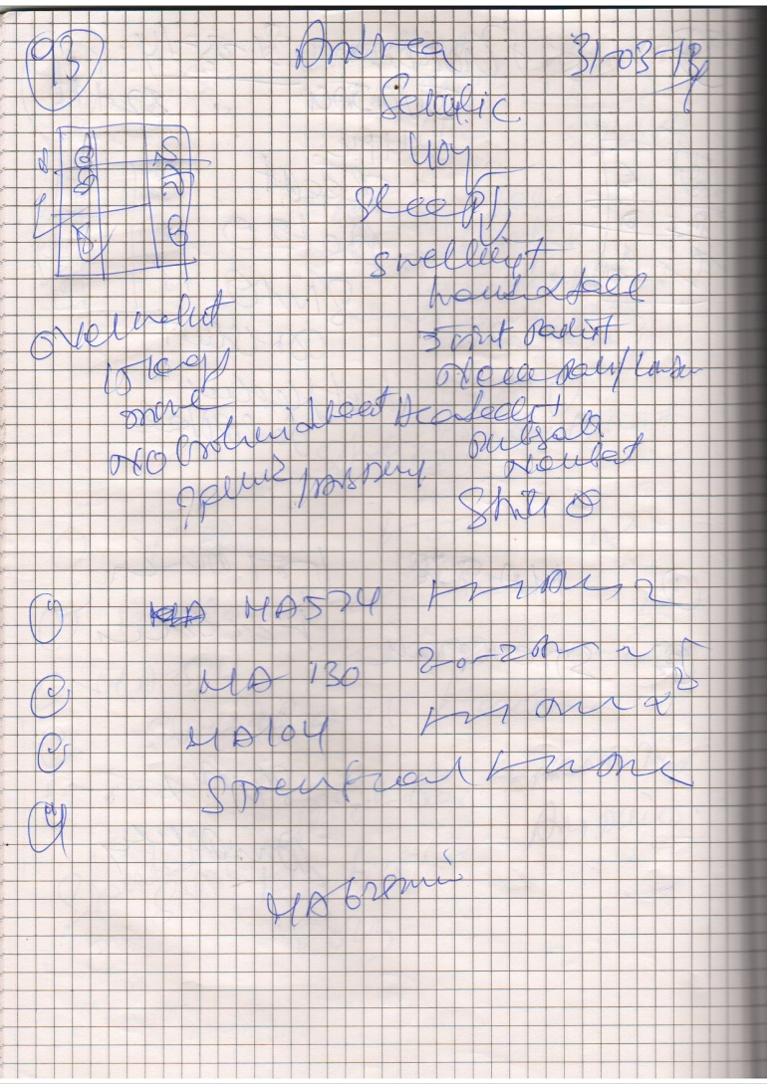
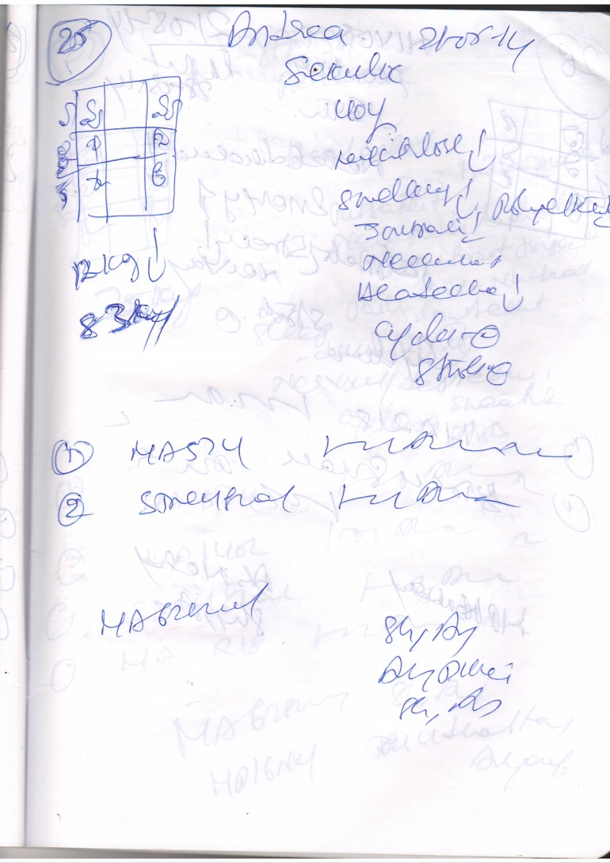
PRESCRIPTIONS-1,2

Slide 19
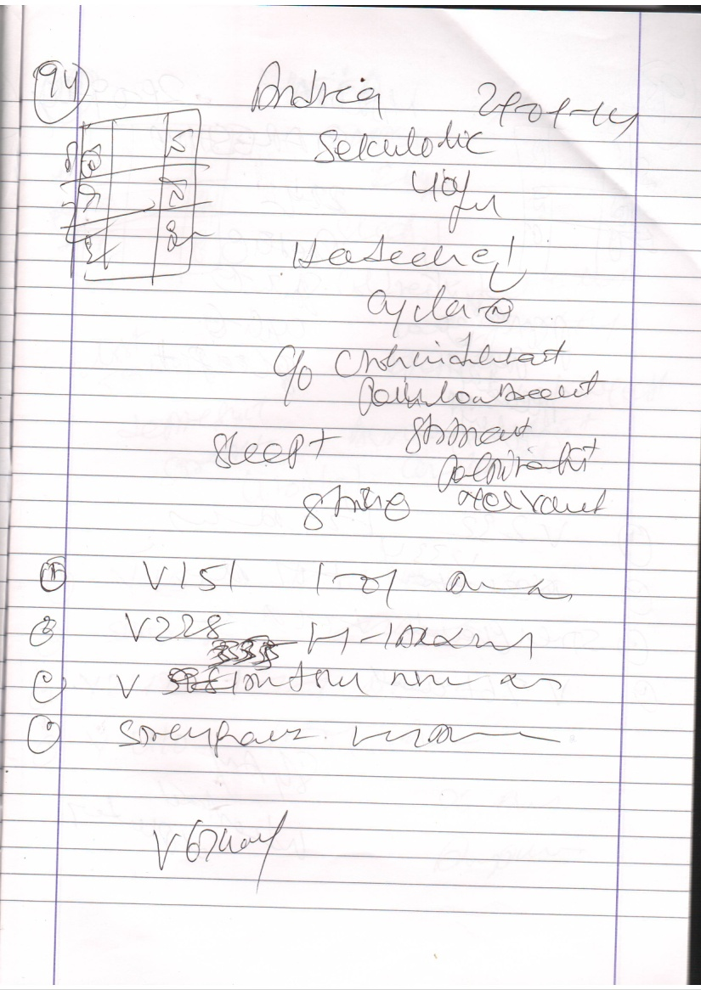
PRESCRIPTION-3

Slide 20
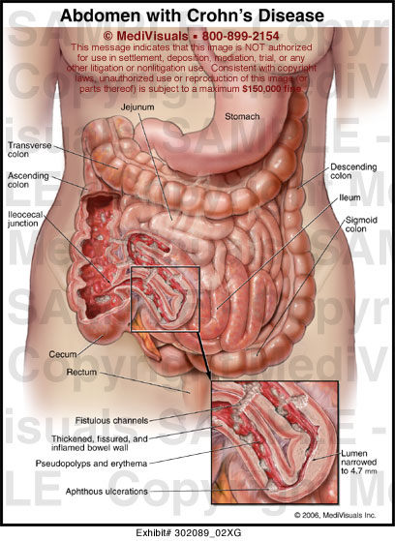
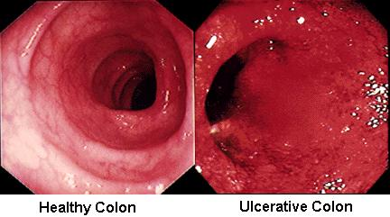
COLONOSCOPIC VIEW –INFLAMMED

Slide 21
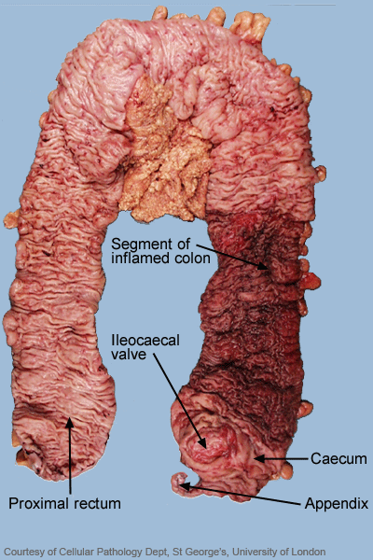
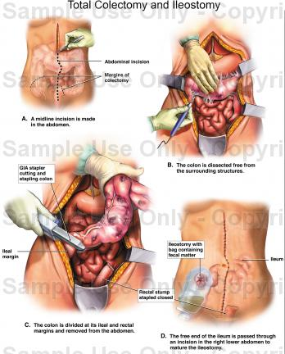
CROHNS DIEASE-COLONECTOMY

Slide 22
CROHNS DISEASE –DIAGNOSIS--1
Crohns disease is inflammatory bowel disease
,parts of diegestive gets swollen with deep ulcers,usually seen in last part of small intestines and first part of colon,
it can happen due to body s immune system has an abnormal response to normal bacteria other kind s of bacteria and viruses may also pays a role
The main symptoms are pain abdomen,diarrhoea with blood,loss of weight,fissures,fistulas in ano
Frequent tempeartures,vomitings
Barium meal x rays,colonoscopy and biopsy conforms crohns disease in Andrea scase

Slide 23
AYURVEDA AND CROHNS
The features of all the symptoms correlates with pittaja grahini –ch.chi—15/65
-chraka expalins that pitta aggravating factors,pitta extinguishes Agni leading to loose stools with blood ,paina abdomen,burning throat,heart.
Pittja grahini chikitsa-
Swasthyanagatham utrishtam agni deepakbishek/
Pittam gnyathava virekena nihirat vamana cha
Increased pitta impairs the agni,excess pitta is to be expelled by virechan or vamana followed by jangala mamsa,mudgayusha,amlaki grita,chandanadhi grita etc.

Slide 24
TREATMENTS POST COLECTOMY
BASIC TREATMENT GIVEN
TREATMENTS
1.PITTA PACIFYING DIET
2.MA 3174, 1-0-1 before food
3.MA 320 , 2-0-2 after food
4.MA 574—1-1-1 after food
5.MA 130 ,2-0-2 before food
6.MA 1402 1-0-1
Results—no relapse or no steroids since 2 years
1.SIRODHARA,ABYANGA
PINDASWEDHANA
PRANAYAMA
1.BASTHRIKA—10 MINUTES
2.KAPALABTHI—10 MINUTES
3.BRAMARI----10 TIMES -2 TIMES A DAY
Iron-increased to 26
CRP-97 decreased to 5

Slide 25
MAHARISHI AYURVEDA PRODUCTS
MA 3174—musa sapientium and glycyrriza glabra
MA 320--Zingiber officinale, Piper longum, Piper nigrum, Terminalia chebula, Terminalia belerica,
Carum carvi, Phyllanthus emblica, Elettaria cardamomum, Myrtus caryophyllus,
Cinnamomum zeylanicum, Embelia ribes, Glycyrrhiza glabra, Ipomoea turpethum, Soda
bicarb., Salt, Sugar
MA 1402--Terminalia arjuna, Oroxylum indicum, Gmelina arborea, Premna integrifolia, Solanum
xanthocarpum, Tribulus terrestris, Aegle marmelos, Desmodium gangeticum, Uraria picta,
Solanum indicum, Cissampelos pareira, Withania somnifera, Amomum subulatum, Emblica
officinalis, Cyperus scariosus, Boerhaavia diffusa, Zingiber officinale, Piper nigrum, Piper
longum, Mytilus margaritiferus, Myristica fragans, Agate, Ocimum sanctum
MA 130--Pongamia glabra, Crataeva religiosa, Tinospora cordifolia, Strychnos potatorum, Withania
somnifera, Nepeta malabarica, Melia azedarach, Piper longum.

Slide 26
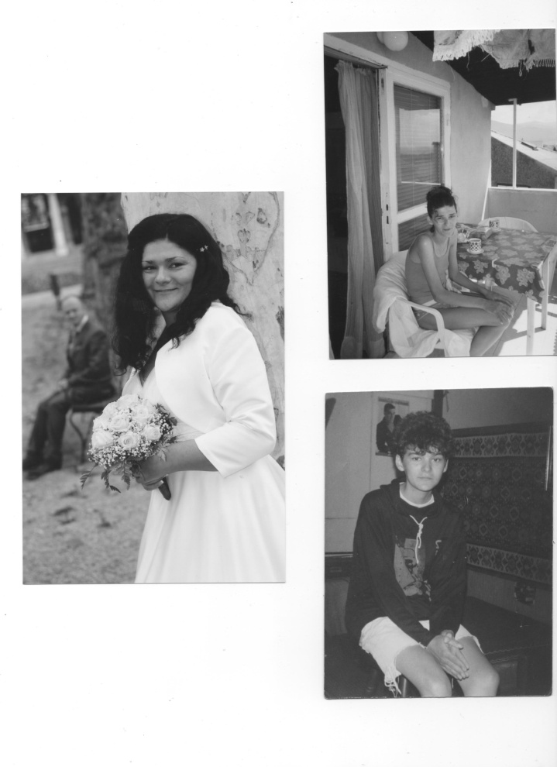
AFTER TREATMENTS-

Slide 27


1.Ayurveda Education -4 yrs -Diplomas-Onlive Education.
2.Ayurveda therapist Courses in ireland,Slovenija,France,ukraine
3.Ayurvedic Consultations-Paris,Tarbes and Nimes,Zagreb,London,Cork,Ukraine.
4..Centre Vedahouse-Zagreb-Croatia
5.Association of Ayurveda Academy-London-UK.
Head Quarters.
  Activities
Association Ayurveda Academy
Bours-France/EAA-Ireland)
Email—eaaclasses@gmail.com
Contactassoeaa@gmail..com
Tel-0618928432
www.europeayurvedaacademy.org
www.aaauk.org
www.europeayurveda.com

Slide 28


