Slide 1


1st International Yoga & Ayurveda Conference organized by Embassy of India, Zagreb, Croatia and Ministry of Ayush, New Delhi Govt. of Republic of India

Slide 2

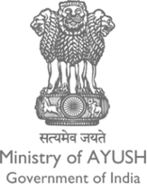
“An Overview of AYUSH (Traditional Healthcare Systems in India)”
Government of India
Ministry of AYUSH

Slide 3

Recognised Traditional Systems of Medicine in India
Ayurveda
Unani
Siddha
Sowa Rigpa
Homeopathy – Even though the Homeopathy is not considered as traditional system it is also recognised under NCH Act 2020 (earlier under HCC Act 1973)
Yoga & Naturopathy
NCISM Act 2020 (Earlier under IMCC Act 1973)
Policy and Legal Support
National Health Policy-2017
Support for Integration of Traditional Medicine in Public Health and also for education and research
Legal Support
Through NCISM Act, NCH Act
Drug and Cosmetic Act 1940 and Rules 1945
Drug, Service and Education Standards – BIS, NABH etc.

Slide 4
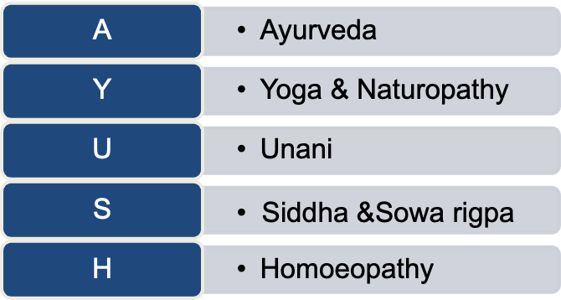
INTRODUCTION
Policy formulation,
research, education, service delivery, development for the growth, development & propagation of traditional Indian systems and Homoeopathy & Naturopathy
1995
(March)
2003
2014
Department of Indian Systems of Medicine and Homoeopathy (ISM&H)
Granted the status of a full-fledged Ministry under Government of India in 2014
Re-named as Department of Ayurveda, Yoga & Naturopathy, Unani, Siddha and Homoeopathy (AYUSH)
Sowa Rigpa (recognized under IMCC Act, 1970 )
on 16thDec, 2011

Slide 5
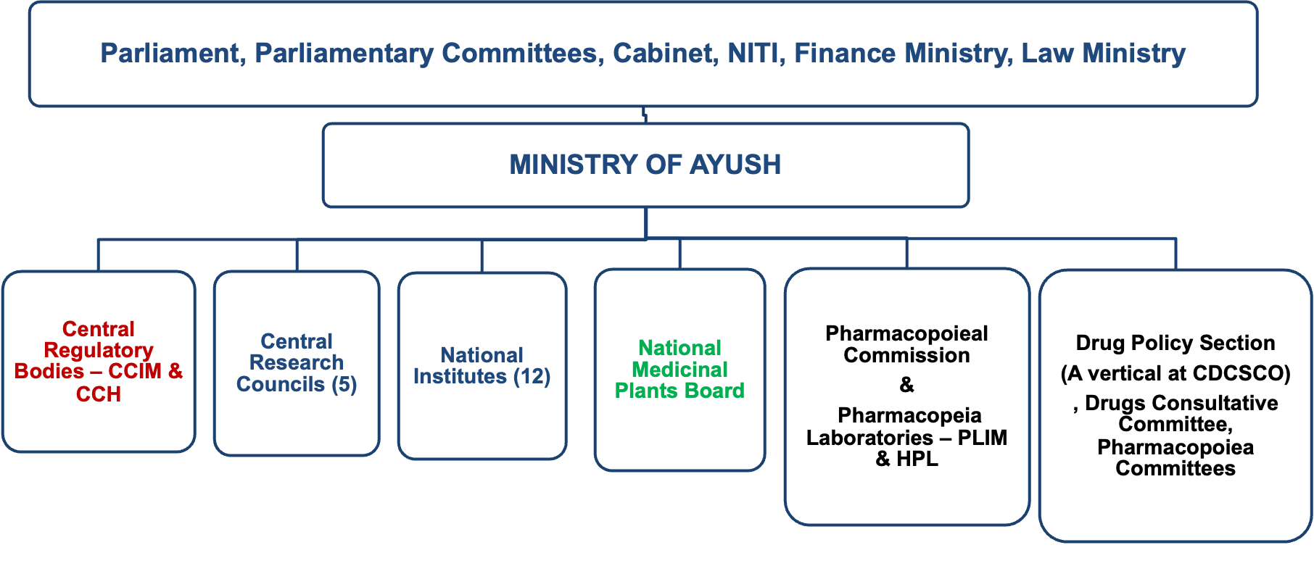
CENTRAL ORGANIZATIONAL SET UP
Statutory bodies
NCISM
NCH
PCIM & H
International Cooperation Section

Slide 6
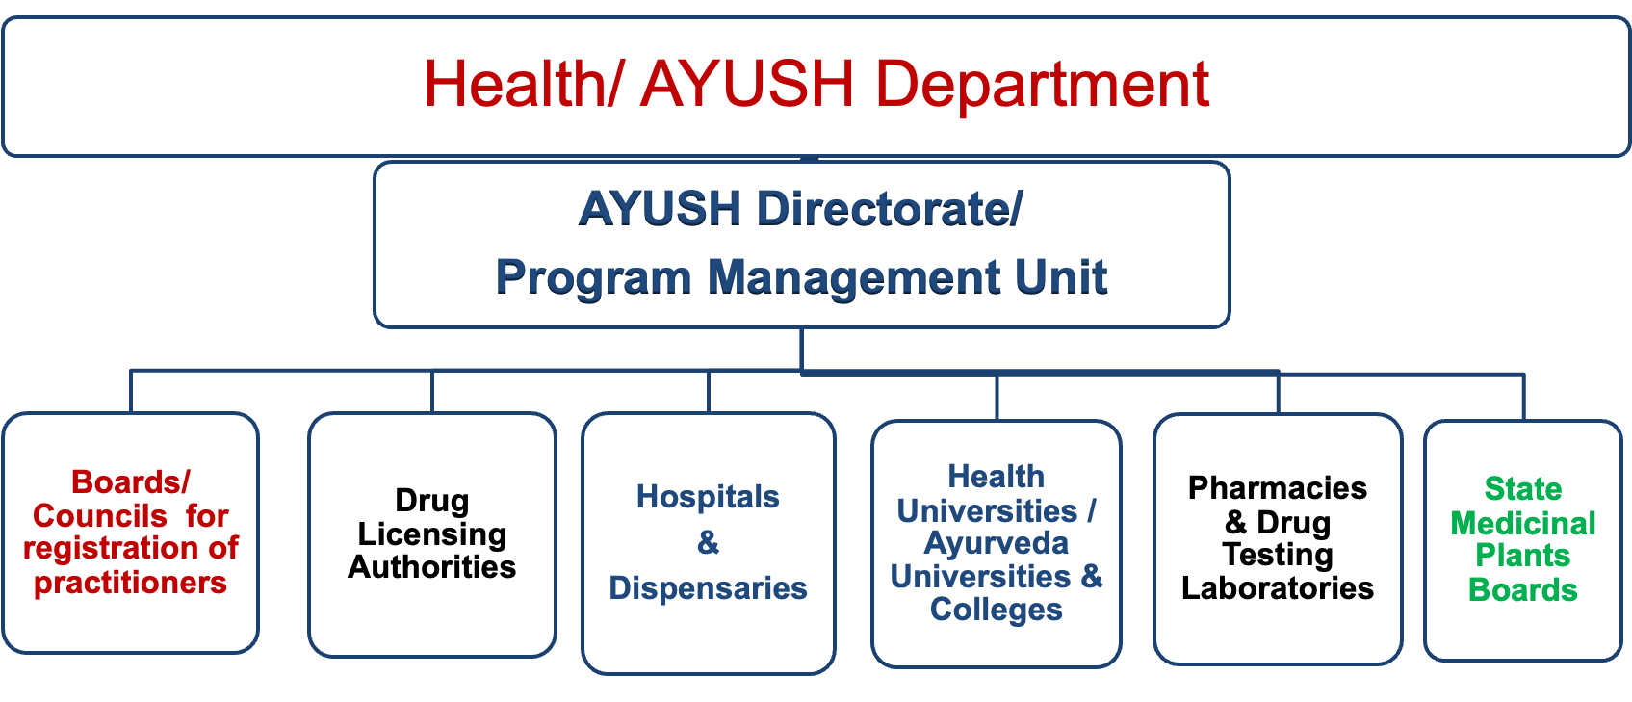
STATE LEVEL ORGANIZATIONAL SET UP

Slide 7
AYUSH Network
Registered Practitioners: (A-443704, U-51110, S-9125, Yoga/Naturopathy-2485, H-293455) | 7,99,879
Total Teaching Institutions (ASU&H): (A-393, U-52, S-10, Yoga/Naturopathy-26, H-221) | 702
Postgraduate Institutions (ASU&H): (A-137, U-11, S-2, Yoga/Naturopathy-3, H-50) | 203
Annual Intake in Degree Courses: (A-25407, U-2945, S-580, Yoga/Naturopathy-1730, H-16173) | 46,835
Annual Intake in PG courses: (A-4188, U-127, S-94, Yoga/Naturopathy-47, H-1080) | 5,536
Hospitals in Government Sector: (A-3205, U-267, S-298, Yoga/Naturopathy-33, H-232) | 4035
Dispensaries in Government Sector: (A-3205, U-267, S-298, Yoga/Naturopathy-33, H-232, Sowa Rigpa-34) | 27,951
Drug Manufacturing Units: (A-7718, U-625, S-214, H-397) | 8954

Slide 8
MAJOR INITIATIVES BY MINISTRY OF AYUSH
National AYUSH Mission (NAM)
New Legislations enacted
NCIM Act, 2020
NCH Act, 2020
10
01
Institute of National Importance
ITRA conferred the status of INI
NIA also recognized as Deemed to be University (De Novo)
Champion Service Sector Scheme
09
02
MAJOR INITIATIVES BY MINISTRY OF AYUSH
NABH Accreditation & insurance coverage
WHO Global Centre for Traditional Medicine
08
03
International Classification of Diseases-11
NAMASTE portal
Inclusion of AYUSH practitioners in WHO Doctor- Population Ratio
07
04
Draft Food Safety and Standards (Ayurveda Aahar) Regulations, 2021
AYUSH Export Promotion Council (AEPC)
06
05

Slide 9
Integration of AYUSH
Public Health
Inter Ministerial Integration
Ayushman Bharat
National AYUSH Mission
Poshan Abhiyan
Technology Sector
Information technology,
Biotechnology,
Industrial technology
SDG 3
Good health & Well being
SDG 2
Zero Hunger
Research,
Tech transfer,
Services,
Trade promotion
Health Services,
Trade promotion
Health Services, Research

Slide 10
New Ayush initiatives in Public Health Program (NAM)
National Program for Prevention and Management of Musculoskeletal Disorders
Integration of AYUSH with NPCDCS
SUPRAJA-AYUSH Maternal & Neo-Natal Intervention
VAYO MITRA: AYUSH Geriatric Healthcare Services
AYURVIDYA: Promotion of healthy lifestyle through AYUSH System in 75000 Schools
KARUNYA: AYUSH Palliative Services
AYUSH Mobile Medical unit
National Program on AYUSH for morbidity management and Disability Prevention (MMDP) of Lymphatic Filariasis (lymphoedema)

Slide 11

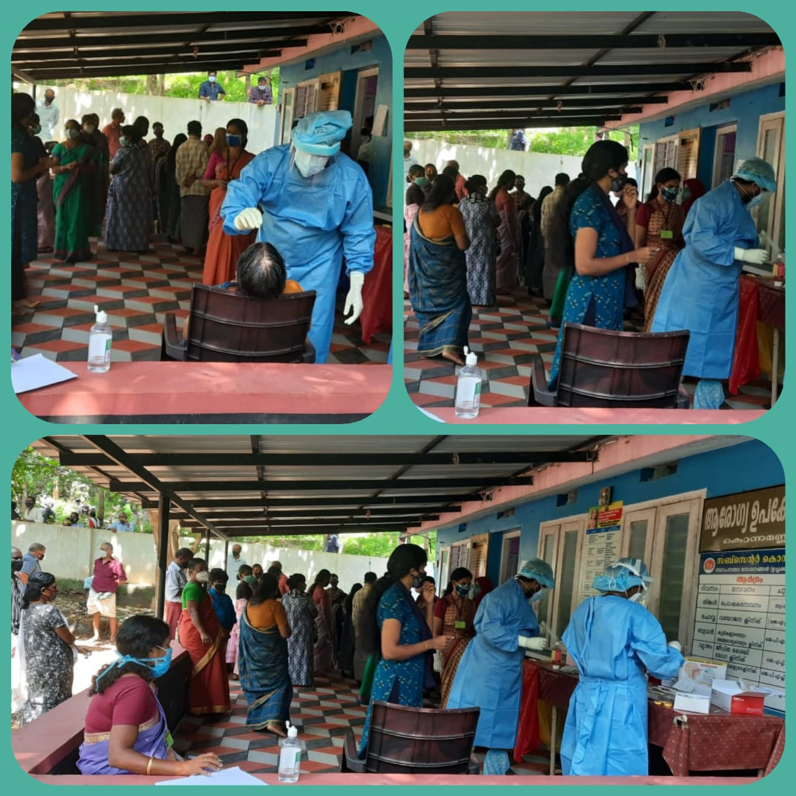
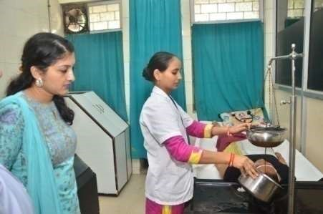
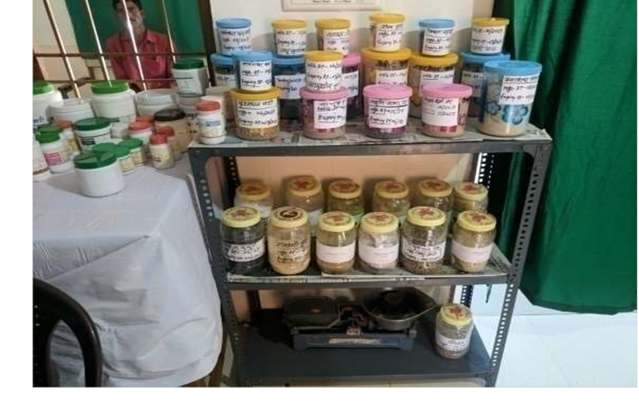
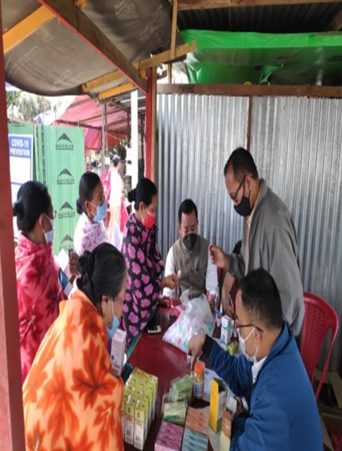
Encouraging Progress in Beneficiaries of AYUSH

Slide 12
OUTSTANDING LEADS OF PUBLIC HEALTH PROJECTS
Project Title: Creating sustainable solutions to address Anaemia in school Children of Rural area through Ayurveda
Belgaum, Karnataka
Total 6663 students screened in 39 schools and 83 Anganwadi centers
Krimikuthar Ras, Punarnawa mandoor and Draksha for 90 days
Prevalence of Anaemia in School going children has reduced from 30.8% before treatment to 1.81% the end of 2nd Year)

Slide 13

Convergence with MoWCD in Poshan Abhiyaan
Activities to be undertaken
Promotion of Take Home Ration on AYUSH Based Guidelines (Fortification/Wholesome Combinations)
The Mission Kalpataru: Propagation and plantation of nutritional Medicinal Plants/Trees
AYUSH based interventions for Malnutrition and Anemia at all AWCs in phased Manner(Mo AYUSH & Mo WCD)
Tele-consultation Hub [CSCs (MeitY), MoWCD & MoAYUSH]
Implementation
All the Anganwadi in the catchment areas of 12,500 AYUSH H&WCs will be roped in for implementation of this program for malnutrition and anaemia by AYUSH based interventions in a phased manner in convergence with MoWCD.

Slide 14
AYUSH Grid: A major step toward digitising Ayush healthcare sector
A mega digital platform for connecting all AYUSH related institutions/ hospitals to generate various types of data for the requirement of Information gathering, sharing and further processes.
Objectives:
Digitization of data of patients.
Data of services as well as products.
Learning management system.
Capacity building of AYUSH Practitioners/ paramedics through online facilities.
Sharing of real time data amongst the stakeholders as per the requirement.
Components of AYUSH GRID under CSSS:
AYUSH Medical Tourism,
AHMIS,
Tele-consultation,
Education,
E- Aushdhi,
Support to International AYUSH Information Cell
Capacity Building for use of Systems,
Up gradation, Radical interoperability & maintenance,
Support to Autonomous Bodies under Ministry of AYUSH for developing digital infrastructure.
AYUSH- Health Management Information System (A-HMIS): launched on 5th Nov 2018. So far 15.5 lakh patients are on AHMIS

Slide 15
Integration of AYUSH Systems in other Ministries/Departments
MoU between MoA and Ministry of Railways for the establishment of AYUSH wings at 05 Railway Hospitals on 6th February, 2018
MoA and Ministry of Defence signed a MoU for the introduction of Ayurveda under their health establishments on 21.10.2019
MoA and Ministry of Home Affairs are in process to sign a MoU to integrate AYUSH services in Central Armed Police Forces (CAPFs)
MoA Signed MoU with MSME to develop Entrepreneurship in AYUSH sector and establishment of incubation centres
MoA is also working in collaboration with Ministry of Labour and Employment for the promotion of AYUSH systems. 314 AYUSH units are functional under the health establishment of M/o L&E. An Ayurveda hospital at Delhi, has also been established.
As an outcome of the discussion between Ministry of AYUSH and Ministry of Power, National Thermal Power Corporation (NTPC) has agreed to establish 05 Ayurveda Hospitals in the Country.

Slide 16
New initiative on development of integrative health policy
The Government of India (NITI) has taken an initiative for formulating a new integrative health policy focusing on the following core aspects
1.Research & Development
2. Education
3.Clinical practice
4.Public health.
The policy would certainly offer provisions for effective implementation of integrative health in the Country.

Slide 17

GLOBALIZATION OF AYUSH

Slide 18
Central Sector Scheme for Promotion of International Co-operation in AYUSH
To promote and strengthen awareness about AYUSH System of Medicine Globally
COMPONENTS OF THE SCHEME
International exchange of experts & officers
Incentive to drug manufacturers, entrepreneurs, AYUSH institutions etc. for international propagation of AYUSH by participating in international exhibitions, trade fairs, road shows etc. and registration of AYUSH products (Market Authorisation) at regulatory bodies of different countries such as USFDA/EMEA/UK-MHRA/ NHPD/ TGA etc. for exports
Support for international market development and AYUSH promotion-related activities,

Slide 19
Contd:
Translation and publication of AYUSH literature/books in foreign languages
Establishment of AYUSH Information Cells and strengthening of Health Centre/ Institution in foreign countries with AYUSH equipments, etc.
International Fellowship/ scholarship Programme for foreign nationals for undertaking AYUSH courses in premier institutions in India.

Slide 20
INITIATIVES OF INTERNATIONAL COOPERATION
Country to Country MoUs for cooperation in the field of Traditional Medicine -25
WHO
Germany (JDI)
Hungary
Malaysia,
Trinidad & Tobago,
Suriname
Brazil
Bangladesh,
Nepal ,
Mauritius,
Mongolia,
Turkmenistan
Myanmar
Iran
Sao Tome & Principe
Equatorial Guinea
Cuba
Colombia
Japan (MoC)
Bolivia
Gambia
Republic of Guinea
China
Saint Vincent & The Grenadines
Zimbabwe
Institute to Institute MoUs for Research/ Academic Collaboration in areas of mutual interest-31
Rosenberg European Academy of Ayurveda, Germany.
FIZ, Germany.
Department of Neurology and Complementary Medicine, Lutheran, Hospital Hattingen, Germany.
College of Medicine, UK;
Medical University of Graz, Graz Austria
National Centre for Natural Products Research (NCNPR), University of Mississippi, USA;
American Herbal Pharmacopeia, USA
University of Alberta, Canada
Spaulding Rehabilitation Hospital, USA.
Western Sydney University, Australia etc.

Slide 21
ACADEMIC CHAIRS
University of Debrecen, Hungary (Ayurveda Chair)
University of Latvia, Latvia (Ayurveda Chair)
University of Primorska, Slovenia (Ayurveda Chair)
Peoples’ Friendship University, Russia (Ayurveda Chair)
Udayana University, Indonesia (Ayurveda Chair)
University of the West Indies, Trinidad & Tobago (Ayurveda Chair)
University of the Western Cape, South Africa (Unani Chair)
Rangsit University, Thailand (Ayurveda Chair)
Yerevan State Medical University (YSMU), Armenia (Homoeopathy Chair)
The Government of InstitutoUniversitario del Gran Rosario and The Government of Fundacion de Salud Ayurveda Prema, Argentina (Ayurveda Chair)
University Tunku Abdul Rahman (UTAR), Malaysia(Ayurveda Chair)
Hamdard University, Bangladesh (Unani Chair)
University of Mauritius (Ayurveda Chair)
Western Sydeny University, Australia (Ayurveda Chair)

Slide 22
AYUSH Information Cell (Centre)
AYUSH Information Cells-35 in 30 countries
Croatia Russia
Serbia, Australia
Romania Cuba
Hungary, Mauritius
Slovenia, Finland
Switzerland Argentina
United Kingdom Israel
Italy (Milan) Egypt
Italy (Buccino) Peru
Malaysia, Venezuela
Trinidad & Tobago, Sweden etc.
Mexico, Indonesia (Bali & Jakarta),

Slide 23
AYUSH Collaboration with WHO
Project Collaboration Agreement (PCA) with WHO: It is an Umbrella MoU for cooperation on promoting the quality, safety and effectiveness of service provision in traditional and complementary medicine including Ayurveda, Yoga etc.
The Ministry has developed comprehensive document on Ayurvedic Terminologies with National Ayurveda Morbidity Codes through a consultative process of experts. The Ministry is Developing WHO terminology in Ayurveda, Unani, Siddha.
The Ministry with WHO is also working for Development of 2nd Module of Traditional Medicine Chapter of ICD-11.
AYUSH PHFI research study entitled “Assessment of integration of AYUSH into the public health system for combating COVID-19 is being conducted in India with the support of WHO.
WHO Global Centre for Traditional Medicine is being established in India.
WHO M Yoga Mobile application has been developed.

Slide 24
Initiatives for the promotion of AYUSH Education at International level
AYUSH Fellowship Scheme- Ministry of AYUSH under Central Sector Scheme for Promotion of International Co-operation in AYUSH (IC Scheme) offers 104 scholarships every year, through ICCR, to the eligible foreign nationals from 98 countries for pursuing undergraduate (UG), postgraduate (PG) and Ph. D courses in premier Institutes in India for Ayurveda and other Systems.
Ministry also offers Ayurveda courses under “Study in India program” for foreign students. The program is a unique initiative of the Government of India will help facilitate the student fraternity from all across the globe to come and experience the best of academic learning from the top institutions in India which would help accommodate the growing quality educational needs of students across the world.
Rashtriya Ayurveda Vidyapeeth (RAV), an autonomous body under Ministry of AYUSH, has been approved as Accrediting Agency for various Ayurveda courses being run by the institutions/universities at abroad .
BIMSTEC Ayurveda and Traditional Medicine University (BATMU) is proposed to be established in India with aims to help the Member States to develop their own Ayurveda and Traditional Medicine Colleges with affiliation to the above University for a sustainable capacity development in Traditional Medicine among the Member States.
Ministry of AYUSH has developed Yoga Certification Board (YCB) which provides certificates for Yoga professionals under various levels & category and accreditation to the Yoga Institutions / centres based on their years of existence, scale of operation and experience in the field of Yoga. As of now, 66 ntional & international institutes have been accredited and thousands of Yoga professionals have been certified.

Slide 25
Other Initiatives for Global Promotion of AYUSH
India-EU Technical Working Group on Ayurveda has been set up.
A Panchkarma centre has been established at Cuba with the support of Mo Ayush.
Establish International Ayurveda institutes in different countries like- Mauritius, Hungary
More than 50 Ayurveda/Ayush products have been registered in 08 countries namely Kenya, USA, Russia, Latvia, Canada, Oman, Tajikistan and Sri Lanka.
Establishing a dedicated AYUSH Export Promotion Council (AEPC) at Ministry of AYUSH to promote export of AYUSH products/medicines as well as AYUSH services
Scheme for “Voluntary Certification of Yoga Professionals” developed by Quality Council of India (QCI) with the aims to certify the competence level of Yoga professionals through Certification Process.
Deputation of AYUSH experts in Foreign Countries i.e. Cuba, Malaysia, Turkmenistan.

Slide 26








AYUSH Representation in Multilateral International Forums
World Health Organization (WHO)
World Intellectual Property Organization (WIPO)
International Regulatory Cooperation in Herbal Medicine(IRCH)
World Trade Organization (WTO)
BRICS – Brazil, Russia, India, China and South Africa
European Union (EU)
India Brazil South Africa Dialogue Forum (IBSA)
South Asian Association of Regional Cooperation (SAARC)
Association of South East Asian Nations (ASEAN)
Bay of Bengal Initiative for Multi-Sectoral Technical and Economic Cooperation (BIMSTEC)

Slide 27
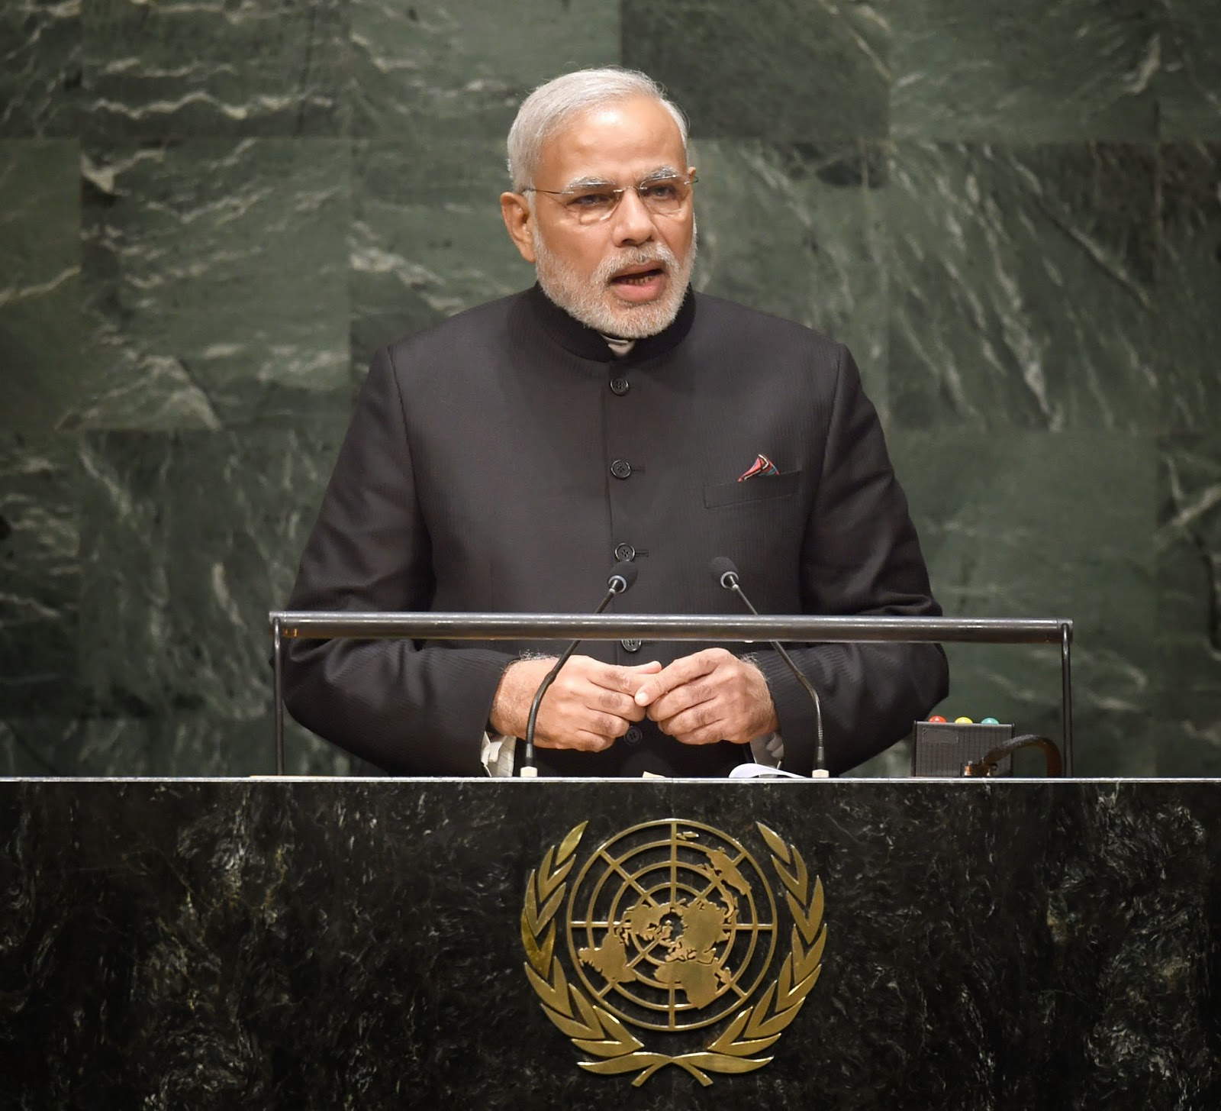
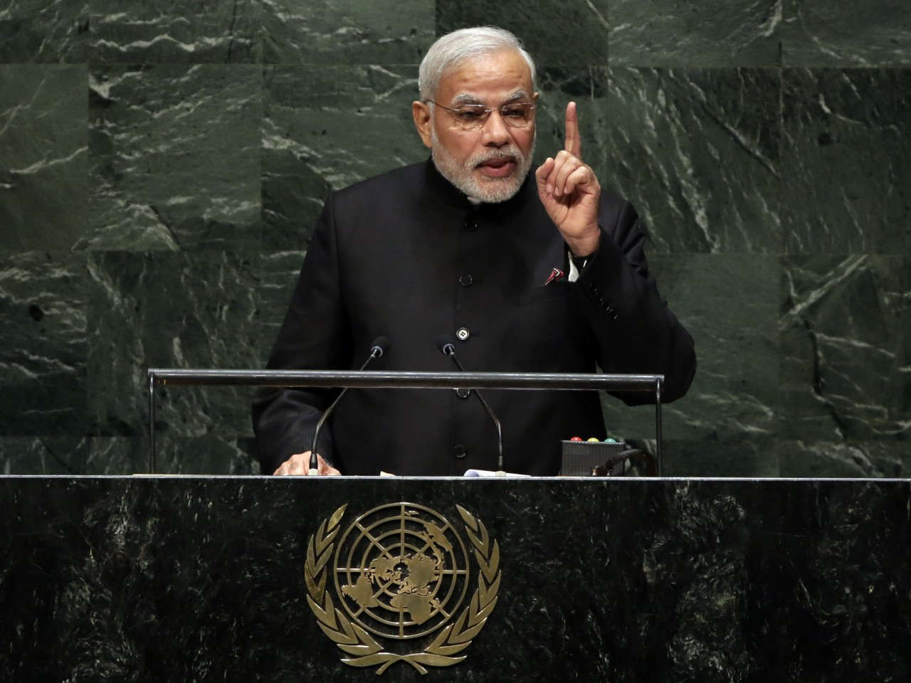
UN Declaration for 21st June as International Day of Yoga

Slide 28
Special Promotion of Yoga
Ministry of AYUSH is celebrating IDY since last 7 years at national &international level for promotion of Yoga.
Extending technical support to foreign countries for celebration of International day of Yoga across the globe.
Setting up of center of excellence (CoE) for Ayurveda & Yoga in UK Under the MoU signed between All Indian Institute of Ayurveda, and College of Medicine (UK) in 2018
WHO in collabraotion with MoA launched WHO mYoga app to demonstrate Common Yoga Protocol (CYP) for wellness and for global use for correct practices of yoga under Be He@lthy, Be Mobile initiative
Ministry of AYUSH has developed Yoga Certification Board (YCB) which provides certificates for Yoga professionals and accreditation to the Yoga Institutions / centres. As of now, 66 national & international institutes have been accredited and thousands of Yoga professionals have been certified.
Ministry is in process of Affiliation of Saudi Yoga Standards with the Yoga Certification Board of the Ministry of AYUSH and also entered into an MoU with MDNIY
MoA has also launched Namaste Yoga app (a one-stop health solution that enables people to access Yoga-related information, Yoga events, and Yoga classes at their fingertips) and Yoga break app.

Slide 29
The Yoga Break Mobile Application
Recently, Ministry of Ayush, Govt of India launched a Y-Break (or the “Yoga Break) mobile application.
It is a unique five-minute Yoga protocol app, consists of Asanas, Pranayam and Dhyana.
It is designed especially for working professionals to de-stress, refresh and re-focus at their workplace to increase their productivity.

Slide 30

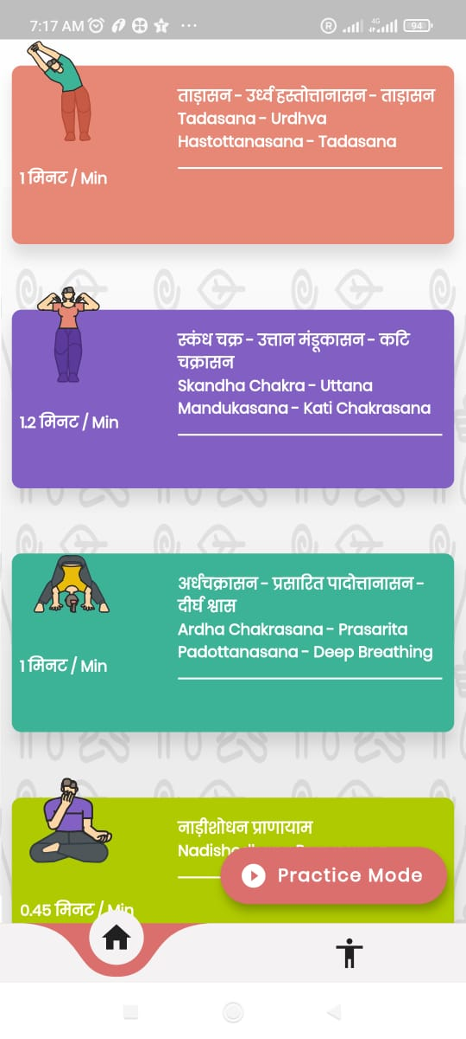
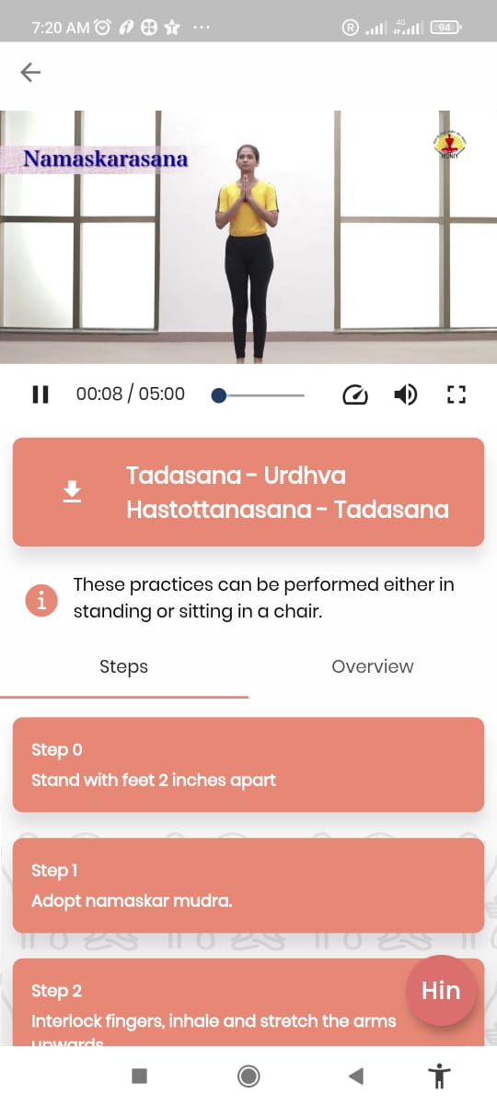

Slide 31

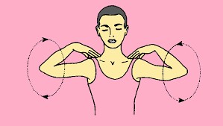
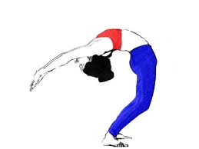
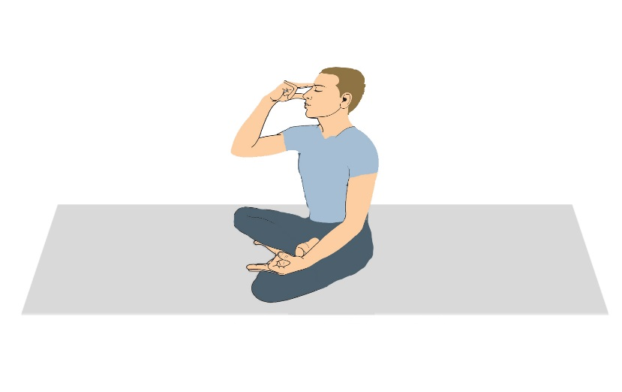

Assans & Pranayams
Tadasana
Skandha Chakra-Uttana Madkasana
Ardha Chakrasna
Nadi Shodhana Pranayama
Bhramari Pranayama- Dhyana

Slide 32

WHO m-Yoga

Slide 33


Slide 34
About WHO m-Yoga APP
With support from the Ministry of AYUSH, Govt of India, WHO has developed and launched M-Yoga app. This is an app for the general public and for yoga teachers to use in their daily life and teaching. It includes WHO approved yoga teaching and practice sessions of different durations developed through extensive international expert consultation processes.
The app is safe and secure, collecting no data from users at all, and can be used as a daily yoga companion for persons aged 12-65 years. It will be available in all six UN languages and in Hindi.

Slide 35
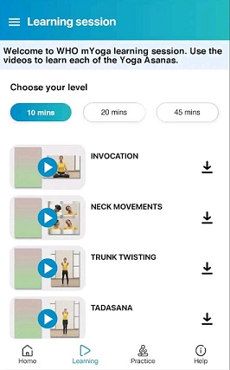
Training session in WHO - mYoga App

Slide 36

THANK YOU
Notes:
36

