Slide 1
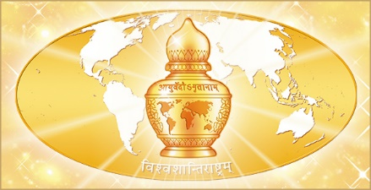
Education and application of Ayurveda in Medicine
Dr. Gordana Marković, MD, PhD
State Expert Committee on Complementary Medicine, Serbia
Alma Mater Europaea University, Slovenia
Notes:
It is a great pleasure for me to be here and to have the opportunity to share the experiences I have had so far in ayurvedic education for health professionals in European countries and implementing Traditional and Complementary Medicine methods into the Healthcare system in Serbia.

Slide 2
The place of
Traditional Medicine in the modern world
The use of traditional medicine has increased significantly and gained great popularity worldwide.
It is recognized not only by the general public but also by the authorities.
30-90 % of the adult population in Western countries uses some form of traditional medicine methods for the prevention and treatment.
Notes:
Over the last three decades, the use of traditional medicine has increased significantly and gained great popularity worldwide. In many countries, traditional medicine has taken a significant place and is being recognized not only by the general public but also by the authorities.
Studies show that between 30 and 90 percent of the adult population in Western countries uses some form of traditional medicine methods for the prevention and treatment of various types of illnesses.

Slide 3
Who are the patients?
Those who suffer from chronic diseases and who have tried conventional treatments without much success
Young, healthy and well-situated people who want to preserve their health in a natural and holistic way.
Notes:
These people usually belong to one of the following groups:
The first group are those who suffer from chronic diseases and who have tried conventional treatments without much success. The fact that the use of traditional medicine methods can improve health in those cases where conventional medicine was unsuccessful is a very significant factor that contributes to the rise A in popularity of these methods.
The second group are mostly the young, healthy and well-situated people who want to preserve their health in a natural and holistic way.

Slide 4
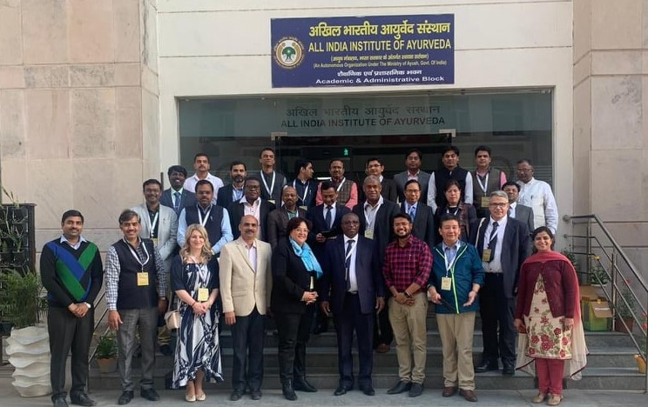
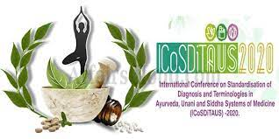
World Health Organization and
Ministry of AYUSH
WHO recognizes the importance of traditional medicine methods.
General Guidelines for Methodologies on Research and Evaluation of Traditional Medicine.
Notes:
The WHO recognizes the importance of traditional medicine methods and has published the General Guidelines for Methodologies on Research and Evaluation of Traditional Medicine, which defines the approaches that help form national regulations and facilitate the implementation of traditional medicine methods in the health care systems of many countries, in regard to the application, research, evaluation, quality control etc.
In February last year, in cooperation with the WHO the Ministry of AYUSH organized an International Conference on Standardization of Diagnoses and Terminologies in Ayurveda, Unani and Siddha Systems of Medicine (ICoSDiTAUS 2020). The conference featured presentations and discussions that focused on topics like relevance and regulation of Traditional Medicine in Health Systems, the further development of the supplementary chapter on traditional medicine diagnoses in ICD-11 (International Classification of Diseases, the eleventh revision), as well as status and challenges for collection and classification of clinical data in traditional medicine.

Slide 5
Public Health issue?
Most doctors are still not ready to accept these methods as a regular form of medical treatment.
Many patients use traditional medicine methods without the knowledge of their doctors.
Two problems:
  The delay of the appropriate conventional treatment
  Possible negative interactions between the treatments of the traditional and conventional medicine taken at the same time without the doctor’s supervision.
Notes:
In spite of all these IIIII recommendations and efforts given by the relevant professional organizations and institutions, most doctors are still not ready to accept these methods as a regular form of medical treatment. Because of this, many patients use traditional medicine methods without the knowledge of their doctors.
This fact potentially represents a major public health issue and carries a great deal of risk to the patients, as it may cause two problems: the delay (I) (E) of the appropriate conventional treatment as well as possible negative interactions between the treatments of the traditional and conventional medicine taken at the same time without the doctor’s supervision.

Slide 6
Creating space for Ayurveda in modern Public Health framework
The proper implementation of Ayurveda requires working in these three areas:
Legislation
Education of health professionals
Informing the general public
Notes:
Because of that, it is the obligation of those of us who are qualified health professionals in our countries in the field of Ayurveda and other traditional medicine methods to create a space in which the methods of traditional medicine will be applied safely and successfully. But how do we do this?
Experience in Serbia shows that the proper implementation of Traditional Medicine methods requires working in these three areas at the same time:
I The first area is legislation
II The second area is the education of health professionals
III The third area which needs focus is informing the general public

Slide 7

Legislation
Each country must regulate the application of traditional medicine, in order to define:
  WHICH METHODS can be applied
  WHO can apply the traditional medicine methods
  WHERE it can be applied
Rulebook
Notes:
Traditional medicine should be recognized by law in each country in which it is being practiced. Serbian laws have recognized these methods since 2005.
One of the biggest challenges in our country was the prejudice on the part of a number of medical professionals who do not accept the methods of traditional medicine and perceive them as inferior (I) (I) (I), useless and/or even harmful.
In December 2019 we adopted the new, much improved “Rulebook on detailed conditions and ways of implementation of complementary medicine methods and procedures” which defines WHICH METHODS can be applied, WHO can apply the Traditional Medicine methods, as well as WHERE they can be applied.

Slide 8
Methods of preserving and improving health
Two groups
Methods of prevention, diagnostic evaluation, treatment and rehabilitation
Acupuncture
Methods of stimulation of
acupuncture microsystems
Quantum medicine
Homeopathy
Traditional Chinese Medicine
Ayurveda
Chiropractic
Osteopathy
*These methods can be applied only by medical doctors and dentists.
Aromatherapy
Reiki
Anthroposophic medicine
Qi Gong and Tai Chi Chuan
Yoga- practice for medical purposes
*These methods can be applied by other health professionals such as physiotherapists, nurses, etc.
Notes:
Two groups of Traditional Medicine methods are legally accepted in Serbia:
1. The first group consists of Methods of prevention, diagnostic evaluation, treatment and rehabilitation… These methods can be applied only by medical doctors and dentists because according to our Law on Health Care, only doctors and dentists can diagnose and treat people, i.e. (that is) recommend treatment related to health.
2. The second group consists of Methods of preserving and improving health… These methods can be applied by other health professionals such as physiotherapists, nurses, etc.
Outside of the health care facilities, Yoga can be taught by Yoga instructors who are not medical professionals and their license to work is issued by the Serbian Sports Federation and not the Ministry of Health.

Slide 9
Who can apply TM methods and where?
Health professionals who have the license for western medicine as well as an additional license for a TM method
State Expert Committee on Complementary Medicine, Ministry of Health
Full-time or part-time work in medical institutions
Notes:
Who can apply Traditional Medicine methods and where?
Exclusively Health professionals who already have the license for western medicine as well as an additional license for a Traditional Medicine method. Licenses for Traditional Medicine methods are granted, according to the Rulebook, by the State Expert Committee on Complementary Medicine, Ministry of Health. Health inspection oversees their work the same way it does with the western medicine practice.
Traditional Medicine methods can be applied as an additional method within a government or a private medical institution where a Traditional Medicine practitioner already works full-time or as additional part-time work in other private medical institutions.

Slide 10
Education of health professionals
There are two groups of health professionals that need to be educated:
Health professionals interested in practicing Ayurveda
Health professionals not interested in applying Ayurveda
Notes:
There are two groups of health professionals that need to be educated:

Slide 11
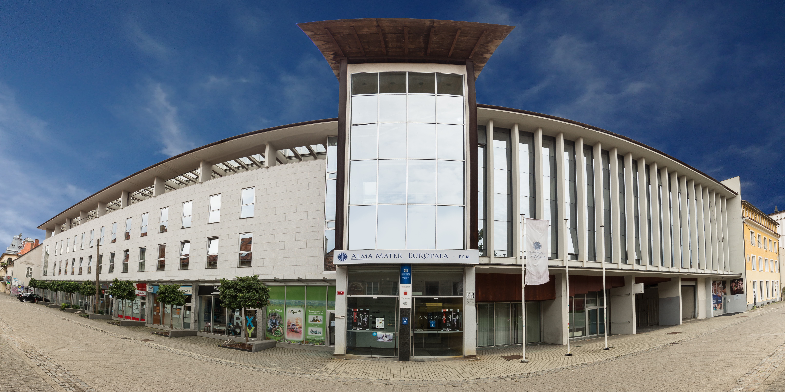
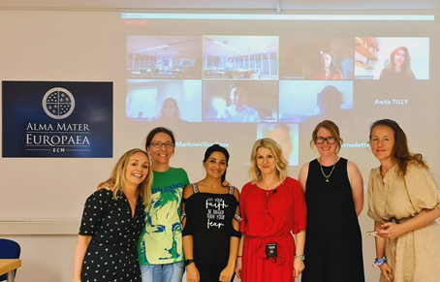
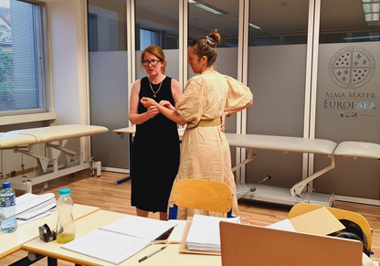
Health professionals interested in practicing Ayurveda
High-standard education
Postgraduate Certificate in Ayurveda for Health Professionals, Alma Mater University, Maribor, Slovenia
A unique educational opportunity for all eligible health professionals
Notes:
The first group consists of those healthcare professionals interested in practicing Ayurveda full-time or part-time. Therefore, it is essential to provide them with high-standard education and knowledge that can be implemented instantly into their daily Western medical practice. In Serbia, for Ayurveda, we provided them with the standard education in Maharishi Ayurveda which is completely under the Rulebook.
Right now, in Europe, there is a great new opportunity for health professionals from different countries: a one-year Postgraduate Certificate in Ayurveda for Health Professionals at the Alma Mater University in Slovenia.
Postgraduate training in Maharishi Ayurveda provides a unique educational opportunity for all eligible health professionals who wish to expand the scope and effectiveness of their health care practice and to practice Ayurveda professionally. It enables them to begin a new career or to add to their existing career the profound, time-tested natural wisdom of Ayurveda.

Slide 12
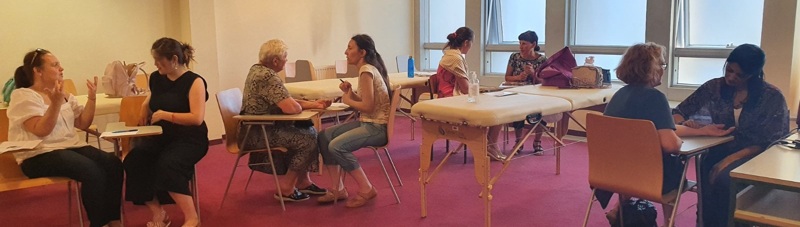
Achievements
How to apply the profound principles and practical skills of Maharishi AyurVeda in their practice
How to use that knowledge for the prevention, diagnosis, and treatment of common diseases
How to cultivate optimum health
Students from 3 different continents and 9 different countries
Notes:
During this training, students learn how to apply the profound principles and practical skills of Maharishi AyurVeda in their practice, how to use that knowledge for the prevention, diagnosis, and treatment of common diseases, and how to cultivate optimum health. They also learn personalized self-care programs (including Transcendental Meditation) which help them to increase (IIIII) their learning abilities, job satisfaction, and general well-being in their own personal lives.
As the principal professor of The Postgraduate Certificate, I can say that we are delighted with the progress of the program. This year we have students from three different continents and nine different countries, and when they finish the course they will be well prepared and ready to implement the Ayurvedic knowledge into their current clinical practice or to practice Ayurveda as a special method of treating their patients in accordance with the legislation in their particular countries.

Slide 13
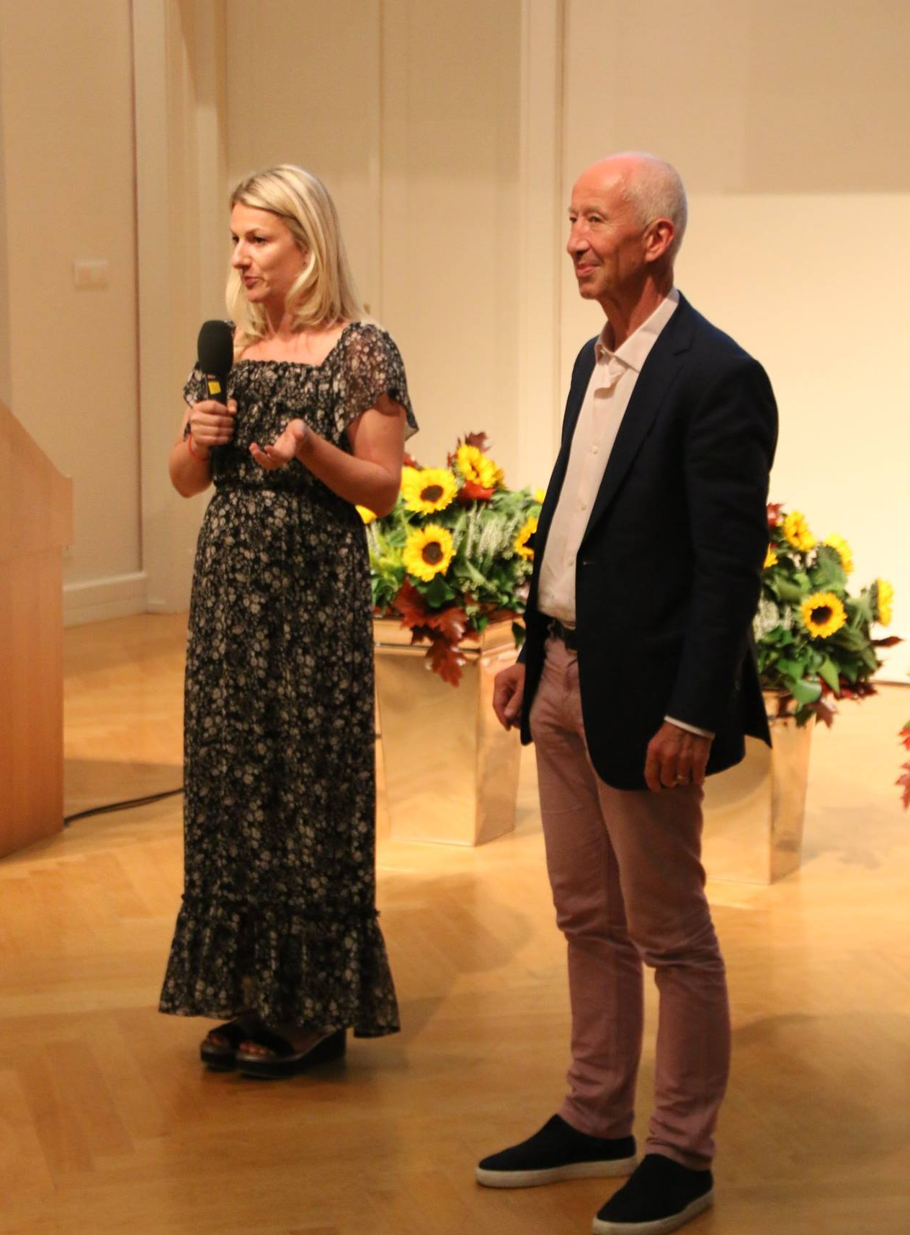
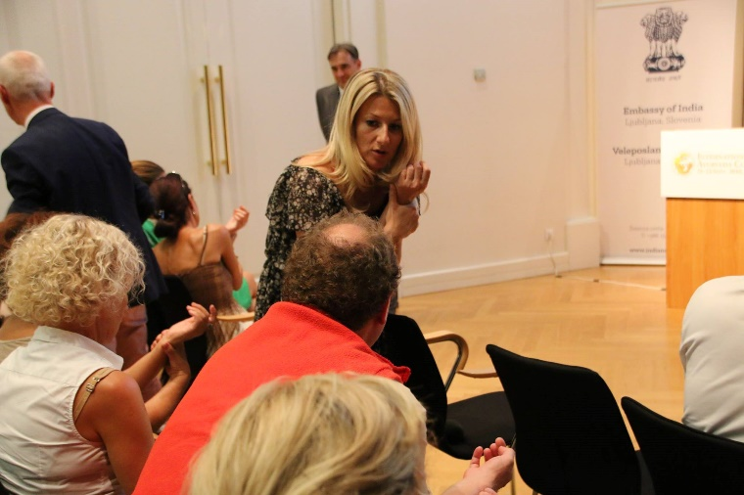
Health professionals not interested in applying Ayurveda
Accredited congresses and lectures
Notes:
The second group of healthcare professionals who need to be educated consists of those who are not interested in applying Traditional Medicine methods but are a part of the health system. It is very important to enable them to understand and accept the importance and benefits of Traditional Medicine methods, to know the indications for their application, and to think about the possible contraindications of their application, as well as the interactions that may occur when these methods are applied at the same time with other methods.
How did we approach educating this group in Serbia?
In Serbia, every doctor has to collect points in order to get and keep their professional work license through accredited education by participating in accredited congresses and lectures.
We have accredited one-hour and two-hour lectures on the importance of applying the Traditional Medicine methods and about the use of these methods, which gave us the opportunity to present this knowledge in any medical institution. For example, we accredited more than 20 different topics for HP about Maharishi Ayurveda.
DITID

Slide 14
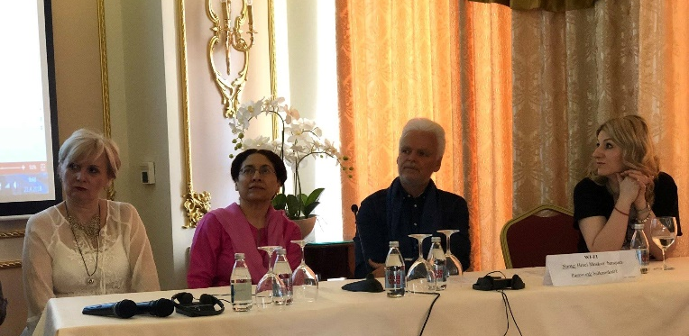
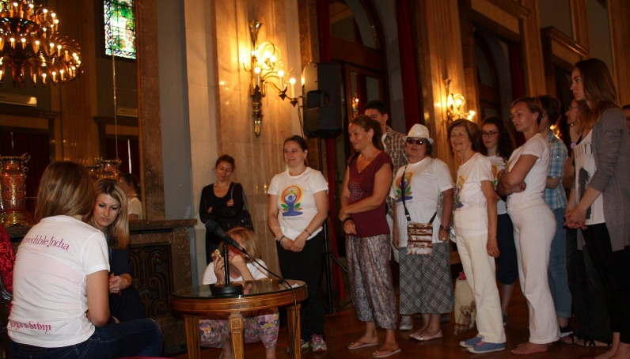
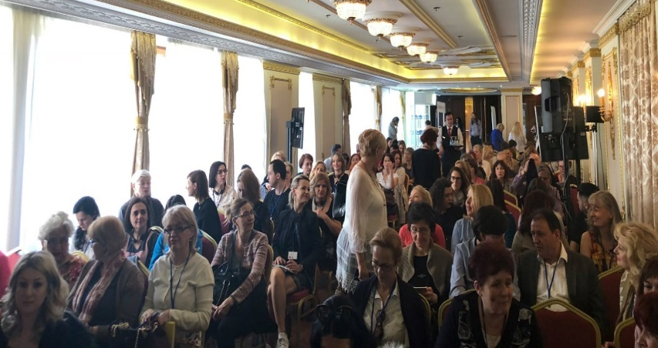
Health professionals not interested in applying Ayurveda
Four international accredited congresses in Maharishi Ayurveda
Notes:
We also received accreditation for organizing four international congresses in Maharishi Ayurveda. The first was organized in 2013 in Belgrade and it was the first international Ayurvedic congress in Europe. It was attended by over 500 doctors as well as a delegation from India with over 25 vaidyas.
The last of the 4 accredited congresses was organized in December 2019, and attended by more than 300 health professionals.

Slide 15
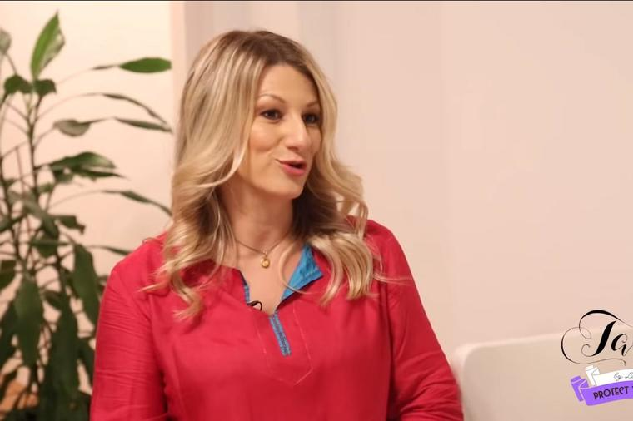
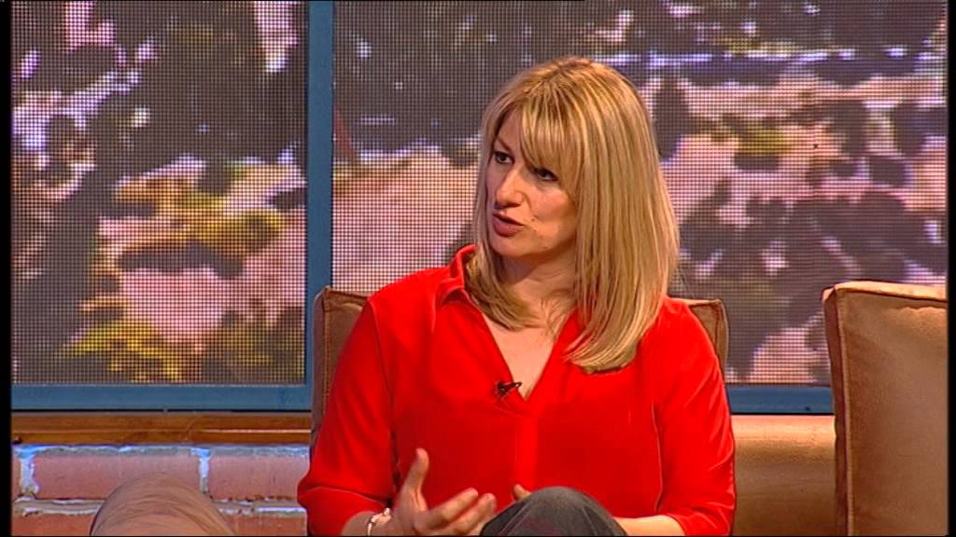
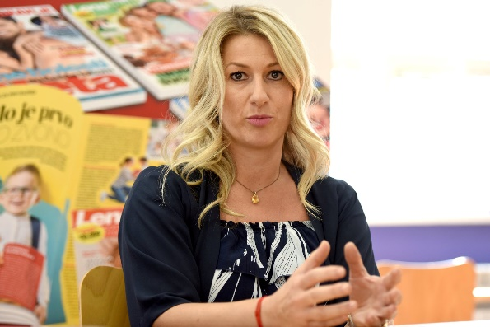
Education of general public
Articles published in popular newspapers and magazines on the use of Ayurveda when treating certain diseases
Guest appearances organized on some of the most popular TV shows and channels
Notes:
It is necessary to raise (E) the collective awareness of the citizens to a level that enables the implementation of these methods to take effect in practice.
When Ayurveda is concerned, what did we do in Serbia?
More than 100 articles were published in popular newspapers and magazines on the use of Ayurveda when treating certain diseases.
Dozens of guest appearances have been organized on some of the most popular TV shows and channels, with simple and easy to understand explanations about the importance of adequate implementation of Maharishi Ayurveda and its effects (what foods to avoid in case of gastritis, rheumatoid arthritis, what routine and diet are recommended during menstruation, what foods are recommended after childbirth, why raw foods are not recommended in patients with neurological diseases like MS, Parkinson's disease etc.)

Slide 16
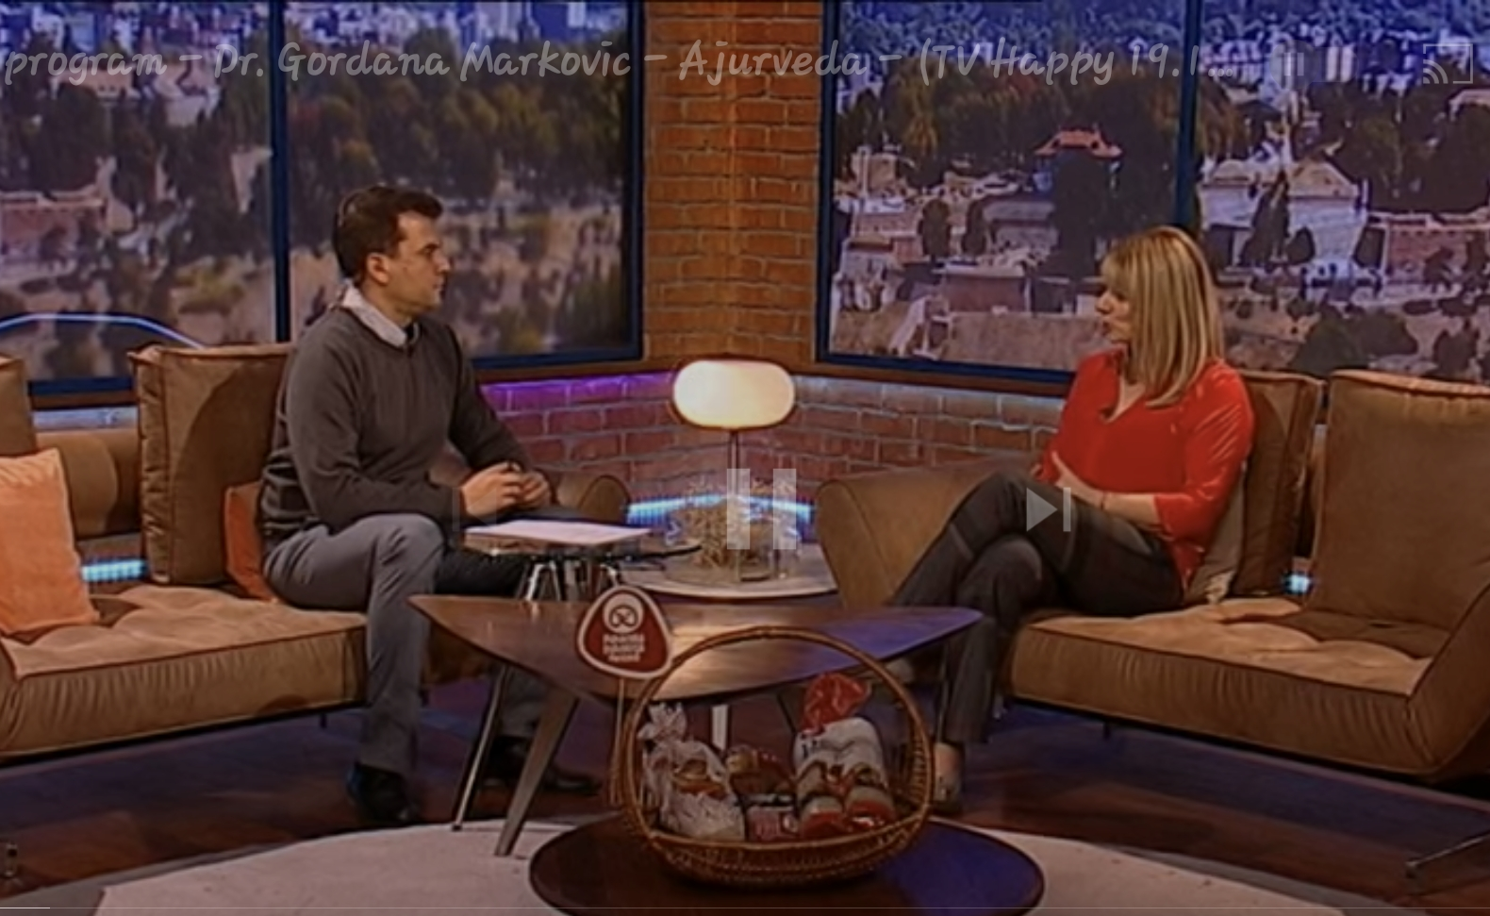
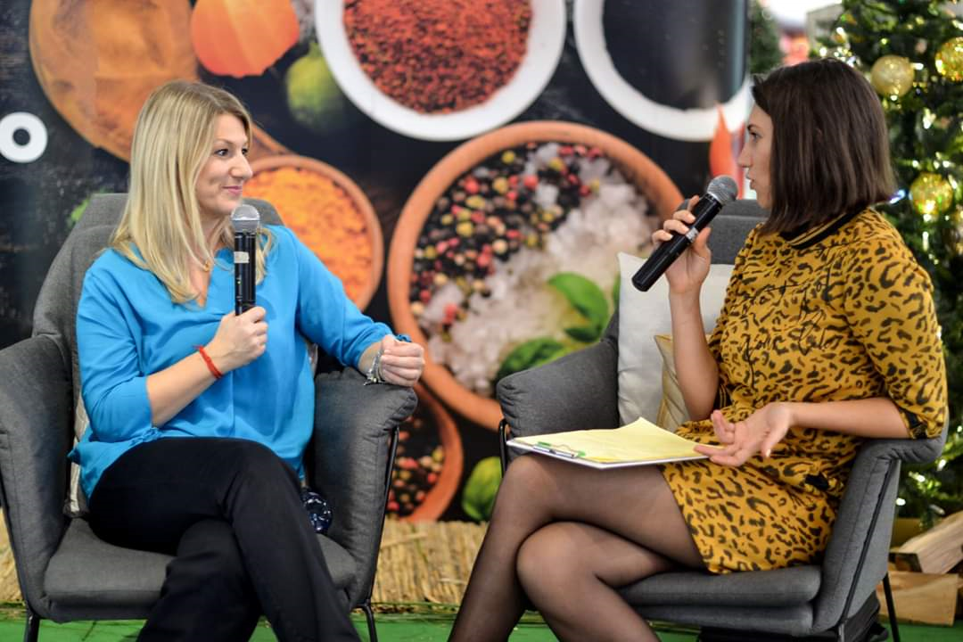
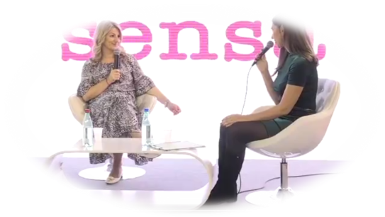
Community health
Education of the general public very much contributes to the better collective immunity.
Even in the current situation with Covid 19, we should think about immunity of the future generations.
Ayurveda offers very precise and valuable instructions.
Notes:
Regarding the current epidemic we can also do a lot to help people to get over this situation with additional support and to find out how to improve their immunity and how to contribute to the creation of better immunity for future generations.
Education of the general public very much contributes to the better collective immunity.
Ayurveda offers very precise instructions.

Slide 17
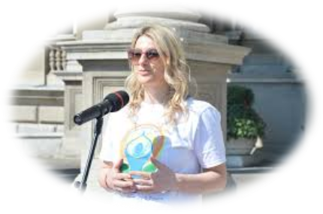
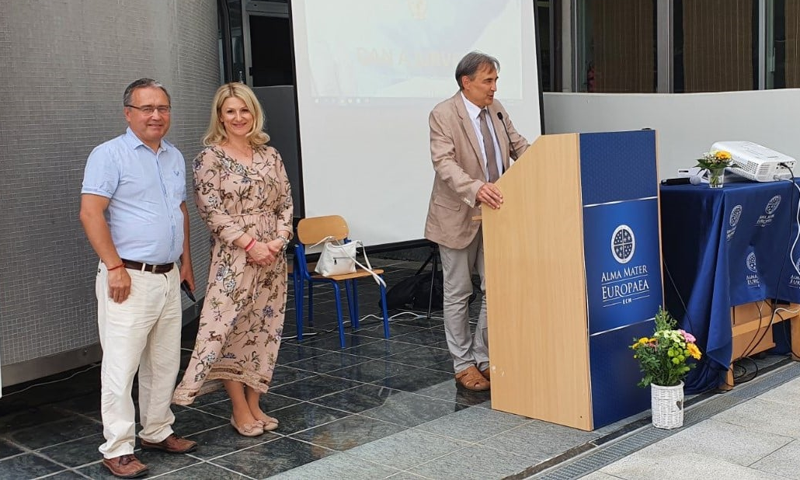
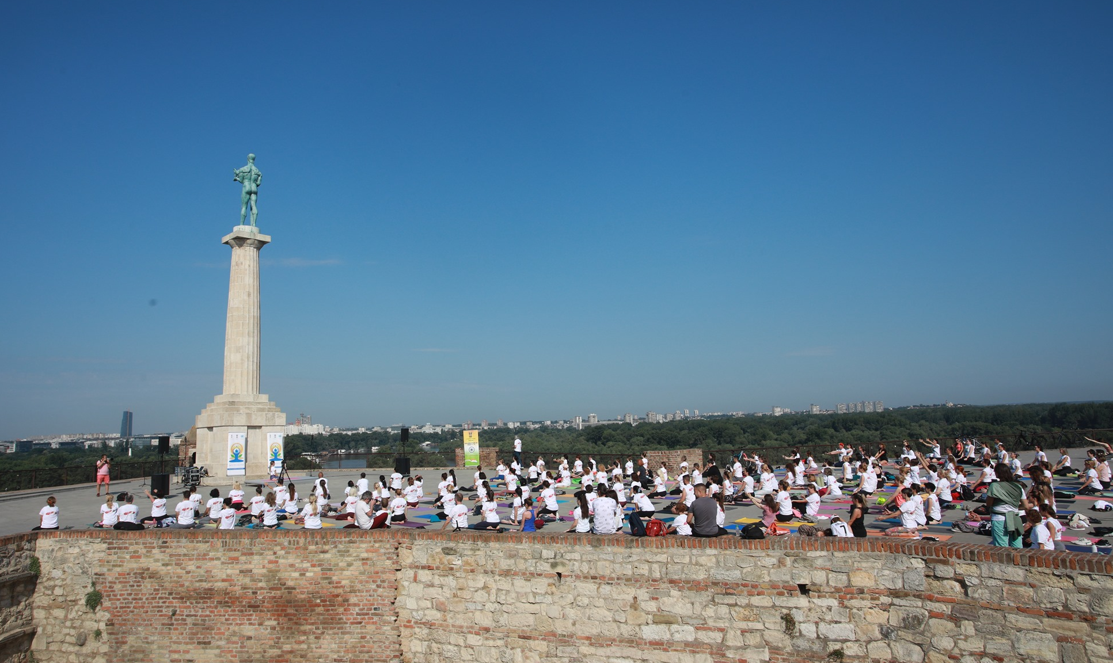
Education of general public
Hundreds of public lectures
Education of future yoga instructors
Notes:
In Western medicine, in cases when we do not have very precise recommendations for some of specific diseases, the Ayurvedic knowledge is very useful and applicable and our mission is to make it accessible to everyone.
We organized hundreds of public lectures on the same topics.
We have taken a significant part in the education of yoga instructors organized by yoga schools. Owing to the rising (A) global popularity of yoga, which we need to thank the Indian government for, our experience shows that the citizens who want to live in accordance with healthy natural principles, in large numbers, choose to take yoga lessons as one of the first steps. We have recognized this as a fundamental fact and we made sure that some basic principles of Ayurveda are covered within the training for becoming a yoga instructor.

Slide 18
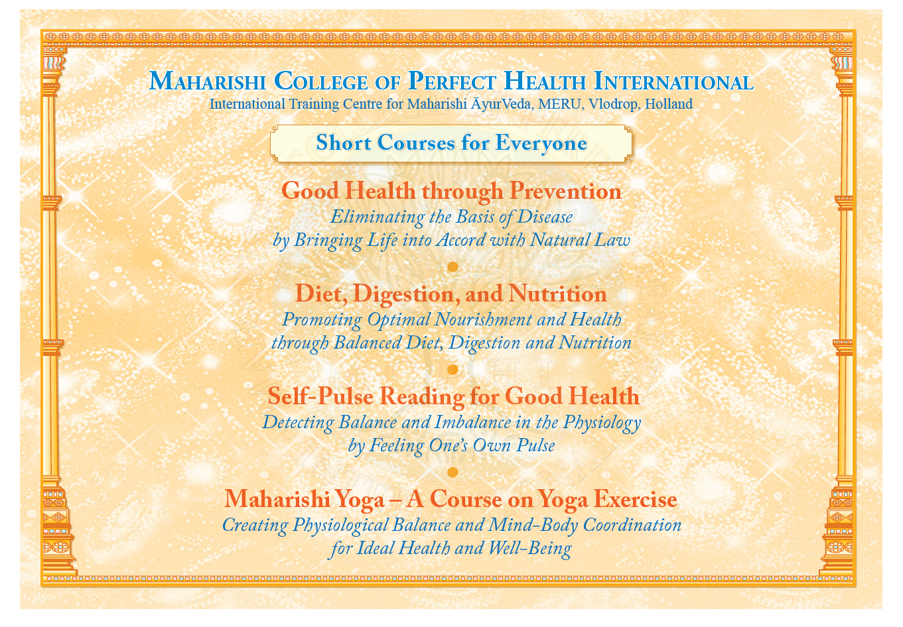
Education of general public
16 lessons courses
Notes:
In Maharishi Ayurveda, we also have an exciting opportunity for the public. Four different fantastic 16-lesson courses are available now online: Good health through prevention, diet, digestion and nutrition, Self pulse reading for good health and Maharishi Yoga Course. The President of the conference Dr. Mladen and I currently teach the Self pulse reading course for the whole Balkans region. It is the second time that we have offered this course, and apart from this, we also taught the course Diet, digestion and nutrition. The Maharishi Yoga Asana course is also going very well. So we can say that cooperation between Serbia and Croatia in the field of Ayurveda is going very well and successfully.
People are very eager for pure knowledge and such courses, especially at this challenging time of the corona pandemic when contacts and movement are limited and when they want to find additional ways to improve their immunity and general health. We are very pleased that we have an opportunity to teach these courses because they are nourishing for people's consciousness and the other aspects of our physiology.
IIIST

Slide 19
Conclusion
All of this, was achieved because we had well-coordinated teams which worked at the same time to educate health professionals and educate the citizens.
Notes:
I am delighted because I am involved in all these activities in my country and education in other European countries.
Everything that I have mentioned today about legislation and education is just an example of how we can use precise Ayurvedic knowledge.
All of this, was achieved because we had well-coordinated teams which worked at the same time to educate health professionals and educate the citizens.
We also feel that it was essential that those involved in training of health professionals and citizens, lived their own lives in perfect accord with the principals of Ayurveda, following ayurvedic diet, daily and seasonal routine, and doing yoga and meditation regularly.

Slide 20
Conclusion
Our experience shows that it is of the greatest importance that competent Western medicine health professionals, educated in different fields of TM are involved in the training of other health professionals. The reason is that they have both competence and authority to ensure that what they teach is recognized as acceptable, safe and applicable, by both – government and the public.
Notes:
Our experience shows that it is of the greatest importance that competent Western medicine health professionals, educated in different fields of TM are involved in the training of other health professionals. The reason is that they have both competence and authority to ensure that what they teach is recognized as acceptable, safe and applicable, by both – government and the public.
With well educated Health professionals, with acceptance by public and with proper Legislative we can create a platform for the future application of TM methods and for exploring the effects of their application worldwide.

Slide 21
Conclusion
Considering the experience I have gained in this field, I propose forming an International team, guided and supported by the Government of India, consisting of representatives of AYUSH, WHO, ministries of health and educators with experience in both Western medicine and in Traditional Medicine methods, that would internationally promote, guide and support implementation of Ayurveda and other Traditional Medicine methods in each country.

Slide 22
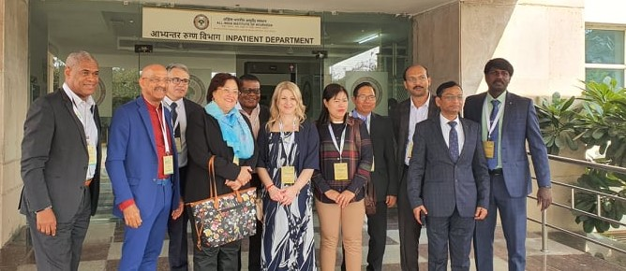
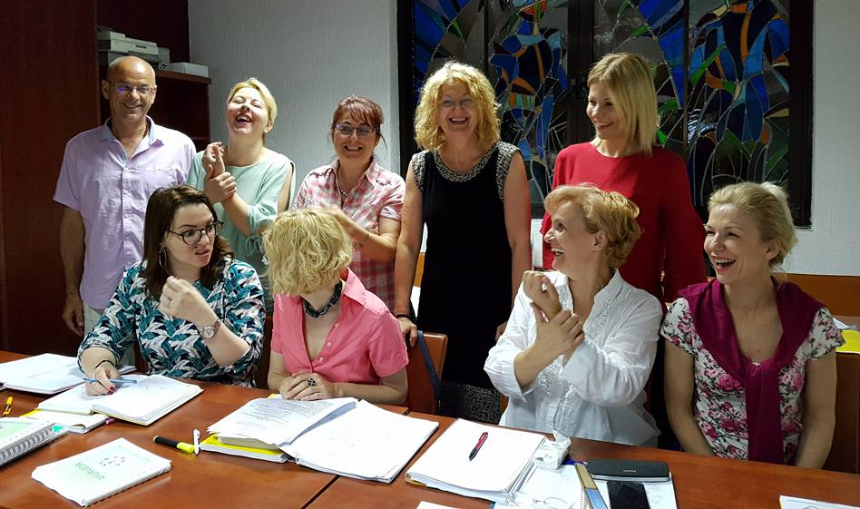
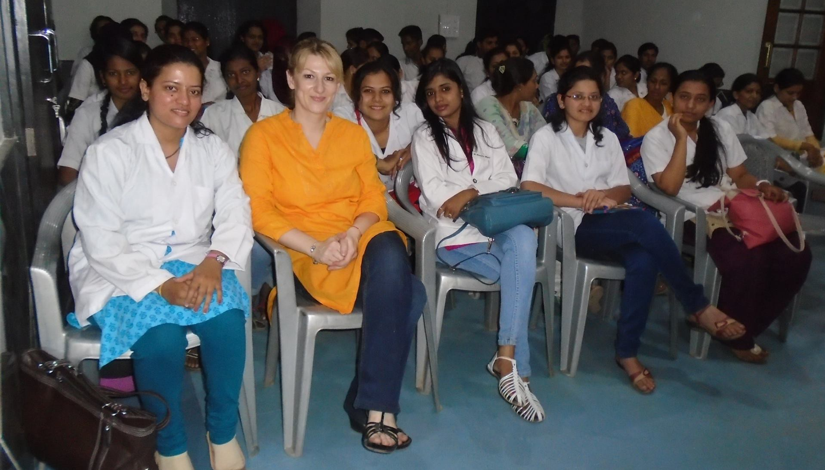
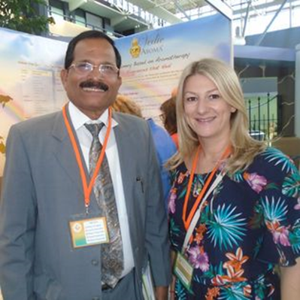
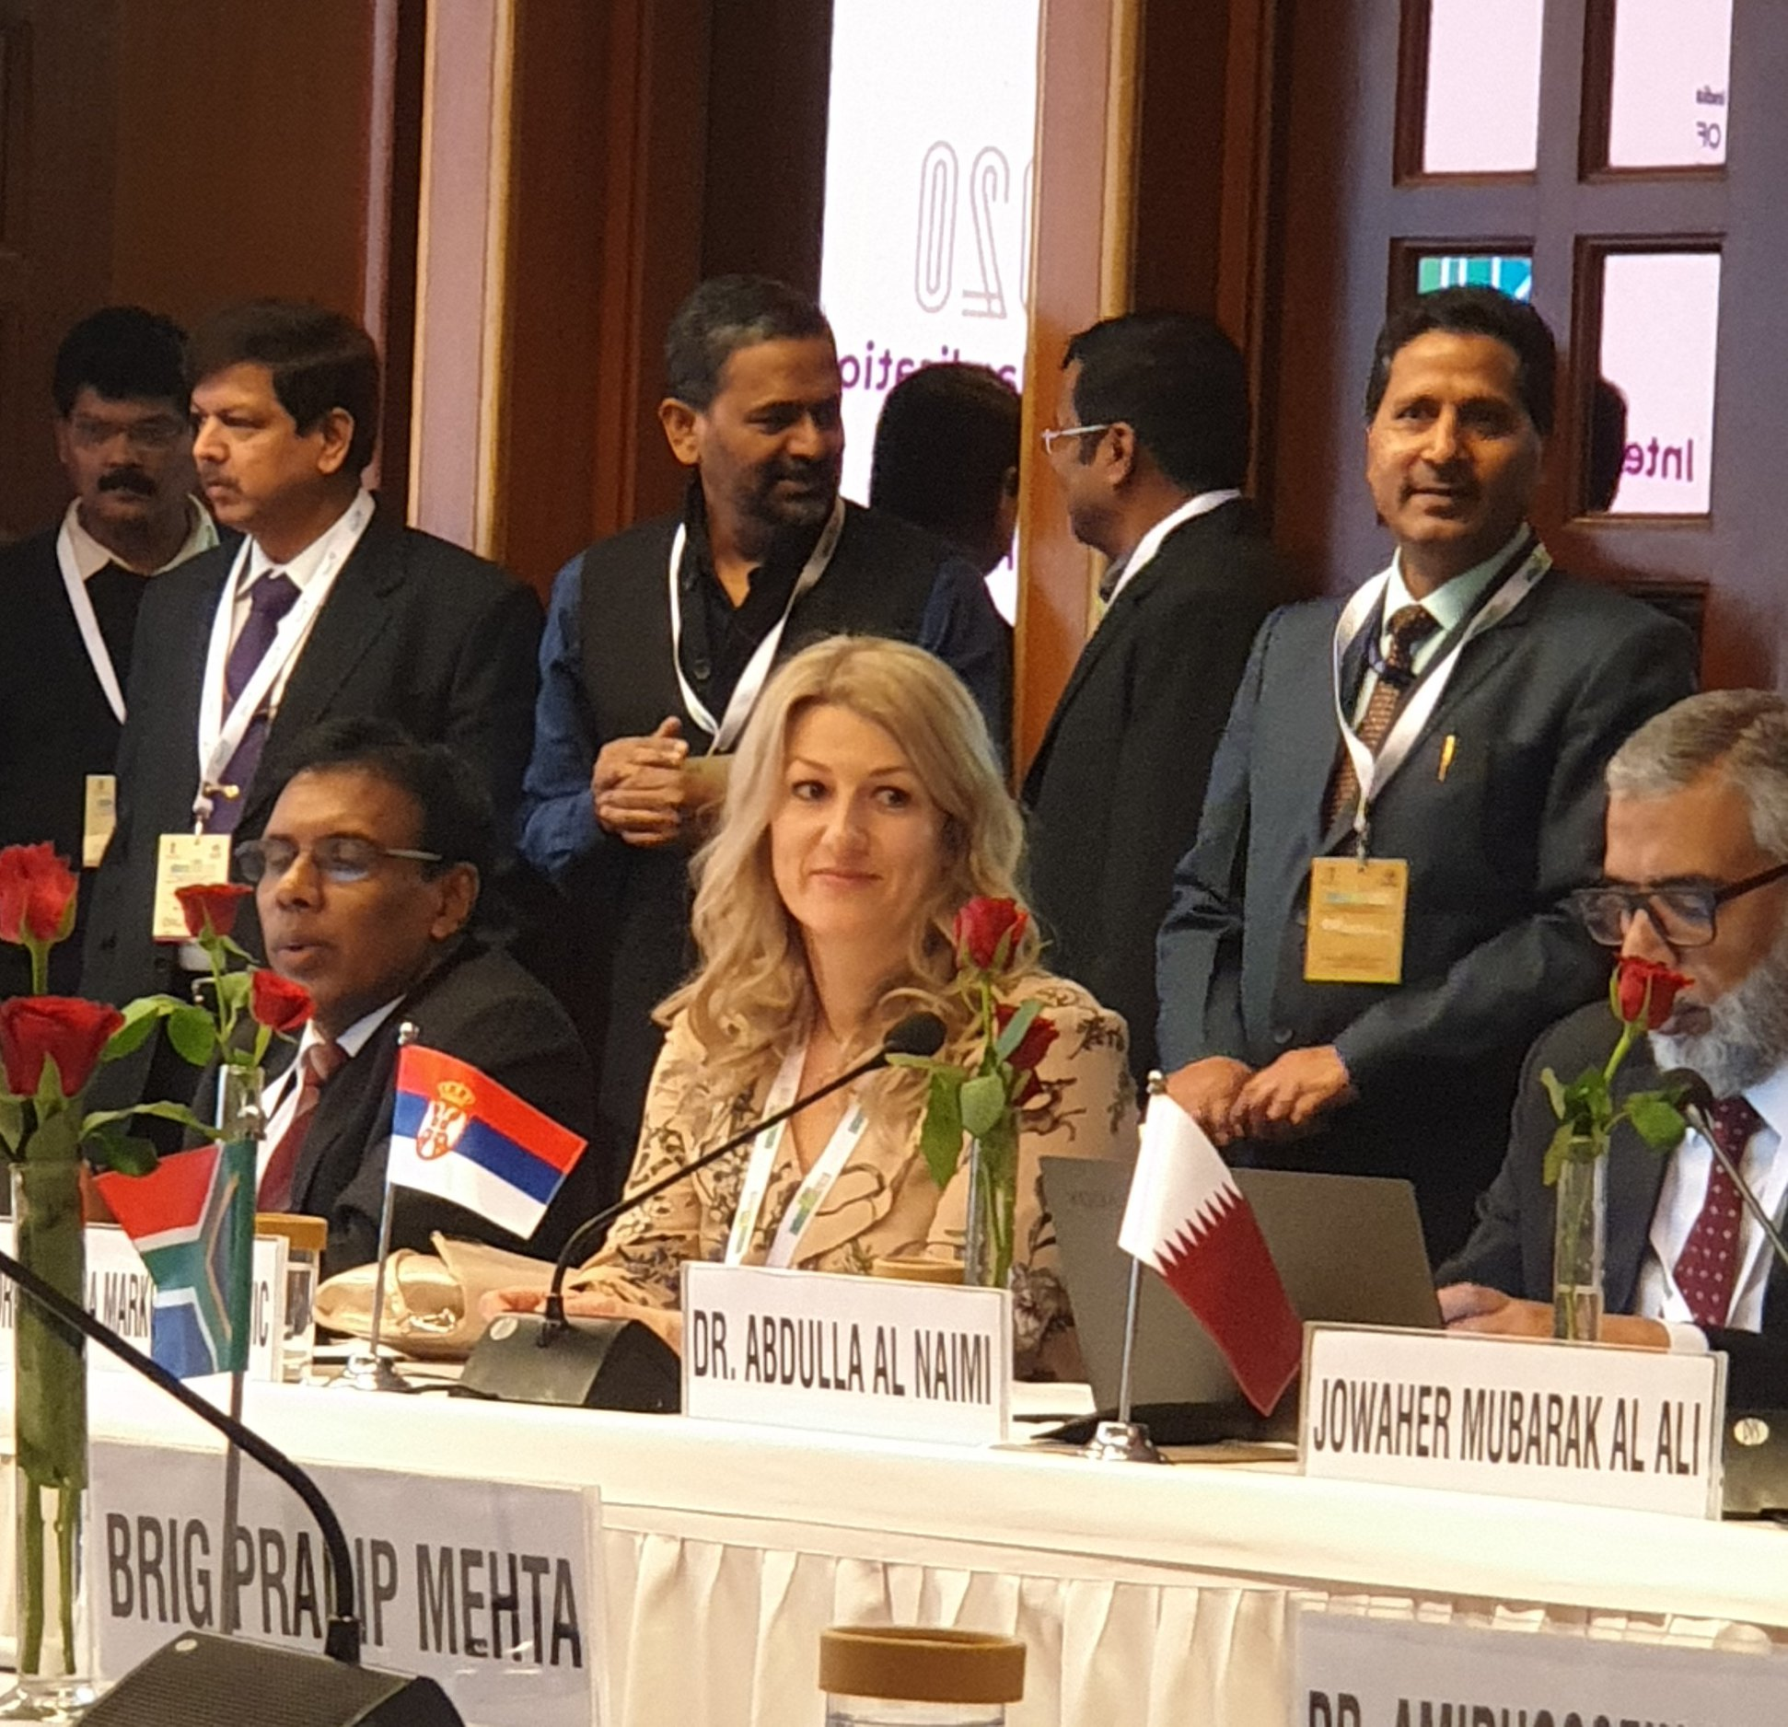
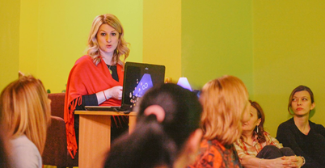
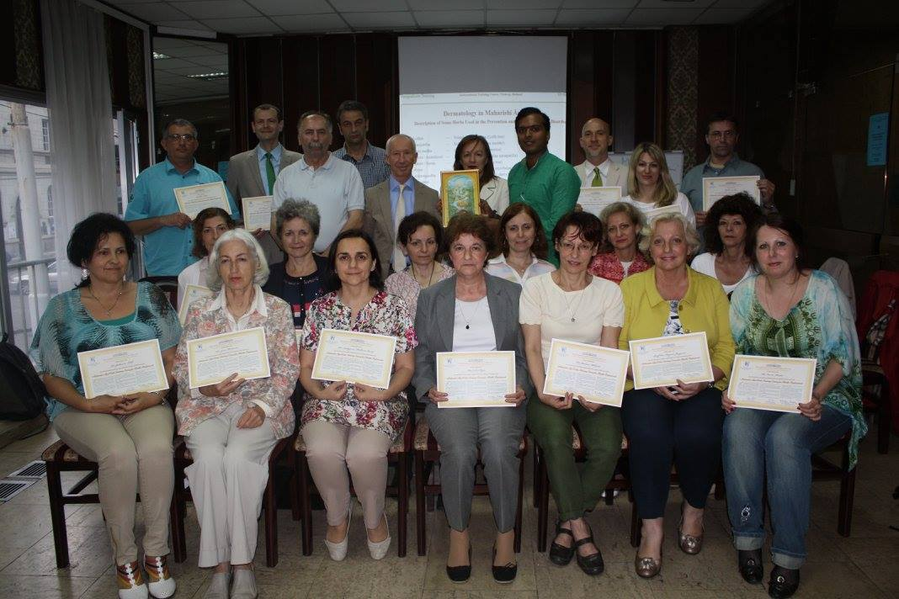
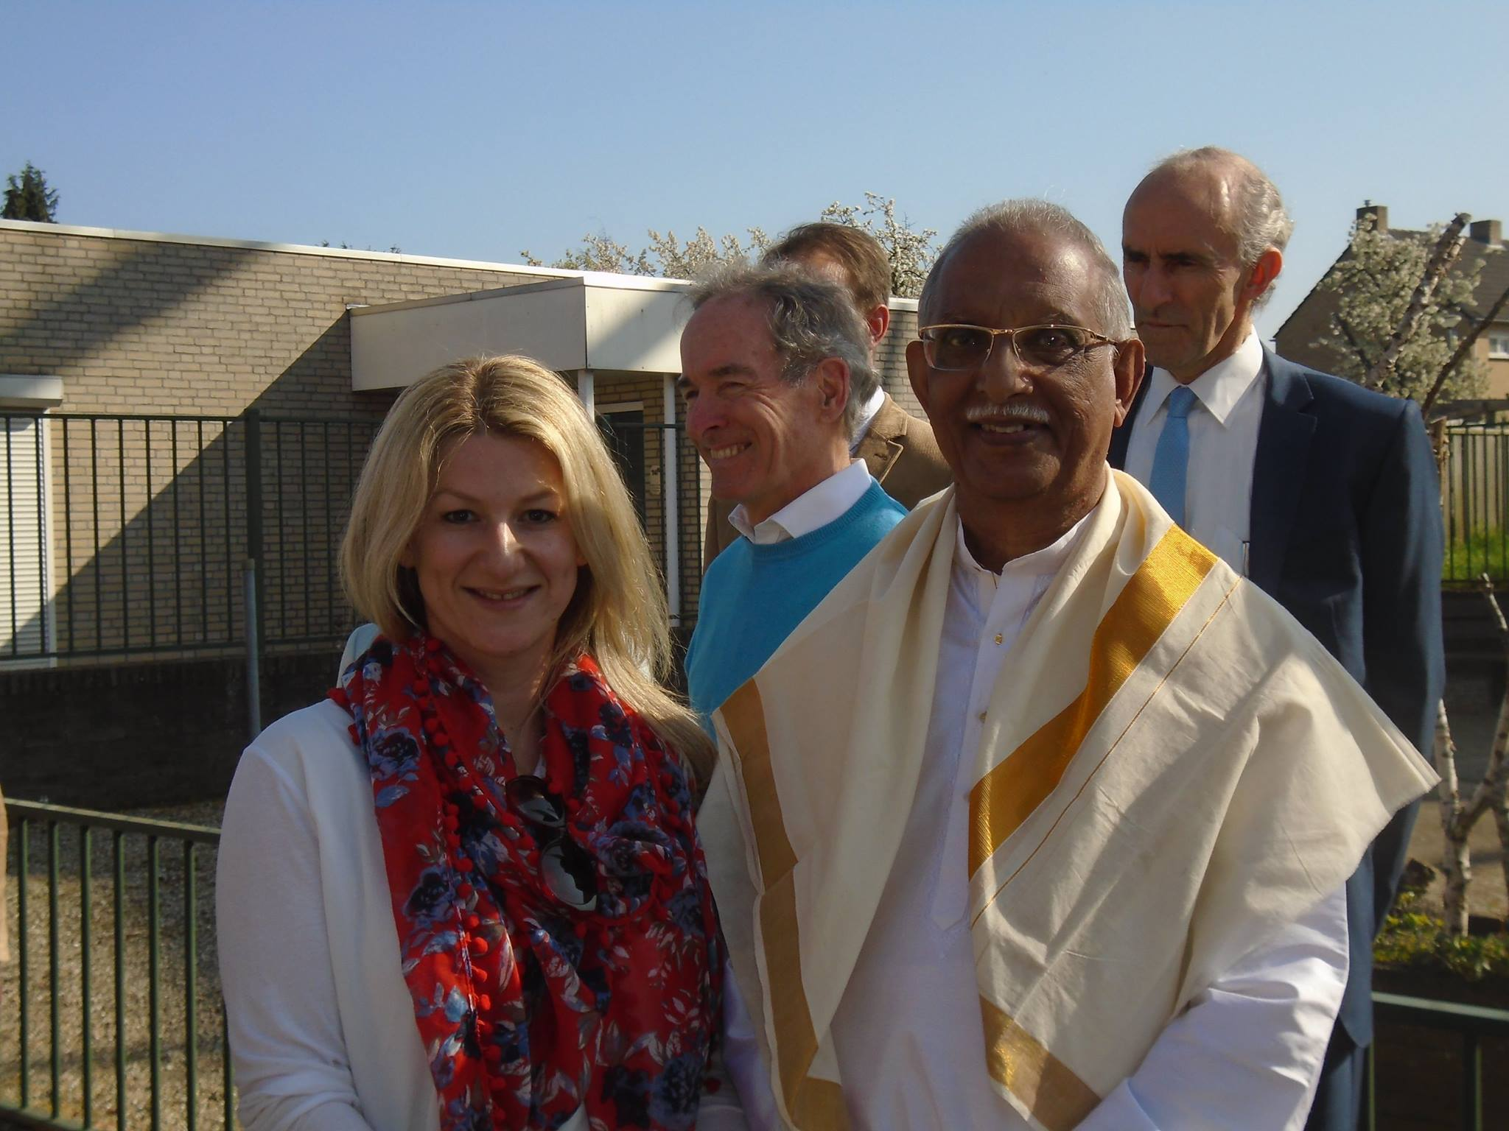
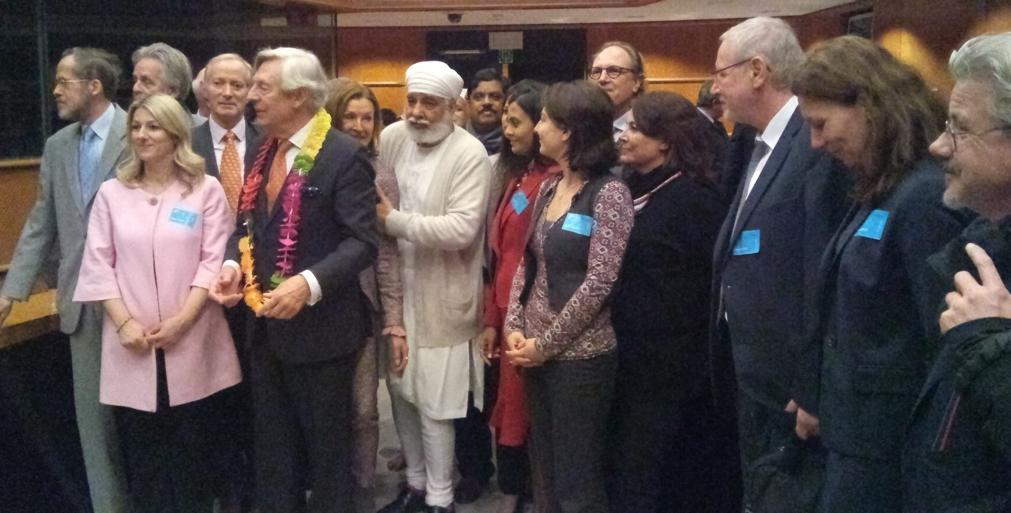

Slide 23
Thank you!

