Slide 1



Slide 2


Our mission
dedicated to propagating traditional yoga i.e. the essence of yoga as per the original teachings codified in the scriptures by Maharishi Patanjali.
HSTY’s mission is to promote a culture of yoga and make it accessible to all of mankind, beyond boundaries of country, religion, gender, class and wealth.

Slide 3
What sets HSTY apart?
In HSTY we do not look at yoga as exercise, but rather as a set of practices that help take one back to his/her original state.
HSTY’s yoga lessons are presented in the original form as it existed eons ago, with no change in form or presentation.
HSTY remains loyal to the original teachings marked by the simplicity and depth of practice.

Slide 4

Certification
HSTY is a Registered Yoga School with Yoga Alliance, the largest global association that represents the yoga community and sets global standards.
HSTY is an Associate Centre of the Indian Yoga Association, an industry body of leading yoga institutions of India that is also a self-regulatory body.

Slide 5
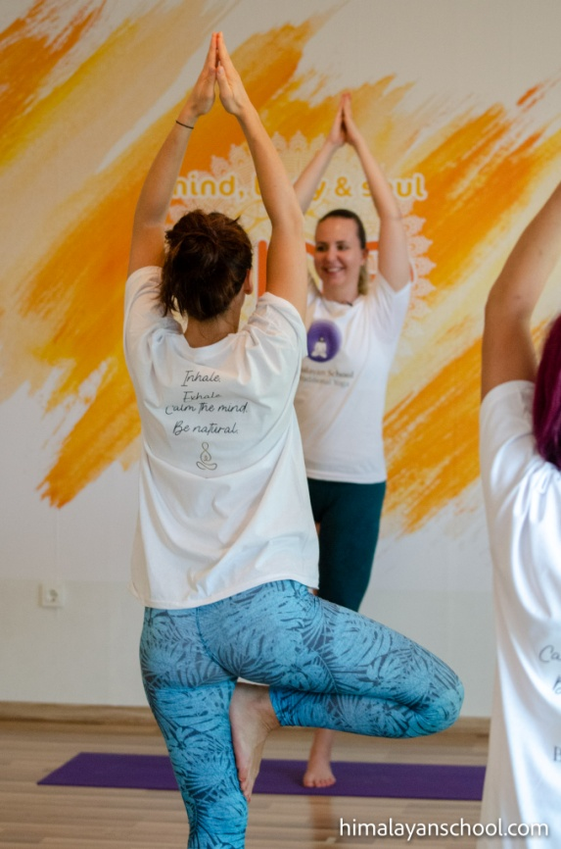
What we offer?
HSTY offers different yoga programs:
Teachers Training Courses
Yoga Programs For Beginners
Yoga Programs for advanced
Therapy-based yoga programs
Yoga Retreats
Online Yoga Courses
Pranayama Courses

Slide 6
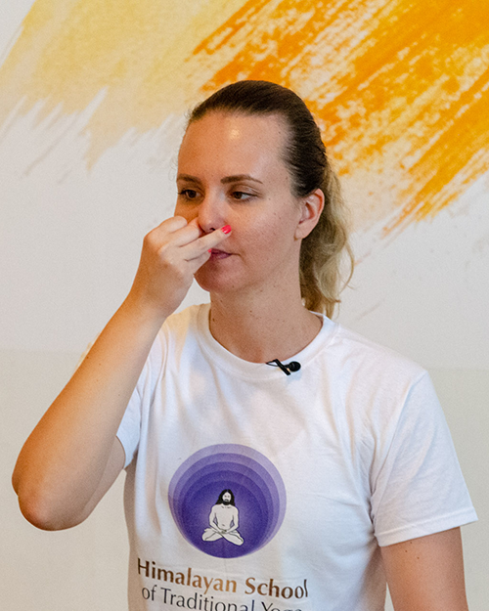
Pranayama
for boosting of the immune system
and respiratory organs
For thousands of years, great yogis have been using the power of breath to improve their physical, mental, and emotional well-being.
It has never been more important to benefit from these ancient secrets of effectively strengthening our immunity – in natural ways.

Slide 7
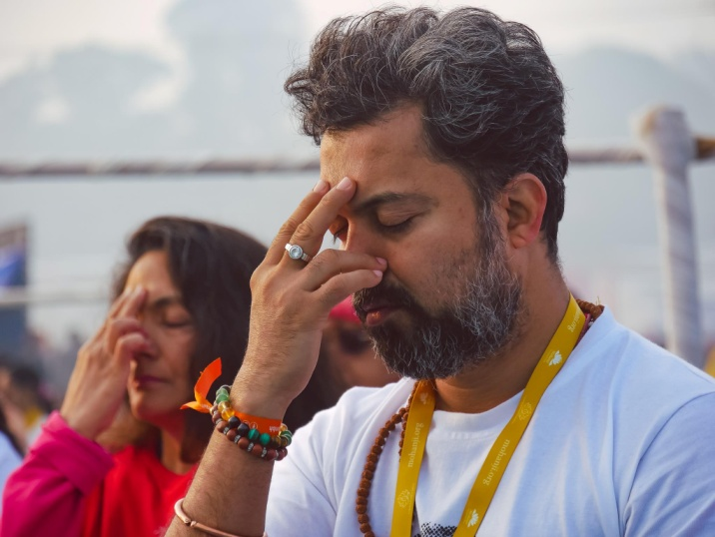
Pranayama
for boosting of the immune system
and respiratory organs
Smooth flow of energy through our subtle meridians is the key to health and inner harmony.
The one and only way in which we can affect the flow of energy through our physical and subtle bodies is through our breath.

Slide 8
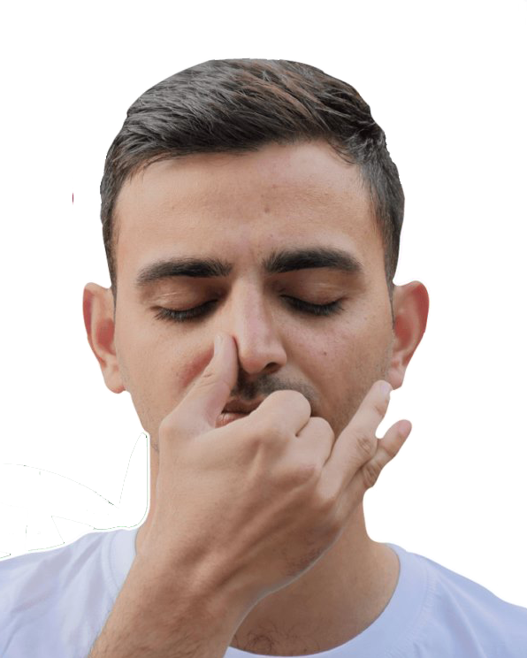
Benefits of pranayama:
Boosting of immune system & energy levels
Brain empowerment & better focus
Relief of stress, anxiety & depression
Deep & restorative sleep
Alignment & spiritual blossoming
Healing mind & body

Slide 9
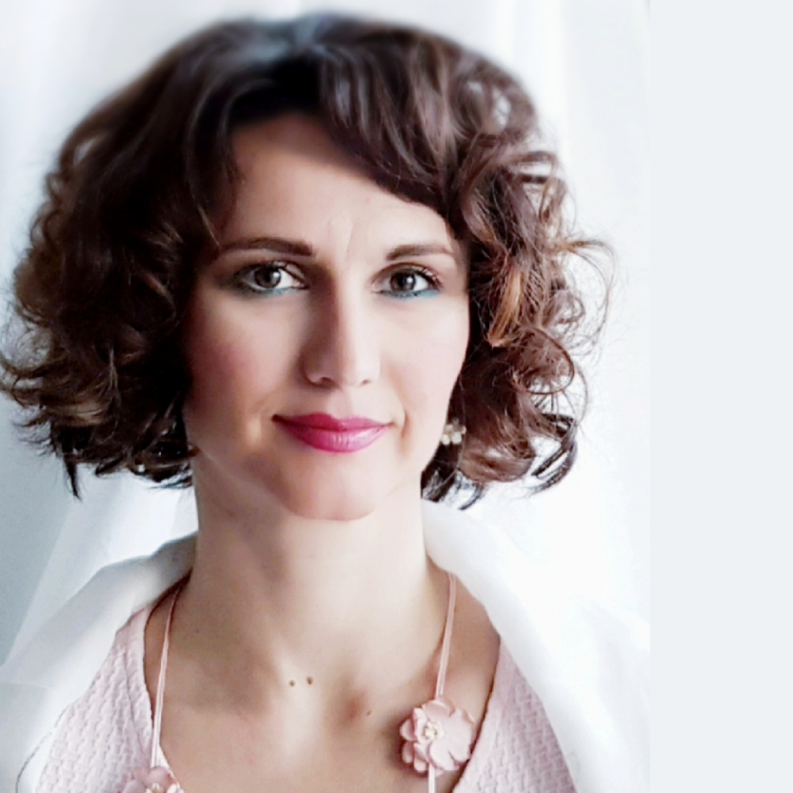
Devi Mohan
Director & Founding Member of HSTY
A core member and senior faculty member of HSTY. She is a certified Yoga Instructor (E-RYT)
Her Yoga training includes two Hatha Yoga certifications from India and one from the American Yoga Alliance.

Slide 10

Devi Mohan
Director & Founding Member of HSTY
Devi conducts yoga workshops and seminars internationally.
Devi stands for experiential spirituality, selfless service, holistic approach to health through energy healing, healthy lifestyle and sincere application of the wisdom and practices of the ancient science of Yoga in one’s life.

Slide 11
Thank you for your attention!
Web: himalayanschool.com Facebook: HSTY.yoga

