Slide 1
Ayurveda u sportu
Ayurveda in the field of sports
Inga Poje, dr.med.spec.sport.med.

Slide 2
Osnovni pojmovi i veza Basic terms & connection
ayurveda
sportska medicina
veza:
određivanje konstitucije u sportu i ayurvedi
ayurveda
sport medicine
connection:
constitution setting in sport and ayurveda

Slide 3
Konstitucija Constitution
Sportska medicina Sports medicine
područje morfološke antropometrije
dimenzije tijela: 10 područja uz antropometrijski pribor
somatograf / somatotipovi
morfologic anthropometry area
body dimensions: 10 areas with anthropometric equipment
somatograph / somatotypes

Slide 4
Sportska medicina Sports medicine
timska procjena različitih utjecaja (trener, psiholog, nutricionist...)
testiranje funkcionalnih sposobnosti tijela (tjelesni parametri)
= dugotrajno i skupo!
tim assessment of various impacts (coach, psychologist, nutritionist...)
testing of body functions (body parameters)
= long lasting and expensive!

Slide 5
Konstitucija Constitution
Ayurveda Ayurveda
holistički pristup određivanju konstitucijskih tipova
procjena na osnovu:
upitnika samoprocjene (mentalni profil, sportski profil, profil ponašanja, tjelesni profil) = vikriti
holistic approach in constitutional types setting
based on:
self-assessment questionnaire (mental profile, sports profile, behaviour profile, body profile) = vikriti

Slide 6
Konstitucija Constitution
Ayurveda Ayurveda
puls dijagnostika
određivanje urođene konstitucije = prakriti
Ayurvedska tipologija:
vata
pitta
kapha
pulse diagnostic
setting of native / congenital constitution = prakriti
Ayurvedic typology:
vata
pitta
kapha

Slide 7

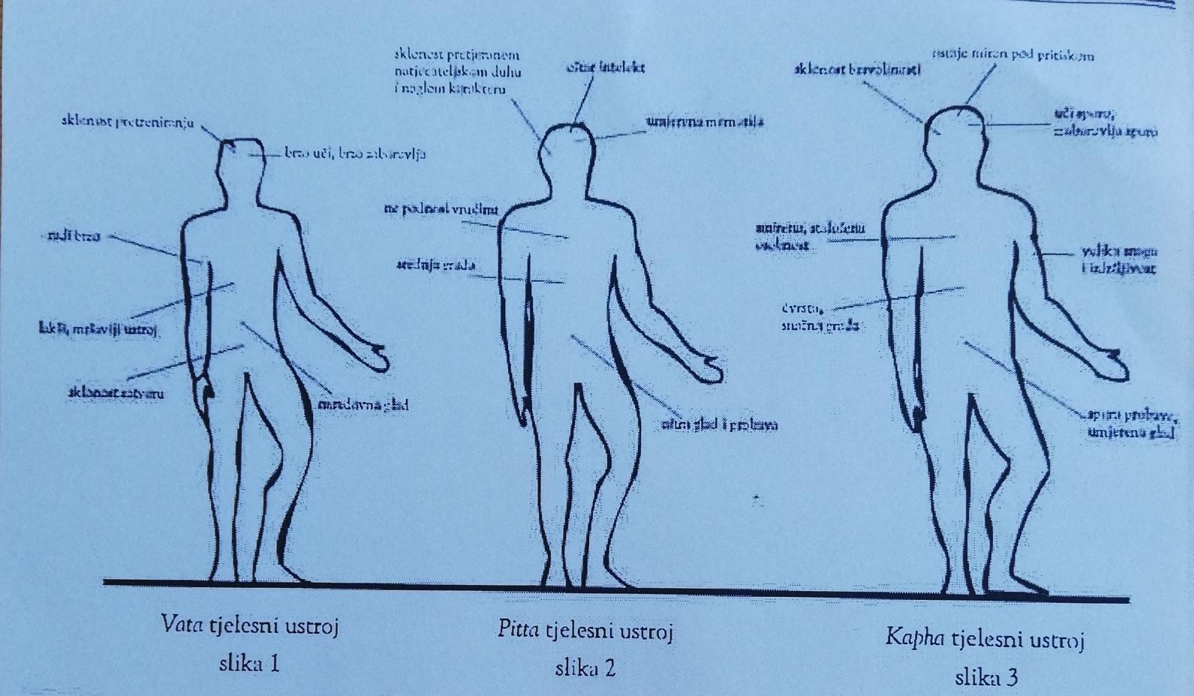
Konstitucija Constitution
Ayurveda Ayurveda

Slide 8
Konstitucija Constitution
Ayurveda Ayurveda
prema tipu se određuje:
vrsta sporta
dnevni termini treninga
sezonske promjene u bavljenju sportom
dnevna rutina prema tipu
odabir ulja za masažu
type specifies:
type of sport
daily training time
seasonal variance in types of sport
daily routine according to type
massage oil selection

Slide 9
Ayurveda Ayurveda
cheaper analysis
shorter assesment duration
leads to taking over self-responsibility in everyday life / trainig according to body type
jeftinija analiza
potrebno kraće vrijeme procjene
vodi preuzimanju odgovornosti pojedinca za svakodnevni život / trening u skladu sa svojim tjelesnim tipom

Slide 10
Zapadna medicina Traditional medicine
treninzi koji aktiviraju simpatikus
srednje jaka do visoka razina treninga
bitan cilj
nemogućnost punog oporavka između treninga
puno oštećenja zdravlja
A
trainings activates simpaticus
middle to strong training level
goal oriented
imposibility of full recovery between trainigs
lots of health damages

Slide 11
Ayurveda Ayurveda
treninzi koji aktiviraju parasimpatikus
= ulazak u „zonu”
bitan proces
slušaju se poruke tijela
vodi se računa o oporavku tijekom treninga
trainings activate parasimpaticus
= entering „the zone”
process oriented
listening to body messages
importance of recovery between trainigs

Slide 12
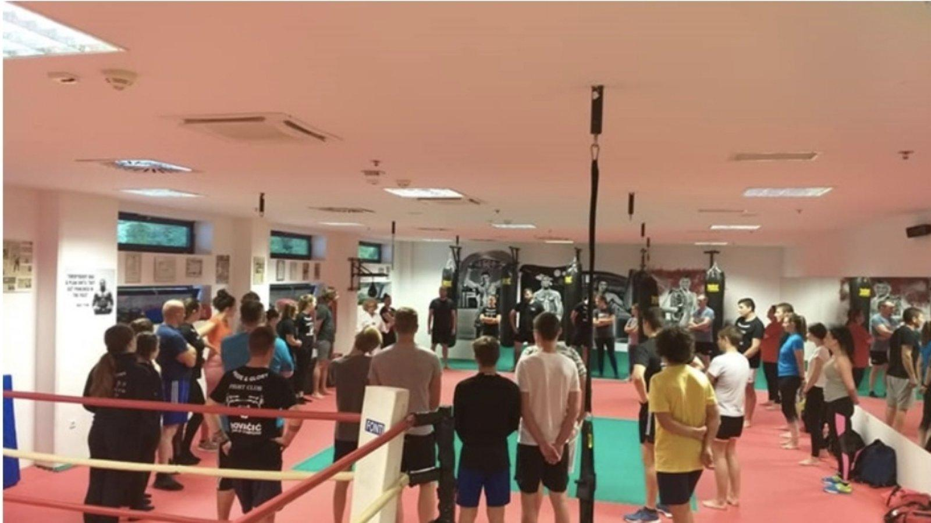
Iskustvo Experience

Slide 13
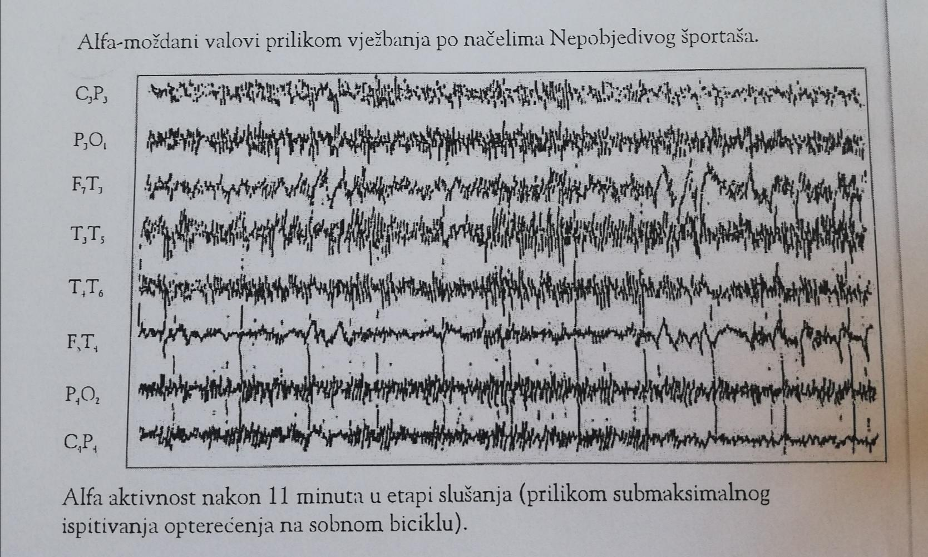
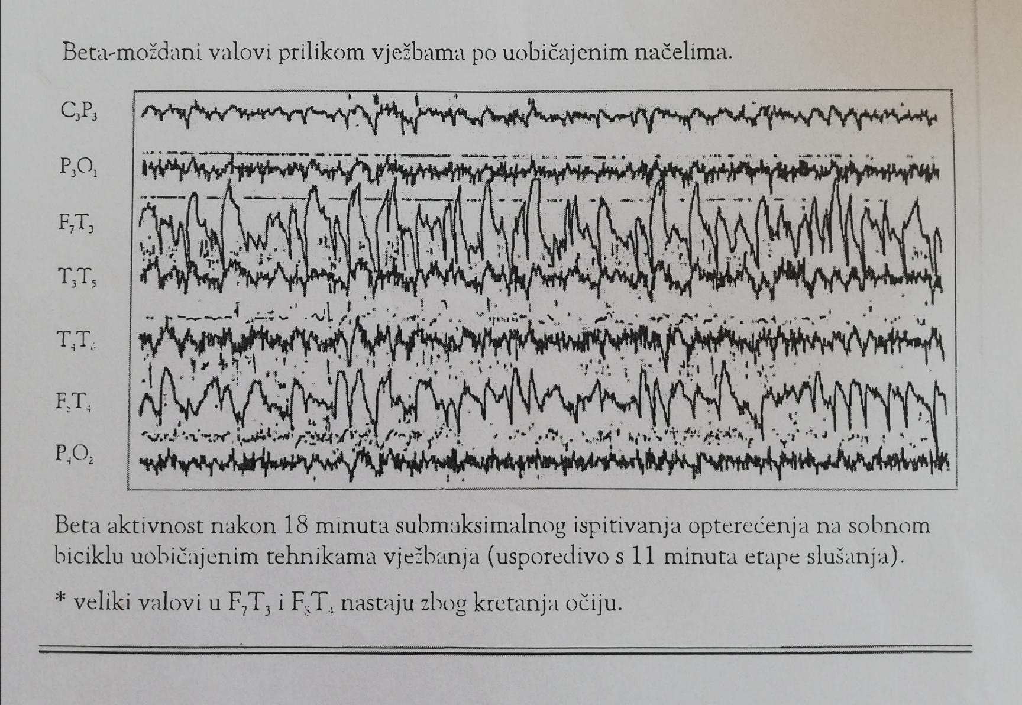
Ayurveda vs. Traditional medicine brain waves

Slide 14

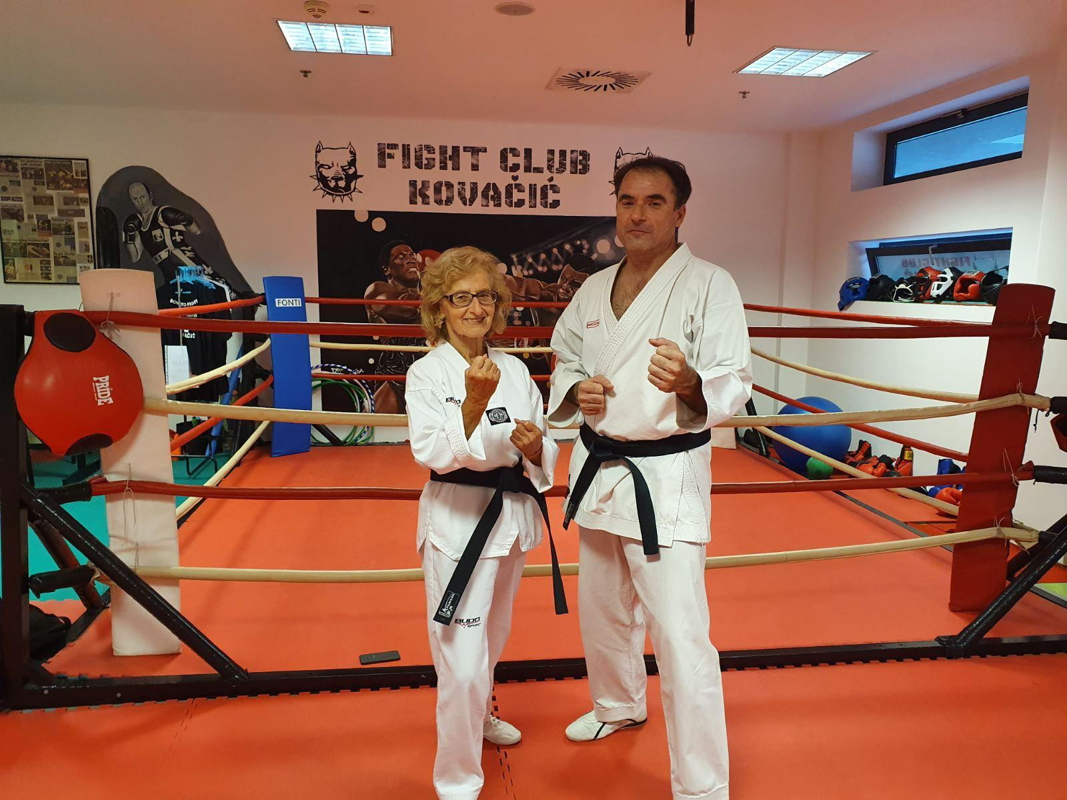
Thank you!

