Slide 1
SPORTS REHABILITATION THROUGH AYURVEDA AND YOGA
Jadranko Miklec

Slide 2
YOGA AND AYURVEDA THERAPY

Slide 3
ABILITY OF MOVEMENT (VAYU), LIFE IS CHARACTERISED BY MOVEMENT.

Slide 4
FITNESS: MASTERING ABILITY OF MOVEMENT TO IMPROVE QUALITY OF LIFE:
HEALTH, HAPPYNESS AND FINALY SELF REALISATION

Slide 5
AKASHA: BAHYA AKASHA – ANTAR AKASHA

Slide 6
HOLISTIC APROACH TO FITNESS THROUGH YOGA

Slide 7
FITNESS IN RELATION TO BAHYA AKASHA – OBJECTIVE KNOWLEDGE, CONNECTING WITH OUTER FIELD OF LIFE, USE OF 5 SENSES
ACHIEVEMENT OF SOME OUTSIDE GOAL,
SPORT RESULTS.

Slide 8
FITNESS IN RELATION TO ANTAR AKASHA – SUBJECTIVE KNOWLEDGE, CONNECTING WITH INNER FIELD OF LIFE, USE OF PROPRIOCEPTION
NO OUTER GOAL, ACHIEVENT OF CONNECTION WITH THE SELF

Slide 9
HOLISTIC APROACH TO FITNESS THROUGH YOGA
FITNESS IN RELATION TO BAHYA AKASHA – OBJECTIVE KNOWLEDGE, CONNECTING WITH OUTER FIELD OF LIFE, USE OF 5 SENSES
ACHIEVEMENT OF SOME OUTSIDE GOAL, SPORT RESULTS.
FITNESS IN RELATION TO ANTAR AKASHA – SUBJECTIVE KNOWLEDGE, CONNECTING WITH INNER FIELD OF LIFE, USE OF PROPRIOCEPTION
NO OUTER GOAL, ACHIEVENT OF CONNECTION WITH THE SELF

Slide 10
MASTERING INNER TO IMPROVE OUTER

Slide 11
YOGA OF THE LIMBS
YOGA AS A SPORT, FITNESS YOGA

Slide 12
YOGA OF THE TORSO – YOGA FOR WHOLE LIFE AND HOLISTIC FITNESS

Slide 13
VYAYAM – DEVELOPING STRENGTH, FLEXIBILITY, ENDURANCE, HEALTH, MIND-BODY COORDINATION

Slide 14
THREE POSSIBLE STATES OF MUSCLES: TONIC, HYPERTONIC AND HYPOTONIC

Slide 15
FORMULA FOR MUSCLE EFFICIENCY: W = F x S Work (power) is force (strength) of the muscle multiplied with distance between contracted and relaxed state of the muscle.

Slide 16
ASANAS FOR ACHIEVING TONIC CONDITION OF MUSCLES BY MASTERING INTERNAL MOVEMENTS (PRANA VAYU AND APANA VAYU – NON LINEAR ACTIVITY). INNER MOVEMENT IS DIFFERENT BY NATURE THAN OUTSIDE MOVEMENTS.

Slide 17
YOGA FULFILS NEED TO GAIN PROPER EDUCATION OF INNER MOVEMENTS.
MASTERING INNER MOVEMENTS WILL ENHANCE EFFICIENCY OF OUTER MOVEMENTS.

Slide 18
ACHIEVEMENT OF THE STATE OF ZONE (SAMPRAJNATA SAMADHI)
IMPROVES RESULTS IN FITNESS AND SPORT.

Slide 19
FEW EXAMPLES OF TOP SPORTSMANS WHO USE YOGA TO IMPROVE THEIR PERFORMANCE

Slide 20
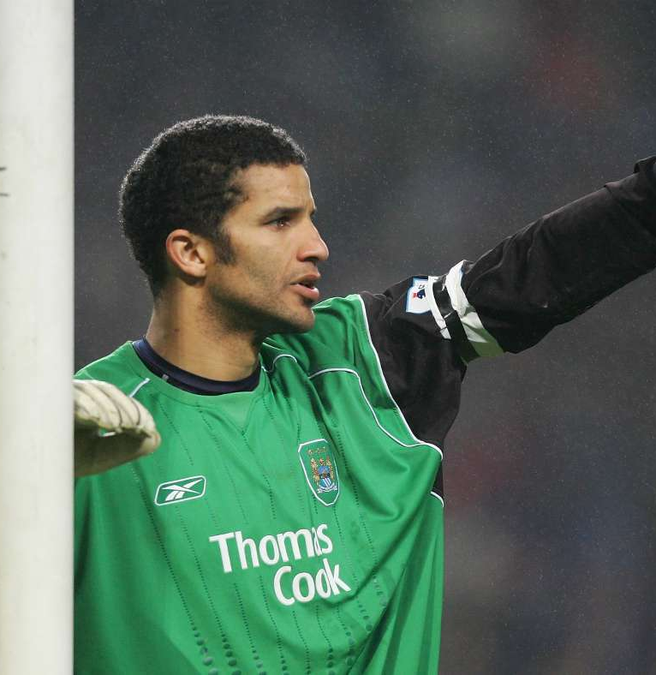
David James, English goalkeeper
„I came to yoga as part of my rehabilitation process but quickly saw the benefit of an ongoing practice. I now have regular sessions to keep my muscles flexible, my body aligned and my mind free from stress. “

Slide 21
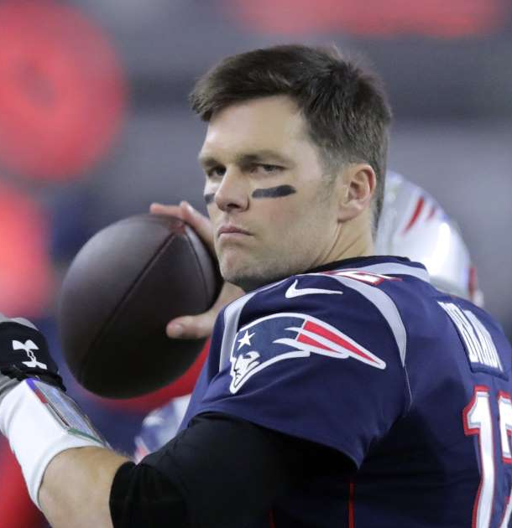
Ted Johnson American football player
Ted Johnson prepares for playing in front of 60,000 fans by doing yoga.
Ted started yoga as injuries had affected flexibility in his upper body. He now finds he is more centered and able to make fast decisions with greater clarity.

Slide 22
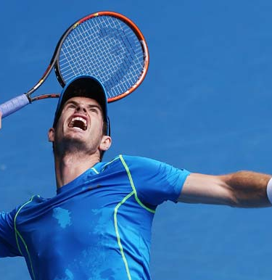
Andy Murray, British tennis player no1
Andy Murray was introduced to yoga by his new fitness trainers Jez Green and Matt Little.
„It has helped me a lot with my fitness and my mental strength...“

Slide 23
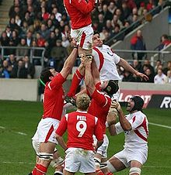
Welsh National Rugby Team
Took up yoga as part of their World Cup preparations. Fitness coach Andy Hore signed up the entire 55-man squad for weekly lessons to improve the players' kicking ability, speed and power.

Slide 24
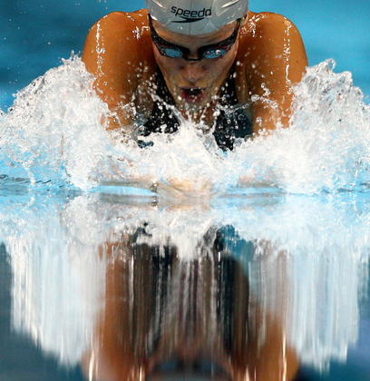
Keri Hehn, US Olympic Swimmer:
„I do have to say, the day after I do yoga I swim so much faster because my muscles are loose and I am not as sore... I would definitely recommend yoga to any athlete that wants an extra edge by learning about their body!”

Slide 25
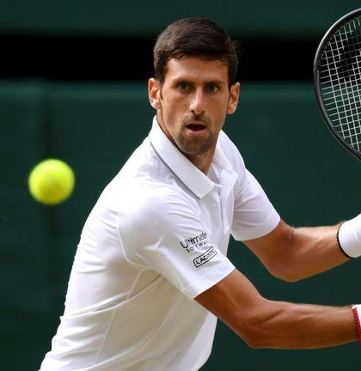
Novak Đoković, World Tennis no1
„ Yoga is very useful. In my profession there is a lot of anxiousness. We need to relax, release stress and achieve balance. Yoga practice helps us to unite mind and body, to create balance. Purpose of yoga is to relax and find inner peace. I learned yoga on one island where I was on vacation. If you practice yoga and meditation for one hour early morning and evening, easily you become World champion.“ – Yoga and Fitness magazine, February 2009 Beograd.
https://www.youtube.com/watch?v=aZWCUCgZspc

Slide 26
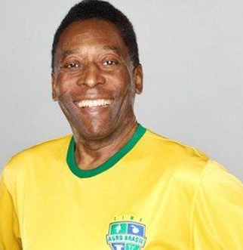
Edson Arantes do Nascimento known as Pele
World famous football player in his autobiography „My Life and the Beautiful Game“ described his experience of ZONE as a feeling of enormous peace mixed with some kind of bliss, and that he could run the whole day without tiredness. He was feeling invincible and able to move between opponent football players without effort.

Slide 27
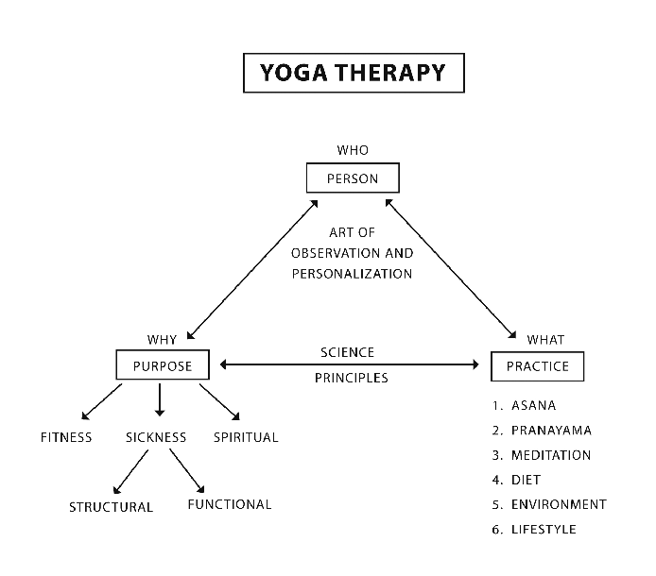

Slide 28
Yoga and Ayurveda programs counterbalance the negative effects of sports.
Today highly trained children in sports and athletics can experience physical problems in later life.

Slide 29
Studies on sports and exercise have shown
that physical exercise, performed in a balanced,
recreational way, can help to reduce stress levels
in the brain.
It does this mainly by encouraging the release of
endorphins,the body's natural painkillers,
which enable us to overcome stress.

Slide 30
Muscle tears, hip diseases, achilles tendon pain,
torn hamstrings, are all conditions resulting from
overuse of a very small group of muscles.
In later life, these injuries can lead to rheumatism,
arthritis, gout, and the need for hip replacement
operations.
Far from making people fit, modern,
competitive sports programs tend to “unfit” them
for later years.

Slide 31
Pressure, expectations, and getting excited about
winning in competitive sports,causes increased
stress and leads to hyperventilation.
The cure for the problem of hyperventilation is to
learn a proper yogic breathing technique
- ujjayi breathing

Slide 32
Exercises recommended by Yoga and
Ayurveda can release pent up emotions
and stresses which have led to the problem
of chronic hyperventilation

Slide 33
By applying principles of Yoga and Ayurveda
to sports, one will enjoy athletic activities
Throughout one's life, stays healthy and fit,
and also achieves better
results in competitions.

