Slide 1
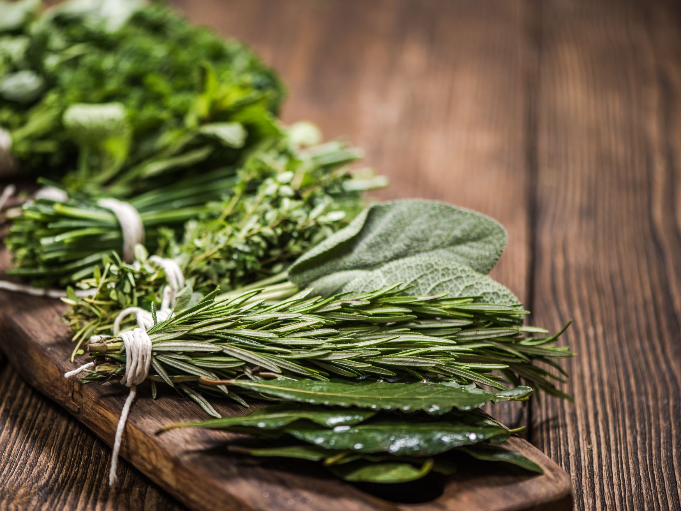
From herb to herbal preparation
Steps behind the final herbal product
Lejsa Jakupović; mag. pharm
Research assistant at Department of Pharmacognosy| Faculty of Pharmacy and Biochemistry

Slide 2
Let us start… ☺
Respiratory infections
Symptoms: sore cough, pain in the chest, headache, fever, heavy breathing, rhinitis …
Cause of the infections – viruses and bacterias
Well known infections flu (Influenza) or the latest COVID-19
How can the herbal preparation help with the respiratory infection?

Slide 3
Ayurveda's herbs located in Croatia and used in the treatment of the mild respiratory infections
Ayurveda and Croatian traditional medicine
Mediterranean area – area full of Lamiaceae species used in alternative medicine such as Ayurveda or traditional Western alternative medicine
Lamiaceae - plant family with herbal species enriched with essential oil
Essential oil – important ingredient with powerfull therapeutic effect against (respiratory) infections
Thymus vulgaris
Oregano vulgaris
Lavender officinalis

Slide 4
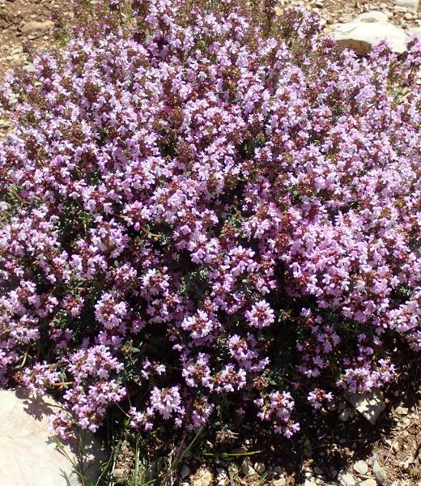
Thymus vulgaris L. – Thymi aetheroleum
Small bush, with small leaves and pink flowers
Location: wild herb grows at dry and sunny places in rocky terrain
Main ingredient: essential oil
Extraction: steam distillation of fresh or dried herb, harvested in the beginning of flowering season
Use: antibacterial and antiviral properties
Acute bronhitis, sore cough, chest infection
Inhalation

Slide 5
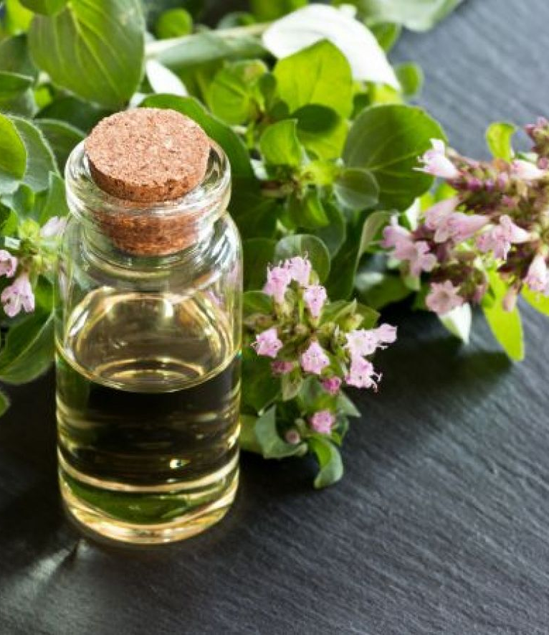
Origanum vulgare L. – Origani vulgaris aetheroleum
Bush with big oval leaves with red-pink flowers
Location: wild herb in woods and meadows
Main ingredient: essential oil
Steam distillation of fresh or dried herb
Use: antibacterial and antiviral properties
External use: diluted and mixed with some base oil (almond oil)
Internal use: max 3 oil drops and encapsulated and dilluted in gelatine for 3 days
Conditions: digestive problems, respiratory infections

Slide 6
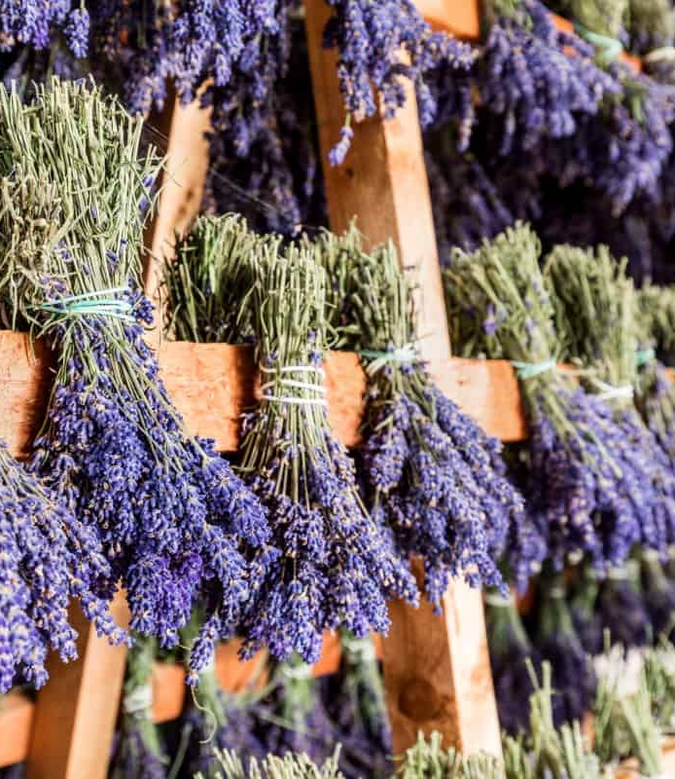
Lavandula angustifolia L. – Lavandulae aetheroleum
Perennial short bush with many shoots. Young leaves are hairy, long and thin. Flowers are blue-violet with intense smell
Location: Mediterranean area, dry and sunny rocky terrain
Main ingredient – essential oil
Steam distillation of fresh or dried flowers
External use for relaxation, anti-inflammatory, antiviral, antiseptic
Inhalations and topical preparations

Slide 7
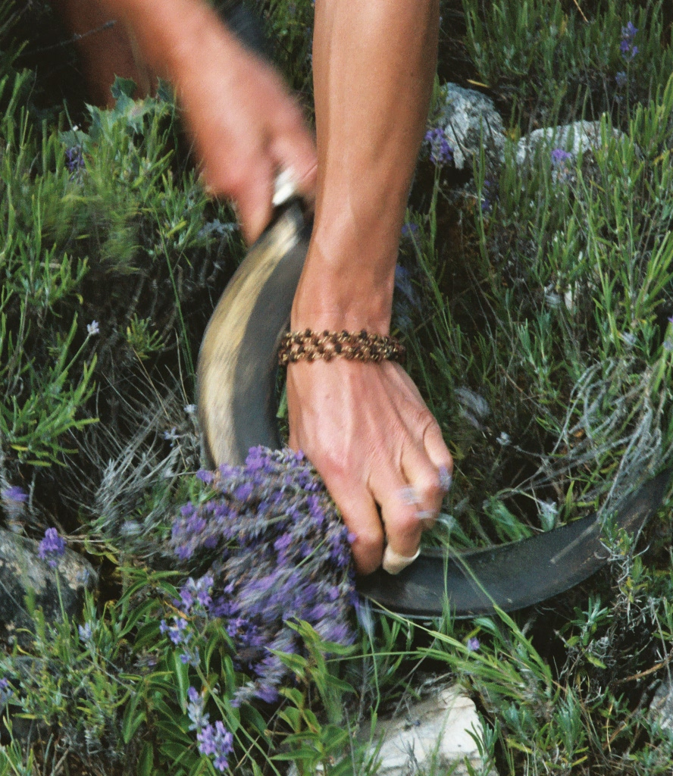
From herb to preparation
Location – Recognising – collecting
Drying (few days in the dark and dry place, at the room temperature)
Separation of plant parts – flowers, leaves, roots etc
Use of specific plant part for extraction of the bioactive compounds such as essential oils
Example: Extraction of essential oil – steam distillation
Checking the quality of the herb by measuring the amount of essential oil (ml/kg)
Preparing the final product with essential oil
Using the herbal preparation

Slide 8
Steam distillation of Lavender flowers to extract essential oil

Slide 9
Prescription for homemade massage oil for mild respiratory infection
Symptoms: sore cough, fever, chest pain, rhinitis
Ingredients:
Sweet Almond oil – base – carrier - 5g
Thymi aetheroleum drops 2-3
Lavandulae aetheroleum drops 2-3
Mixed together with the base oil in the mortar
Prepared massage oil applies on the chest several times per day during the cold or flu (2-3 days)
Effects: antiviral, relaxation, anti-inflamatory

Slide 10
Conclution
To prepare a herbal preparation there are many steps
Knowing and recognising the herb
Finding it and harvesting
Processing the herb: drying, isolating the main active compounds (extraction, distillation etc); preparing the final product from it
Use of the herbal preparation for better cause

Slide 11
Thank you for your attention.

