Slide 1
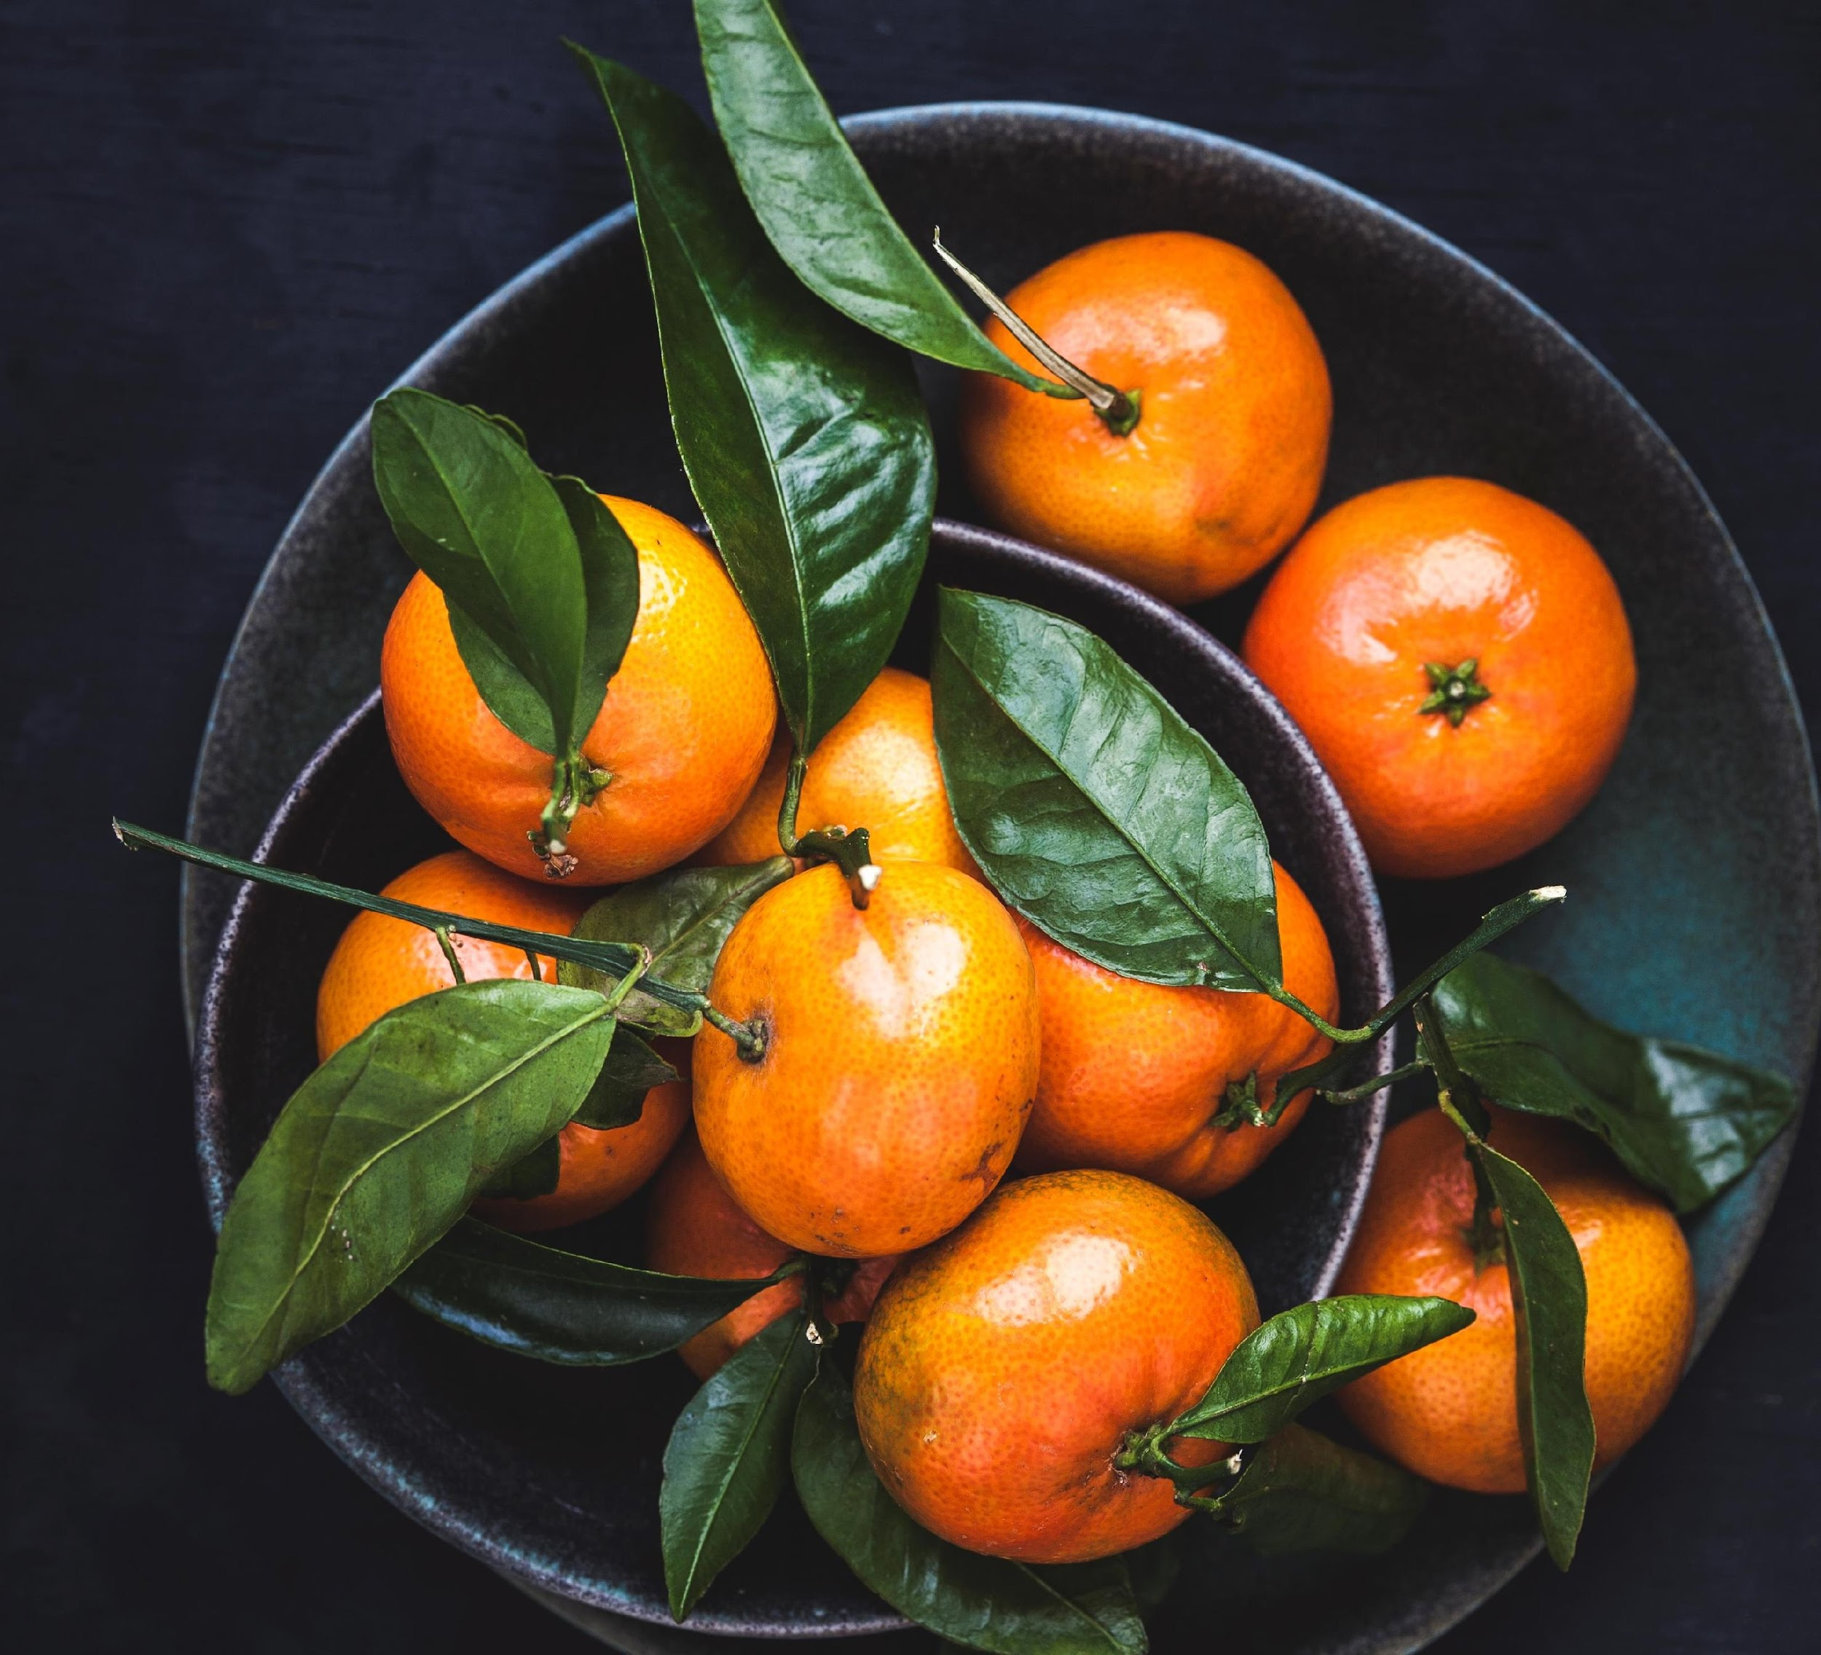
HEALING POWER OF FOOD
DT. DEEPTA NAGPAL
- FOUNDER, BEYOND KILOS & INCHES
- CO-FOUNDER, IFITTIN

Slide 2
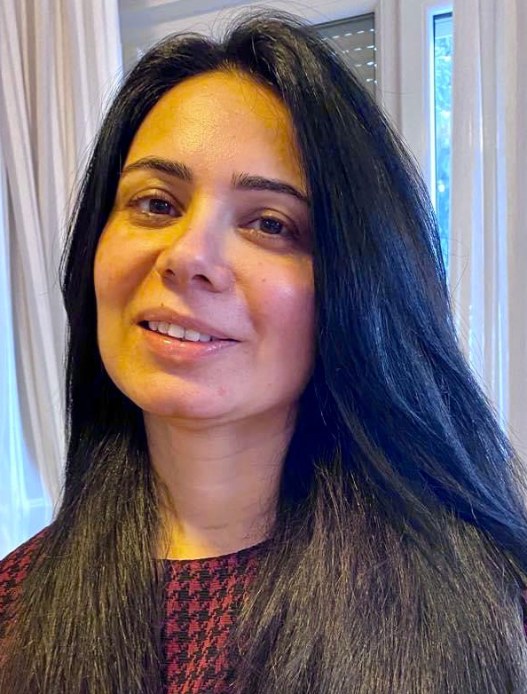
DT. DEEPTA NAGPAL
A Clinical Dietitian with specialization in chronic disorders and a University Double Gold Medalist, Deepta Nagpal served as the Diet Counselor to the President of India (Late Dr. A.P.J. Abdul Kalam), International Athletes, Senior Army Officers and Corporate Executive Leaders. She has worked with various elite Indian Hospitals including AIIMS, New Delhi; PGIMER, Chandigarh; Army Research & Referral Hospital, New Delhi during her career spanning 15+ years. She has been associated with various educational institutes in India and Europe, spreading awareness about food & nutrition.
She is the founder and chief dietitian of ‘Beyond Kilos & Inches’ and co-founder of iFITTIN. She is currently based in Croatia. She believes in Mindfulness, Macrobiotic diet and Ayurveda and tries to implement their principles into her patients' modern lifestyle.

Slide 3
HEALING POWERS OF FOOD
Human Body is a self healing machine.
We can bio-hack our health. We can arrest, prevent and cure diseases by doing certain things.
Remove the causes – Allergens, Poor Diet, Toxins, Stress, etc.
Add ingredients – Real Food, Sleep, Restoration, Exercise, Community, etc.
Healing powers of food are well recorded since Charak Samhita; mentioned by Hippocrates of Greece and in traditional Chinese medicine.

Slide 4
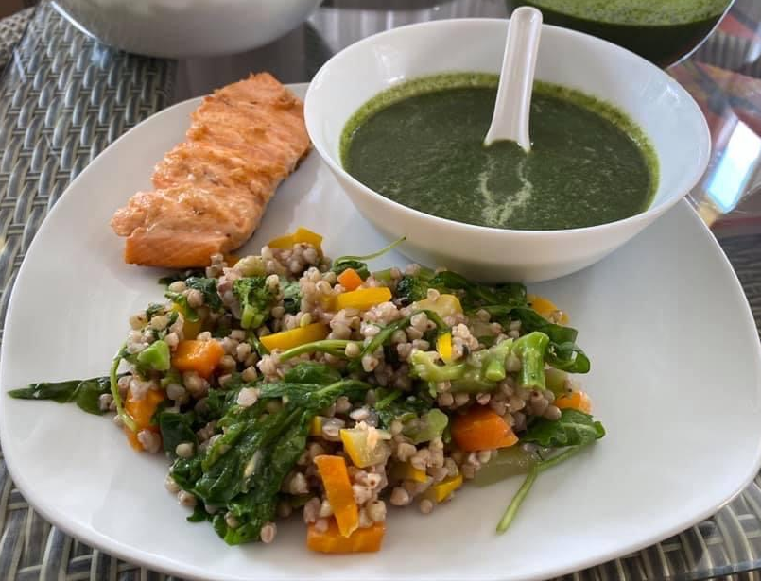
FOOD IS THE MOST POWERFUL DRUG
Optimize Hormones
Improves gene expressions
Strengthen immune systems
Optimize protein networks
Diversify gut flora
Replenish and Rejuvenate cells
Optimizes Metabolism
There is plenty of evidence around it. I see this in my daily practice with my patients.

Slide 5
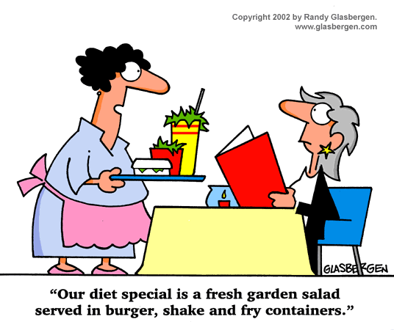
OUR RELATIONSHIP WITH FOOD IN MODERN WORLD
Calories
Fasting or Feasting
Fad Diets
Convenient and Ready-to-eat foods
Culinary Mod cons but Nutritional Paupers
Distrubed food supply chain – Hormones and Anti-biotics, Depleted Soil, GMOs, Sugars, Chemicals, Preservatives

Slide 6
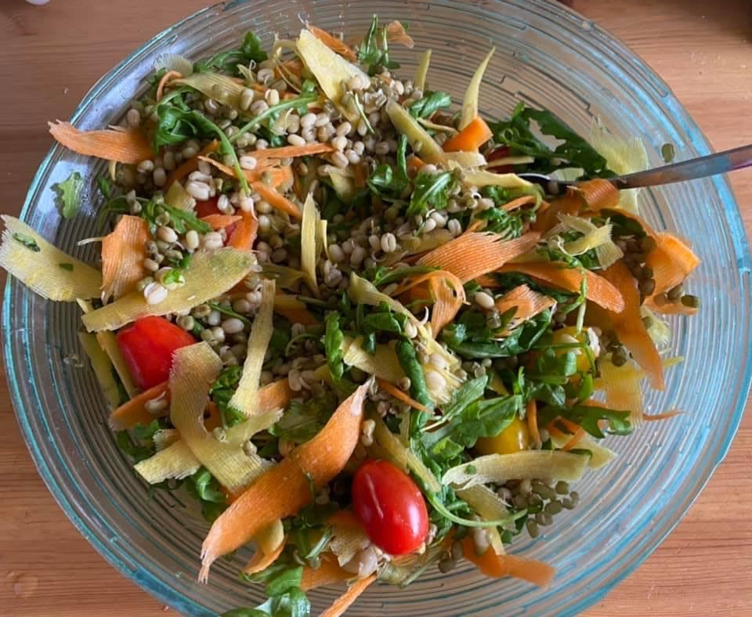
ANCIENT WISDOM OF FOOD
Food is Celebration, Food is Love, Food is Emotion.
Nutrition does not come from bottles and packets.
Natural food compliment each other.
Food can cause healing in most wondrous ways.

Slide 7
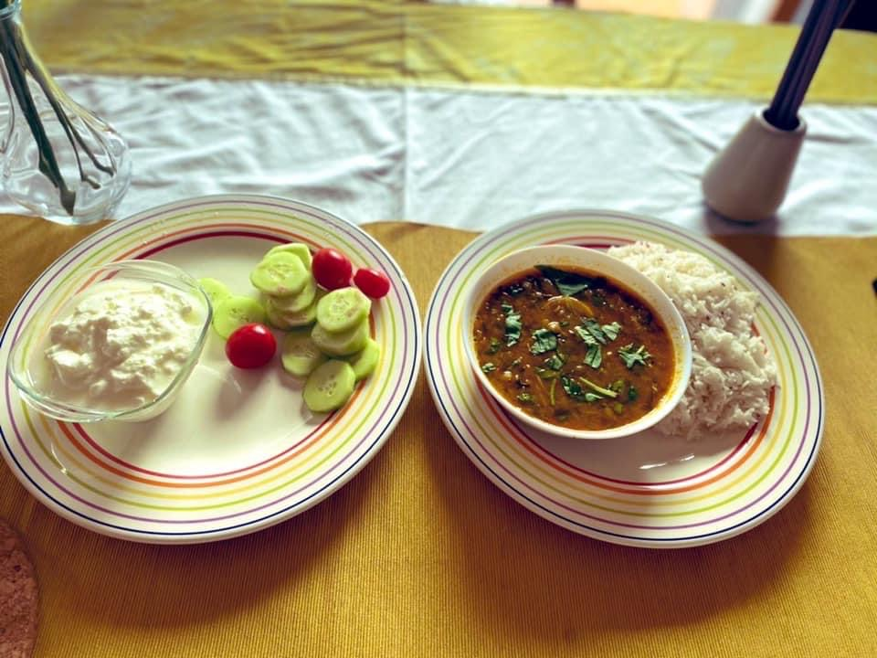
It is not an Apple a Day which keeps the Doctor away but it is well planned, balanced meal served with love and magic

