Slide 1
Glimpses of Research and Development in Ayurveda
Dr.N.Srikanth
Director General (Additional Charge)
Central Council for Research in Ayurvedic Sciences
New Delhi

Slide 2
Research in Ayurveda-Background
Traditional systems of medicine in Asia has been the subject of perceptive philosophical, historical and anthropological content that enables the systems to have a holistic aspect
Not all medical traditions have identical trajectories though they have broadly similar historical experience.
Among Asian systems of medicine, TCM, Arabic, Japanese and Indian Systems of medicine has gained global attention
Ayurveda and other Traditional systems of medicine in India such as Siddha, Unani, Yoga &Naturopathy have a unique understanding of physiology, pathogenesis, pharmacology, and therapeutic approach which are different from Western biomedicine
Globally the interest in traditional systems of medicine, specific to that region as well as of other geographic areas, has increased due to easy accessibility, flexibility, relatively low cost, low levels of technological input, and relatively low side effects (WHO, 2002).

Slide 3
Research in Ayurveda-Background
The goal of WHO Traditional Medicine Strategy 2014–2023 is “promoting the safe and effective use of traditional and complementary medicine through the regulation, research and integration of the products, practices and practitioners into the health system, as appropriate
Safety, efficacy, quality, and rational use of Ayurveda has emerged as a major field in the last couple of decades
While there is an increase in the use of Ayurveda and such other systems worldwide, research in this area is inadequate, and available evidence often have limitations such as inadequate research designs, small sample sizes, inconsistent results, inconsistency of descriptions of interventions, poor controls, and even difficulties in getting published.
Way forward: Generating evidence on efficacy and safety of Ayurveda formulations and procedures/practices, standard and quality assured medicines, training/capacity building of Ayurveda professionals in research methodology, global positioning of Ayurveda, enhancing visibility of research publications.

Slide 4
R&D Strategy
SNo. | Issue | Initiative
1 | Policy | National Policy exists
2 | Quality | APC/PCIM
3 | Safety and Efficacy | R&D Support Validation and Drug trials -Experimental and Clinical trials
4 | Accessibility | R&D Support Feasibility Operational Studies -Level of integration -Acceptability -Intervention efficacy Pharamacovigilance
5 | Rational Use

Slide 5
Research support
S.No. | Government Initiatives | Period | Details
1. | Ayurvedic Pharmacopoeia Committee(APC) Ministry of Health and Family Welfare, Government of India | 1962 | Quality standards and Quality assurance
2. | Pharmacopoeia Commission for Indian Medicine (PCIM) Government of India | 2010 | Quality standards and Quality assurance
3. | Extramural Research Scheme(EMR) Ministry of Ayush, Government of India | 1997 onwards | Support for Research in AYUSH and Related Scientific Disciplines (Quality ,Safety Efficacy, Rational use, Fundamentals etc.)

Slide 6
Research support
S.No | Government Initiatives | Period | Details
4. | New Millennium Indian Technology Leadership Initiative (NMITLI) Herbal Project Council for Scientific and Industrial Research (CSIR),Government of India | 2002 | Fast track innovation driven development of herbals through contemporary science and technology
5. | Golden Triangle Project(GTP) Department of AYUSH Ministry of Health and Family Welfare, Government of India | 2005 | Scientific Validation of Ayurvedic Formulations

Slide 7
Major R&D Contributors
AYUSH Research Councils
CSIR- Council for Scientific and Industrial Research
ICMR- Indian Council of Medical Research
National institutes , Universities
Department of science and technology, department of biotechnology, various Universities, medical colleges, AYUSH colleges, NGOs, hospitals, pharmaceutical industry etc.

Slide 8
R&D Policy Initiatives
S.No. | Policy | Focus
1 | The National Population Policy-2000 | Mainstreaming of ISM & H in the National RCH Program
2 | National Health Policy on AYUSH -2002 & 2017 | Re-orientation, prioritization of research in AYUSH and to validate therapy and drugs in Chronic and Life Style Related Diseases
3 | National Health Policy-2002 Ministry of Health and Family Welfare, Govt. of India
4 | National Commission on Macro-economics and Health-2005 Ministry of Health and Family Welfare, Govt. of India | Health conditions and disability - adjusted life years (DALYs) lost in India results from Communicable diseases, Reproductive and Child Health conditions and Life style related disorders

Slide 9
CCRAS Overview
An apex body for the formulation, coordination, development and promotion of research on scientific lines in Ayurveda system of medicine.

Slide 10
Core Objectives
Development of safe & effective formulations/therapies for diseases of national and global importance.
Validation of Classical Ayurvedic formulations for generating evidence on safety and efficacy.
Capacity building in Core Research areas.
Translational Research including Technology Transfer and Patents
Research oriented Public Health Activities
Dissemination of research outcomes

Slide 11
Clinical Research
Medicinal Plant Research
Pharmacological Research
Core Research Areas
Drug standardization and quality control
Literary and
Fundamental Research
Other activities:
OPD & IPDs
Research Oriented Public Healthcare Activities
IEC

Slide 12
Major Research Activities and CCRAS institutes
Clinical Research(25)
Medicinal Plant Research (6)
Drug Standardization Research(5)
Pharmacology Research(5)
Literary & Fundamental Research(5)
1. CARI, New Delhi
2. NARIP, Cheruthuruthy
3. CARI, Bhubaneswar
4. CARI, Kolkata
5. CARI, Patiala
6. RRAP - CARI, Mumbai
7. CARI, Bengaluru
8. CARI, Guwahati
9. RARI, Lucknow
10. MS-RARI, Jaipur
11.RARI, Gwalior
12. RARI, Vijayawada
13. RARI, Nagpur
14. RARI, Thiruvanthapuram
15. RARI, Patna
16. RARI, Gangtok
17. RARI, Itanagar
18. RARI, Jammu
19. RARI, Mandi
20. RARI, Ahmedabad
21. RARI, Ranikhet
22. ALRARI, Chennai
23. RARI, Port Blair
24. RARC, Dimapur
25. RARC, Agartala
CARI, Bengaluru
CARI, Guwahati
RARI, Itanagar
RARI, Ranikhet
CARI, Jhansi
RARI, Pune
NARIP, Cheruthuruthy
CARI, Kolkata
CARI, Jhansi
RARI, Gwalior
CSMCARI, Chennai
NARIP, Cheruthuruthy
CARI, Kolkata
RARI, Gwalior
RARI, Pune
CSMCARI, Chennai
NCIMH, Hyderabad
RARI, Nagpur
NARIP, Cheruthuruthy
RRAPCARI, Mumbai
CCRAS, Hqrs.
Public Health Research Activities
THCRP –in 14 States through 14 Institute
AMHCP (SCSP) –in 18 States through 20 Institutes
RCH (SCSP) –in 10 States through 10 Institutes
NE –functioning at 19 centres in 4 States

Slide 13
Research Policy
Ministry of Ayush- EMR Scheme
Intra Mural Research
CCRAS RESEARCH POLICY
Collaboration at National level
Collaboration at International Level
Formulated a research policy in 2015 to streamline research through intramural and collaborative modes & approved by Governing Body
Collaboration with Industries

Slide 14
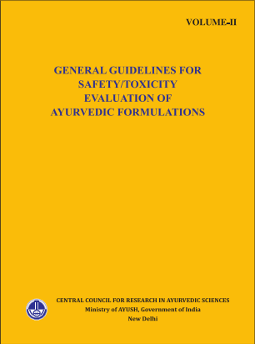
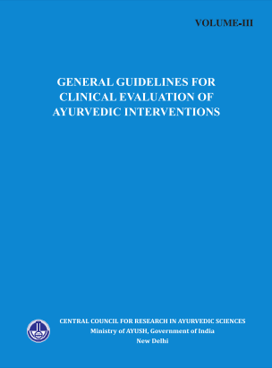
General Guidelines for Research and Development in Ayurveda
CCRAS has developed three comprehensive and concise Guidelines for Ayurvedic Formulations / Interventions focusing on
Drug development (Standardization and quality assurance)
Safety / Toxicity
Clinical evaluations

Slide 15
Objectives & expected outcomes for Research in TM
Generation of safety and efficacy evidence through robust studies→ Integration to Public Heath care and global positioning
Development of New Drugs through elaborate and robust drug development process → Commercialization of affordable and safe, easily accessible medicines
Drug Interaction Studies→ Integration to National treatment guidelines for specific diseases and encourage prescription from all systems of medicine
Repositories, databases, portals on traditional medicine with national and international linkage for the benefit of stakeholders across the globe
Provide Botanical Reference Substance (BRS) and repositories to act as an accredited reference library cum institution for authentication of raw drugs
Development of TM based Diagnostic protocols/ softwares for TM based diagnostic assistance → global acceptance, integration to bio medicine & Research evidence to be generated on diseases as per standard diagnostic criteria
Systematic Review and Meta-Analysis
Activities targeting restoration of ecology and protection of endangered species of plants

Slide 16
Core outcomes at a glance

Slide 17
Evidence on clinical safety and efficacy on classical Ayurveda interventions
Completed :
140 formulations
32 disease conditions
Bronchial Asthma, Chronic Bronchitis, Dry Eye Syndrome, Cognitive Deficit, Obesity, Dyslipidemia, Type II DM, Essential HTN, OA,, RA, Rasayana, Gout, Psoriasis, Osteopenia, Osteoporosissis, PCOS, DUB, MR, GAD, Computer vision syndrome, Uterine Fibroids etc.
Ongoing:
31 formulations
14 diseases
IDA,, Post Natal Care, Urolithiasis,Gout, Bronchitis, Bronchial Asthma, Psoriasis, etc.
New initiatives:
20 formulations
12 diseases
BA, Eczema, Bronchitis, Malabsorption Syndrome, Chronic Diarrhoea in Children, Dyslipidaemia, Obesity, etc.
Nearly 50 Research papers published for generation of evidence in safety and efficacy of classical Ayurveda formulations

Slide 18
Prioritized areas of Clinical Research Health conditions studied
Reproductive & Child Health (RCH)
Musculo –skeletal disorders
Eye diseases
Obesity
Diabetes Mellitus
hypertension
Iron deficiency Anaemia
Vector borne diseases
Renal disorders
IBS
Neurological, Neuro-muscular and Neuro-degenerative disorders
Rasayana therapy & Geriatrics
Quality of life (QOL) in Cancer etc.
Skin diseases
Ayurveda Dietetics
Para surgical procedures: Kshara Sutra
Pain management

Slide 19
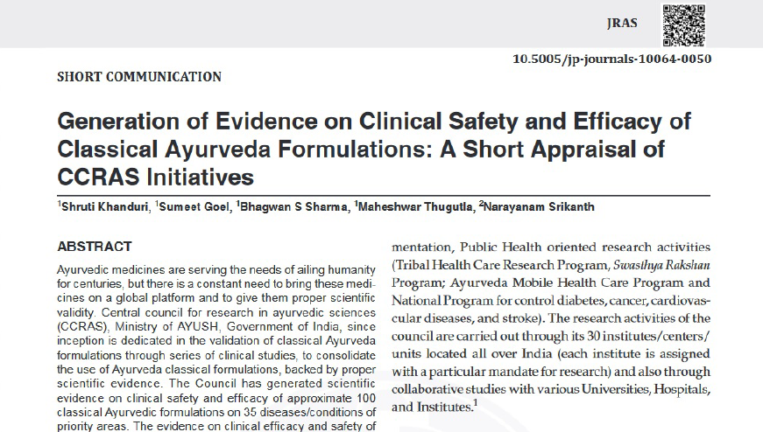
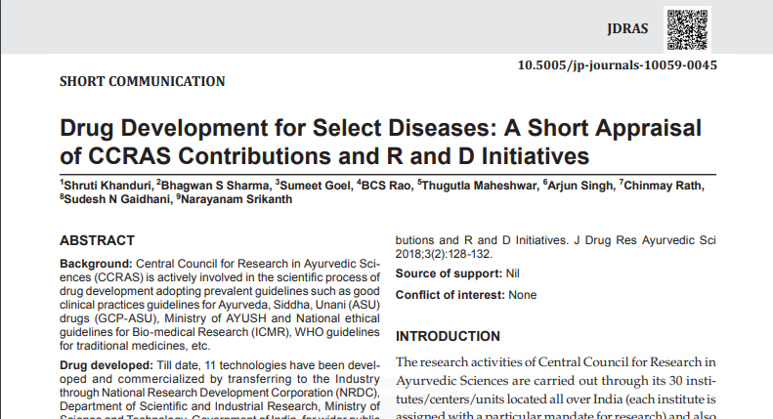
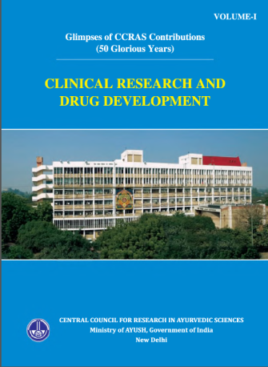
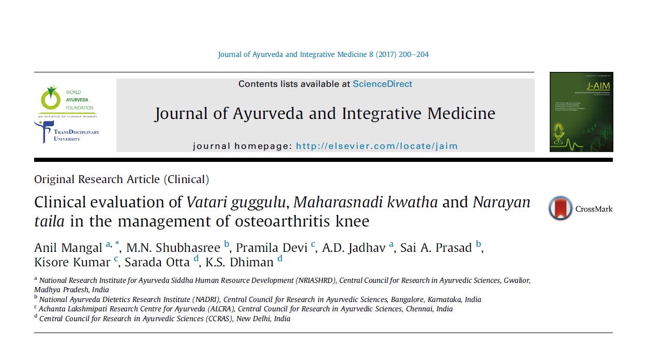

Slide 20
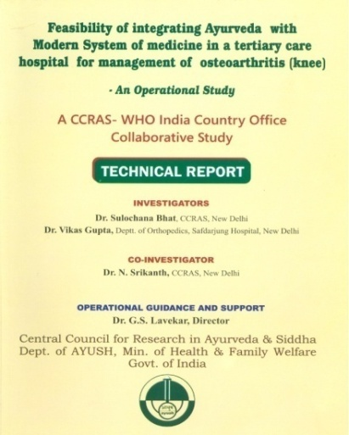
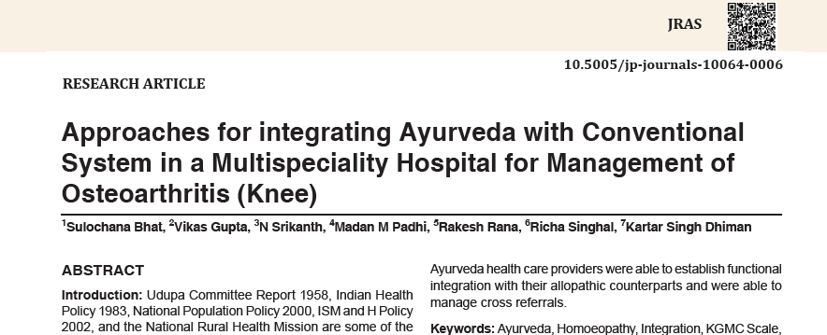
R&D on Integration and Mainstreaming of AYUSH: a WHO India Office Collaboration
Feasibility integrating Ayurveda with Allopathic system of medicine in a tertiary health care hospital to the management of Osteoarthritis (Knee)
Strengthened Communication Among Ayurveda and Allopathic system Health care Providers
Awareness on System Strength
Functional integration and Cross referrals
Effective Ayurvedic intervention (KGMC Index)
Improved QOL and reduced burden of analgesics

Slide 21
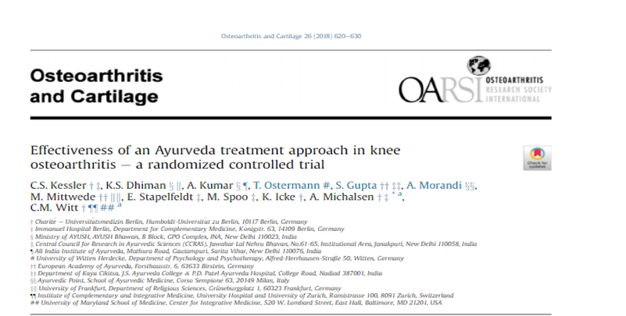
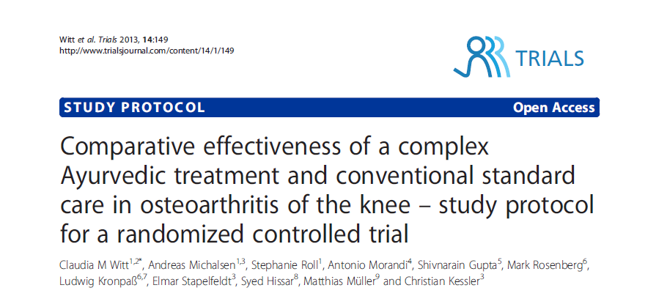
INTERNATIONAL COLLABORATION
Charite University Medical centre, Germany for the management of Osteo Arthritis
Project under process:
Clinical study in the management of Type 2 Diabetes Mellitus with University of Latvia

Slide 22
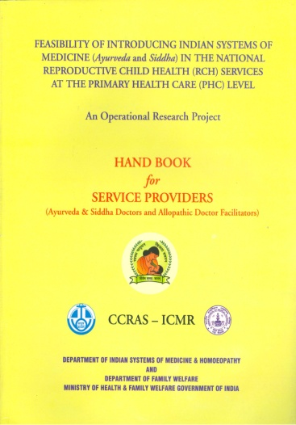
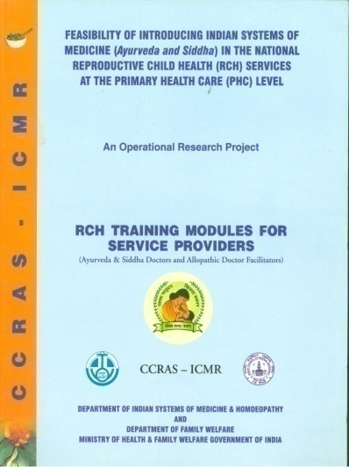
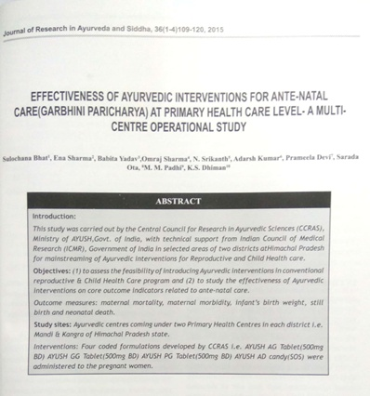
R&D on Integration and mainstreaming of AYUSH - ICMR Collaboration
Feasibility of introducing Indian systems of medicine (Ayurveda & Siddha) in the National RCH at the primary health care (PHC) Level: An Operational Study
17 drugs developed through R&D
implemented in 4 PHCs in 2 districts (Mandi & Kangra) of Himachal Pradesh
Total 2465 participants were enrolled in the study.
Significant improvement in various outcome indicators such as improvement in Hb%, minimal complications such as vomiting, Edema etc. during pregnancy, achievement of full term pregnancy nil still birth and neonatal death were observed

Slide 23
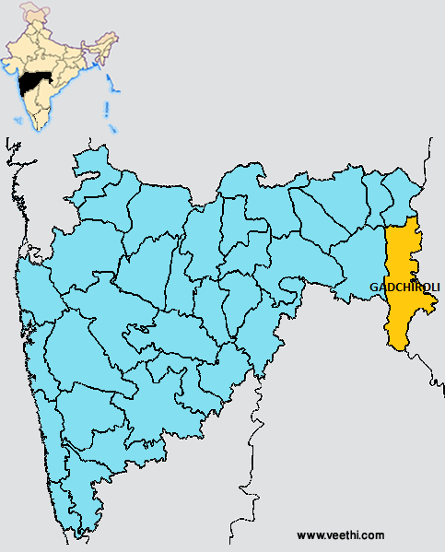
Feasibility of introducing Ayurveda intervention in Reproductive and Child Health (RCH) in PHC’s of selected district (Gadchiroli) of Maharashtra: Effectiveness of Ayurvedic intervention for Ante-natal care (Garbhini Paricharya) at Primary Health Care level: A Multi Centre Operational study
30 PHCs of Gadchiroli district of Maharashtra
Ayush-AG, Ayush-AD, Ayush-GG, Ayush-PK Avaleha, Ayush-SDM tablet and Ayush BL oil developed by CCRAS through systematic scientific studies
For antenatal and postnatal care of pregnant women
Enrolled: 7161
Expected Outcome: Introduction of Ayurveda Interventions in National RCH Programme

Slide 24
INTEGRATION OF AYUSH (AYURVEDA) WITH NATIONAL PROGRAM FOR PREVENTION AND CONTROL OF CANCER, DIABETES,CARDIOVASCULAR DISEASES AND STROKE (NPCDCS)
Functional at 52 centres i.e. 49 Community Health Centres (CHCs) and 3 District Hospitals of 3 identified districts viz. Surendranagar (Gujarat), Bhilwara (Rajasthan) and Gaya (Bihar,) through AYUSH-NPCDCS Clinic/Lifestyle modification Clinics since January, 2016
108631 patients enrolled for selected non communicable diseases.
Overall encouraging benefits of stand-alone Ayurveda therapies as well as benefits as add-on therapies
Outcome : Functional Integration through delivering Ayurveda-Allopathy Integrative Health Care Services in the management of Non- Communicable Diseases

Slide 25
Research in Maternal and Child Health -ICMR funded projects
Clinical evaluation of the efficacy of “Ayush SS Granules” in exclusively breast feeding mothers with Insufficient Lactation (Stanyalpata)- A Randomized Double blind placebo control trial
Evaluation of AYUSH-LND a coded Ayurvedic Formulation in the management of Asrigdara (Abnormal Uterine Bleeding)-A randomized open label prospective clinical trial

Slide 26
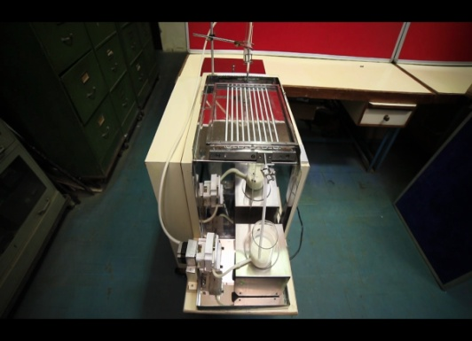
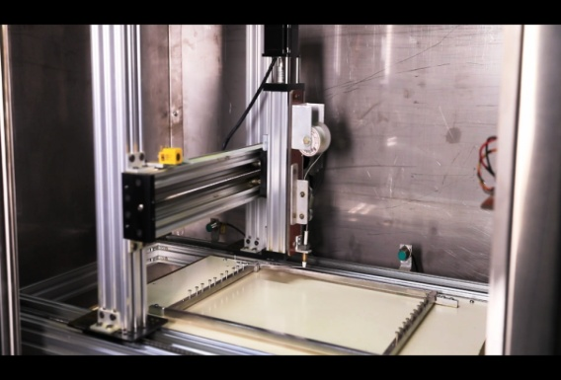
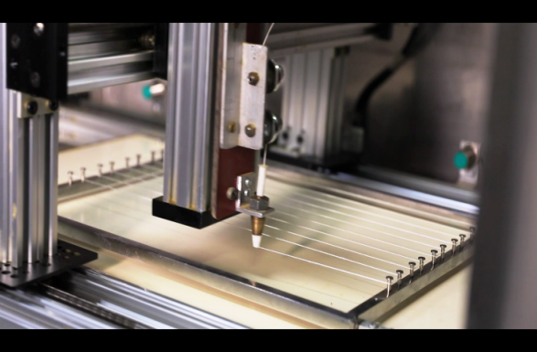
Automation of Ksharasutra
Developed a technique of automated Ksharasutra production in collaboration with IDDC, IIT New Delhi.
Enabling speedy production of standard Ksharasutra confirming the parameter of modern medical standards.
CCRAS has also used it clinically and found it very effective in terms of tolerability and other clinical parameters.
A medicated thread, used in Ayurvedic parasurgical technique for treating fistula-in-ano, piles, and pilonidal sinus like anal disease.
Joint patent filed with IIT Delhi

Slide 27
Systematic Review and Meta-analysis Studies
Summary of On-going Systematic Reviews
Total No. of Systematic Reviews | 30
Systematic Reviews Protocols Registered with PROSPERO | 29
Protocols Published/ Submitted in Peer-reviewed Journal | 20
Submission of Preliminary draft report of completion | 03
On-going | 27
List of Diseases/Conditions identified for Systematic Review
Sinusitis | Anxiety
Hemiplegia | Diabetic Retinopathy
Conjunctivitis | Parkinson Disease
Iron Deficiency Anemia | Depression
Asthma | Fistula in Ano
Hepatitis | Dry Eye Syndrome
Obesity | Sciatica
Glaucoma | Urolithiasis
Rheumatoid arthritis | Diabetes
Allergic rhinitis | Epilepsy
ADHD | Dysmenorrhea
Female Infertility | Hypertension
Gout | PCOS
Psoriasis | Hypothyroidism
 | Acid Peptic disorder
Expected Outcomes:
Publication of the outcome of the Systematic Reviews
Development of Evidence Gap Map
Development of Standard Outcome measures and Core Outcome set for evaluation of safety and efficacy of Ayurveda interventions

Slide 28
Research oriented public health services

Slide 29
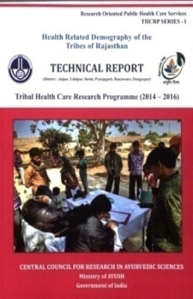
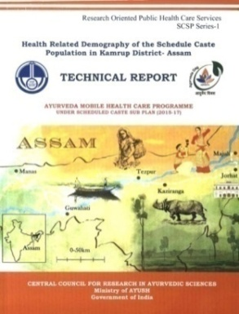
Research impact on Public Health: CCRAS
TRIBAL HEALTH CARE RESEARCH PROGRAMME (THCRP) Initiated in 1982 14 States Population covered : 1,55,2225 Beneficiaries: 870795 | AYURVEDA MOBILE HEALTH CARE PROGRAMME UNDER SCHEDULED CASTES SUB PLAN (SCSP) Initiated in 2015 18 states Population covered 29,11,021 Beneficiaries: 4,14,483 | SWASTHYA RAKSHAN PROGRAMME THROUGH MOBILE HEALTH SERVICES (SRP) Initiated in 2015 and continued upto 2019 19 states Beneficiaries: 4,30,865 | AYURVEDIC HEALTH CENTRES UNDER NORTH EAST PLAN 4 states(Assam, Arunachal Pradesh, Sikkim, Tripura) Initiated in 2018 19 Health centres Beneficiaries: 4,64,013
 | RCH in 2018 10 states Population covered: 2,02,358 Beneficiaries: 1,04,732

Slide 30
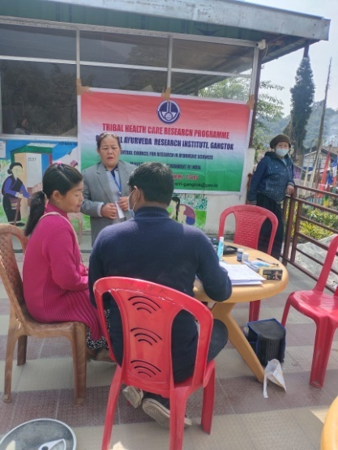
TRIBAL HEALTH CARE RESEARCH PROJECT (THCRP)
Objectives:
To Study the living conditions of tribal people
To Collect information related to health statistics
To provide medical aid at their door steps
Documentation of use of common medicinal plants in the area
Outcome
Covered 74513 population of 85 villages and
Medical aid provided to 34716.
110 of Local Health Traditions/Folk Claim collected.
New Initiatives
“A prospective community based study for the evaluation of Dhatri Lauha in Anemia (Pandu)”
“A prospective community based study for the evaluation of Yograj Guggulu, Ashwagandha Churna and NarayanaTaila in Osteoarthritis Knee (Janugat Sandhivata)

Slide 31
Impact of CCRAS Research oriented public health services

Slide 32
Medicinal Plant Research

Slide 33
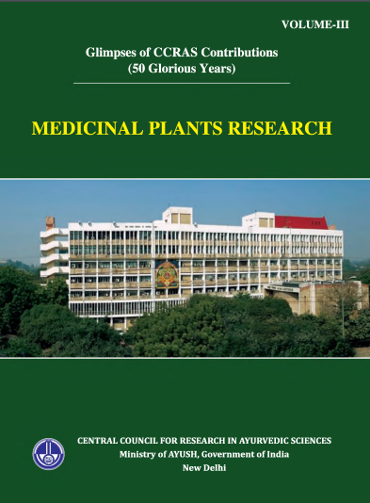
Medicinal Plant Research
Survey tours conducted : 970
Herbarium prepared: 1,20,000
Museum specimen collected: 20,000
New plant species recorded: 10
Pharmacognostical studies on 500 plants
30 Agrotechnique and 14 in-vitro propagation protocols developed
International recognition to the herbarium at five institutes (listed in INDEX HERBARIORUM and accredited with acronyms by the New York Botanical Garden, USA)
Regional Research Institute of Himalayan Flora, Tarikhet – ‘RKT’
Central Ayurveda Research Institute, Jhansi– ‘JHS’
Central Ayurveda Research Institute, Bangalore – ‘RRCBI’
Regional Ayurveda Research Institute, Itanagar – ‘ARRI’
Central Ayurveda Research Institute, Guwahati- ‘NEHAR’

Slide 34
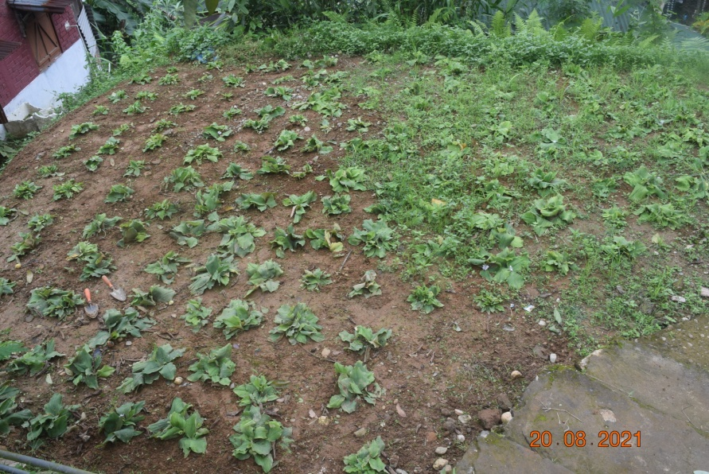
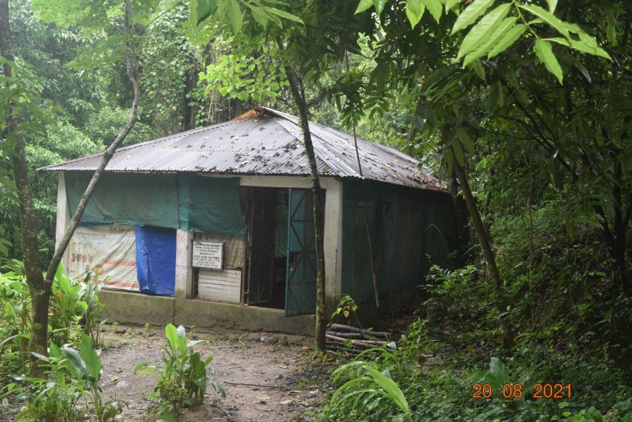
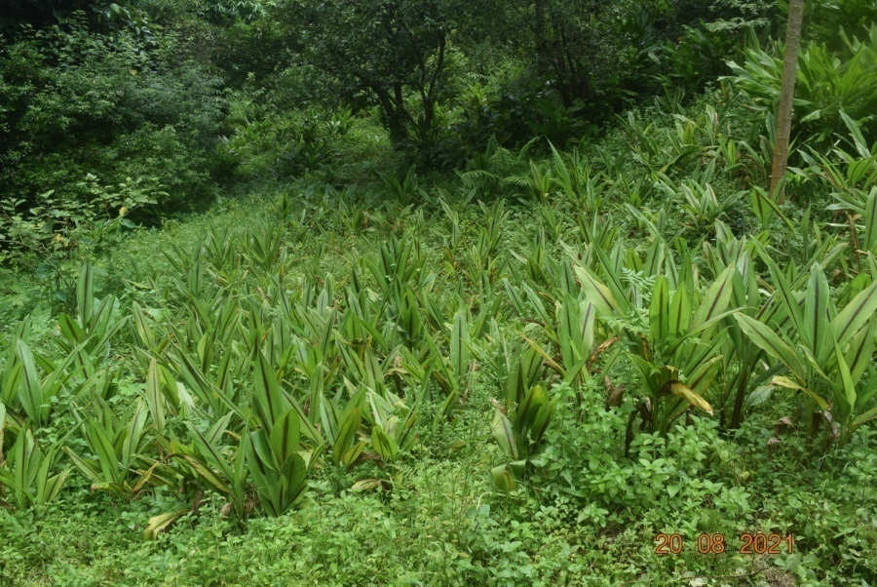
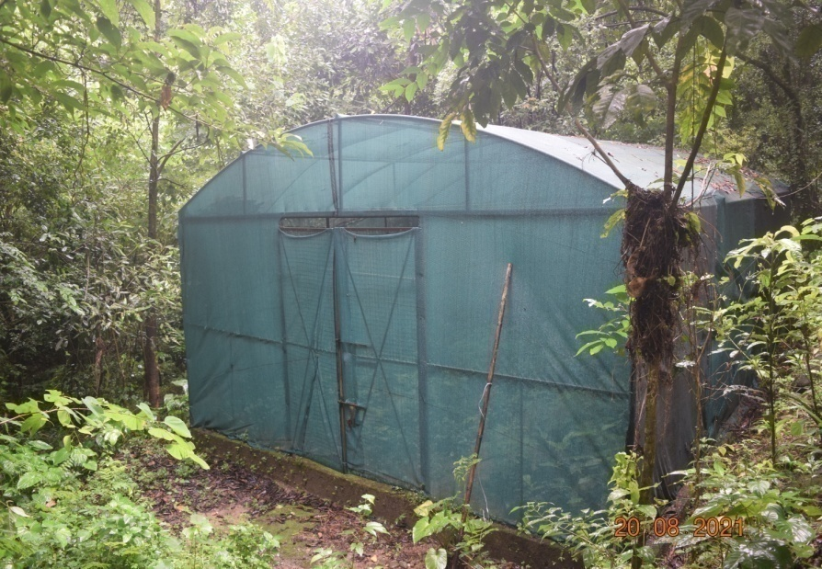
CONSERVATION AND DEMONSTRATION MEDICINAL PLANT GARDEN

Slide 35
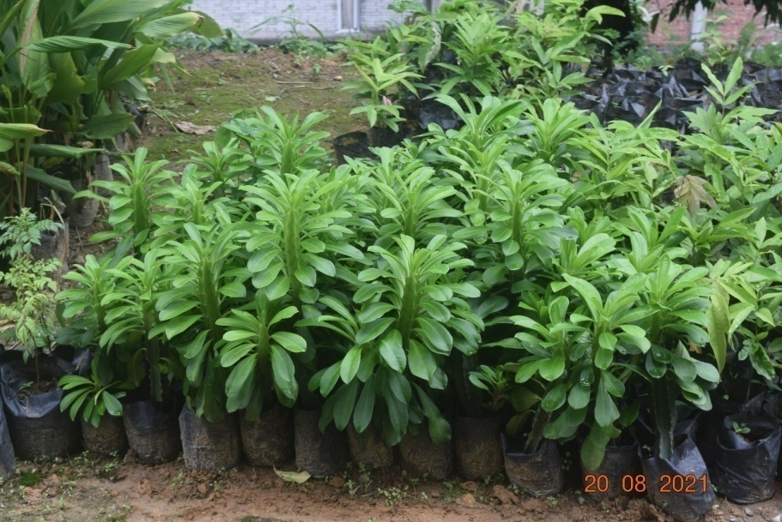
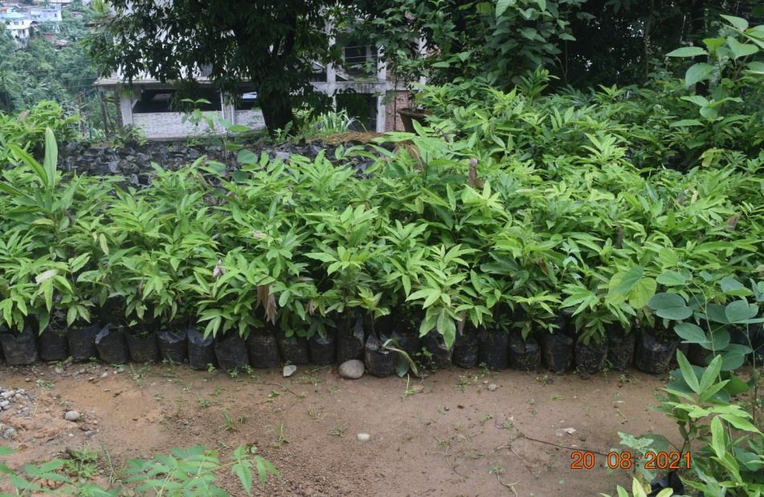
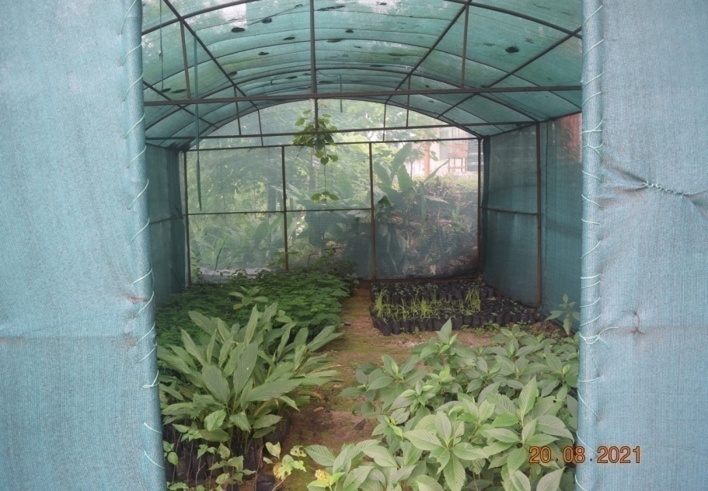
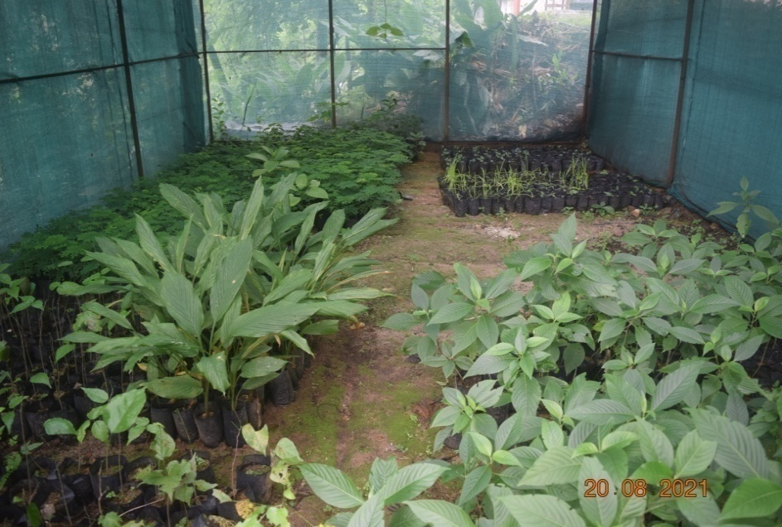
MEDICINAL PLANT NURSERY

Slide 36
Validation of Local Health Traditions (LHTs) and Ethno-Medical Pracitces (EMPs) for generation of Scientific Evidences
CCRAS approach in documentation and validation of LHTs and EMPs
Proactive approach
Tribal Health Care Research Program (THCRP), and Medico-Ethno Botanical Survey (MEBS)
Reactive approach
documentation through taking leads voluntarily provided by individuals
Screening and Validation
Identification of the LHTs and folk claims pertaining to new indication
Publication of the LHTs and folk claims, which are not novel/ found in classics.
Success stories
C1 Oil for wound healing
AYUSH D for Diabetes Mellitus
AYUSH A for Bronchial Asthma
Total 1140 folklore collected in THCRP and 1496 in MEBS so far

Slide 37
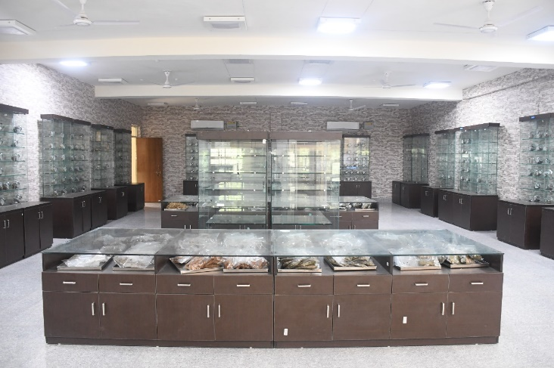
National Raw Drug Repository (NRDR)
82 monographs completed encompassing Pharmacognosy, Chemistry, preservation (BRS reference samples) and Documentation of data.
More than 200 plant species collected from its natural habitat through survey units.
At RARI, Pune; CARI, Jhansi; RARI, Ranikhet; and RARI, Bengaluru.
Planted around 70 plant species with Miyawaki method of plantation along with the comparison in controlled region for developing the micro forest of the plant sp. which are native to their geographical region.
Expected Outcome:
Provide Botanical Reference Substance (BRS) leading to revenue generation.
Act as an accredited reference library cum institution for authentication of raw drugs
Expected Outcome
Restoration of land and ecological flora
Conservation of native flora
Facilitate the natural growth and germination of seeds
Transfer of Know how technology of successful model for the development of mini forest

Slide 38
DRUG STANDARDIZATION

Slide 39
Drug Standardization
Objective | Activities since Inception
Quality analysis of single drugs and compound formulations: | 1031(Single drugs) 684 (compound formulations)
Phytochemical Investigations of Medicinal plants used in Ayurveda | 201 medicinal plants were studied for their phytochemical components.
To isolate marker compounds from Ayurvedic medicinal plants. | Isolation of Marker compounds from 22 medicinal plants (On going project)
To develop standard manufacturing process, Pharmacopoeial Standards of Ayurvedic Classical Formulations | Standard manufacturing process and Pharmacopoeial Standards of 58 Classical Ayurvedic formulations were prepared in project mode of APC.
Finger print profile of single drugs of API | Thin Layer Chromatography (TLC) Atlas of 80 drugs of API Part-I, Vol.I was developed and was printed by Deptt of AYUSH. TLC Atlas of 99 drugs API Part-I, Vol. III was developed and published by PCIM.
Monograph included Ayurvedic Pharmacopeia (API) | 50 Single drugs and 35 Compound formulations
:

Slide 40
Development of Quality standards of Ayurvedic Drugs
CONTRIBUTION to AYURVEDIC PHARMACOPOEIA OF INDIA (API)
Pharmacopoeial Standards for Ayurvedic Formulations (431 covering 21 dosage forms)
Phytochemical investigations of Medicinal plants (220) used in Ayurveda
Isolation of Marker compounds from 53 medicinal plants
Pharmacopoeial Standards of Compound Formulations (202)
Pharmacopoeial Standards of Single Drugs(645)
TLC Finger print Atlas of single drugs of API
Contributed for Monographs on 95 plants for book “Quality standards of Indian Medicinal plants” in different volumes published by Indian Council for Medical Research (ICMR)

Slide 41
Generation of experimental evidence for safety of Ayurveda drugs
160 drugs were screened for various safety/toxicity
54 Single drug have been screened for safety/toxicity
31 Ayurvedic Formulations have been screened for safety/toxicity
75 Coded drug have been screened for safety/toxicity

Slide 42
Biological screening of Ayurvedic formulations
389 drugs were screened for various biological screening studies

Slide 43
Generation of Evidence on Quality and Safety of Rasaushadhi through GTP and other collaborative studies
Current activity: Safety study at GLP labs
Name of the formulations (n=19)
Dhatri Lauha
Mahalaxmivilas rasa
Mahayogaraj Guggulu
Swarna mahayogaraj guggulu
Arogyavardhini Vati
Kajjali Yoga
Makardhwaj
Punarnava mandura
Rasa Sindoor
Tamra bhasma
Trivanga Bhasma
Naga Bhasma
Svarna Bhasma
Kasisa Bhasma
Vasant Kusumakar rasa
Rasamanikya
Hridyarnava Rasa
Navaratna Rasa
Shveta Parpati
Rasamanikya
Shwasakuthara Rasa
Smritisagar Rasa
Tribhuvankirti Rasa
Vatagajankusha Rasa
Garbhapala Rasa
Shankha Vati
Mritunjaya rasa
Kumarkalyana Rasa
Navajivana rasa
Expected Outcomes:
Enhanced Prescription trends and Market potential
Global Acceptance

Slide 44
New Drug Development
Patents granted : 18
Technology Transfer : 11
Industry Partners: 40
Revenue generation: Approx. 4.5 cr.
Major formulations commercialised
AYUSH-64: Malaria
AYUSH 82: Type 2 Diabetes mellitus
AYUSH SG: For management of rheumatoid arthritis
07 RCH Formulations
C-1 Oil for wound healing
AYUSH Manas for Mental Retadation
AYUSH QOL-2C for Improvement of Quality of life in Cancer patients
AYUSH PJ 7 for Dengue
AYUSH D for DM and Prediabetes
AYUSH Rasayana A and B for Geriatric Health
Ayush-SL for Chronic Filarial Lymphoedema
Clinical trial phase
Ayush Manas in Cognitive deficit
Carctol-S for Cancer
Ayush-A for bronchial Asthma
Ayush-PTK for Hepato-protection as add on to ATT
Ayush CCT for post operative cardiac care
Ayush GMH in NAFLD
Preclinical
Ayush SC-3 for Sickle Cell Anemia
Ayush K1 in Kidney disorders
Ayush DVR for burns
Ayush RS for bleeding

Slide 45
Evidence on Safety of Rasaushadhis through Retrospective and Prospective Pharmacoepidemiological Studies
Retrospective pharmaco- epidemiological cross sectional analysis (2012-2017)
24 CCRAS institutes
Data of 1,09,307 patients
15 rasaushadhis
Prospective Open Label Study to
document the potential safety issues
and prescription trends in selected
Rasausadhis
18 CCRAS institutes
11 Rasaushadhis
Retrospective: Rasausadhi (n=15)
Agnitundi Vati | Punarnava Mandoora
Arogyavardhini Vati | Shirahsuladivajra Rasa
Chandraprabha Vati | Simhanada Guggulu
Dhatri Lauha | Sutashekhara Rasa
Kamdhudha Rasa | Swasakuthara Rasa
Krimimudgara Rasa | Tribhuvana Kirti Rasa
Laxmivilasa Rasa | Vatagajankusha Rasa
Maha Yograj Guggulu
Rasausadhi (n=11)
Laxmi Vilas rasa (Naradiya) | Rasa manikya Rasa
Sutasekhar Rasa | Smritisagara Rasa
Tribhuvankirti Rasa | Arogyavardhini Gutika
Swasakuthar Rasa | Mahayogaraja guggulu
Chandraprabha Vati | PrabhakarVati
Gandhaka Rasayana
Expected Outcome:
National reference for safe & rationale use
Tangible evidence on safety and Global positioning
Helpful for Prescription trends
Enhancement of marketing potential of Rasaushadhis

Slide 46
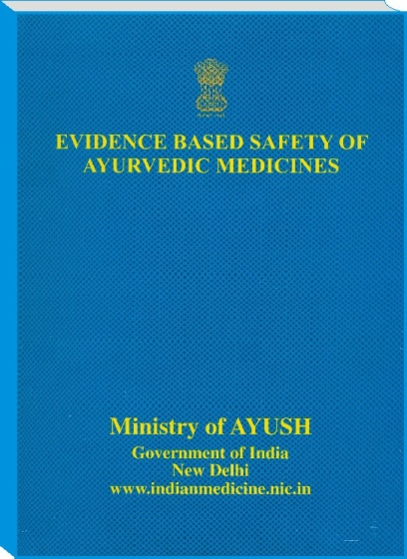
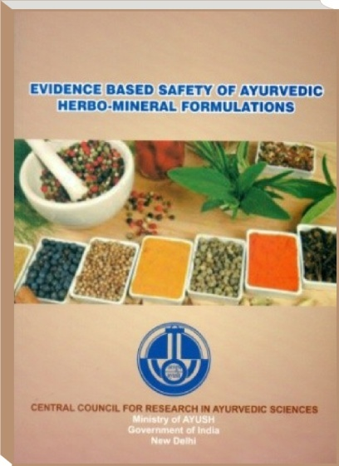
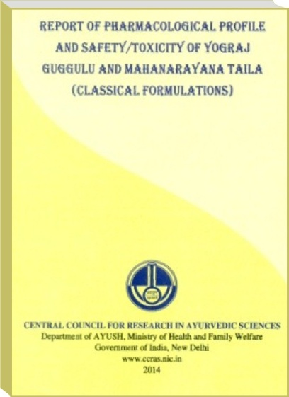
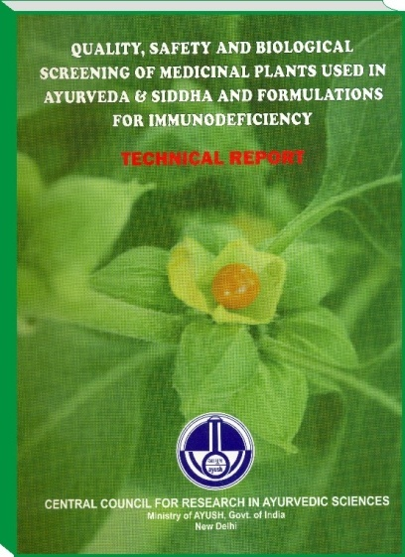
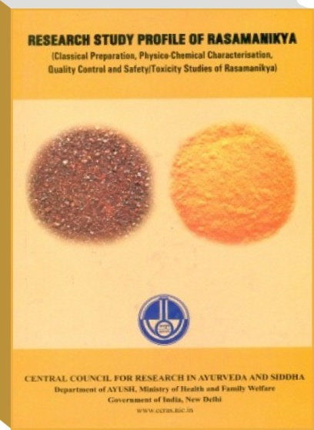
Generation of evidence on safety of Ayurveda medicines

Slide 47
Fundamental Research
Development of Ayurveda based Diagnostics
To develop standard diagnostic protocol for selected diseases
Interface for integration/ customization and development of diagnostic gadgets
To develop Standardized Ayurvedic Case Taking Protocol (SACTP)
Validated diagnostic Criteria of 2 disease conditions viz. Grahani & Kasa
Development of Ayurveda based Health assessment scale
Standardization of Prakriti Assessment Scale & Developed AYUR Prakriti Web Portal
Expected Outcome:
Mainstreaming of Ayurveda clinical diagnostics
Development of Integrated Protocol
Expected Outcome: Helpful in Predictive, promotive & Preventive Health reducing the global burden of disease.

Slide 48
Literary Research
Revival and Retrieval of Medical Manuscripts and rare books including digitization of about 5000 manuscripts
Publication of 11 catalogues/descriptive catalogues & creation of Centralized Digital Repository for Medical Manuscripts of Ayurveda, Siddha and Unani
Collection and retrieval of 48 out of 54 books mentioned under Schedule I of Drugs & Cosmetics Act 1940 in print/digital form
Publication of about 40 books from original manuscripts/rare books.
Development of various IT related applications such as E-books of major classical books of Ayurveda such as Charakasamhita, Sushruta samhita, Madhavanidana & 25 Nighantu

Slide 49
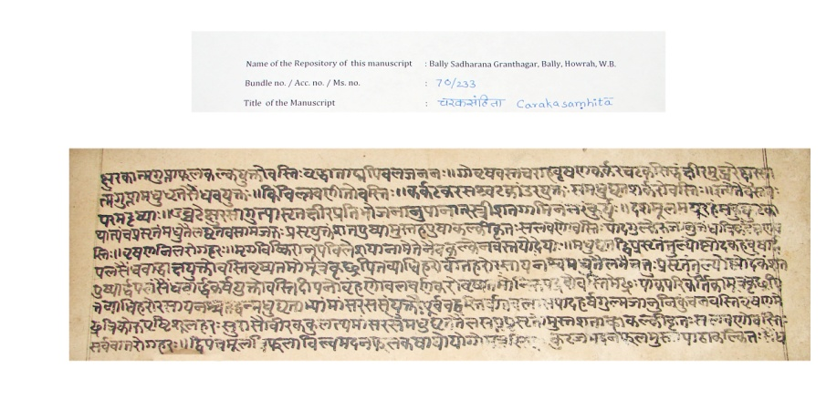
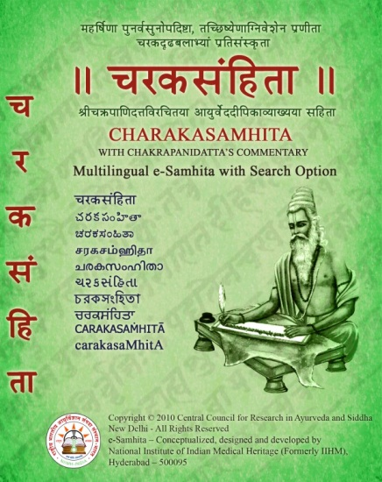
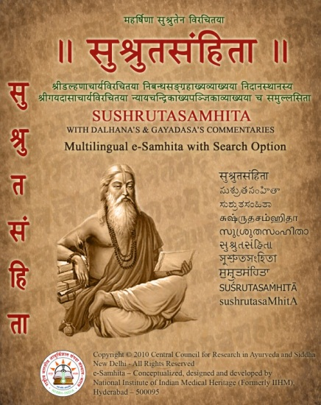
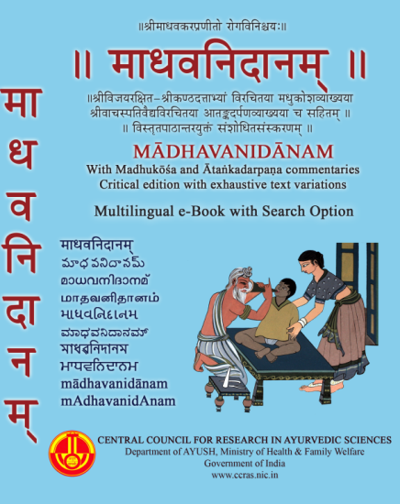
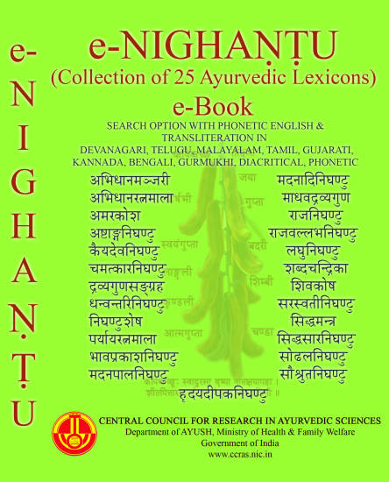
Digitization and editing of Manuscripts
Before editing
After editing
Development of E-books of Ayurveda Classics

Slide 50
IT Initiatives
Total number of visitors 752691
32118 Research papers/ abstracts

Slide 51
NAMASTE Portal
National AYUSH Morbidity And Standardized Terminologies Electronic Portal (NAMASTE Portal) – An AYUSH Informatics Initiative for centralised collection of morbidity statistics pertaining to various systems of medicine under the Ministry of AYUSH

Slide 52
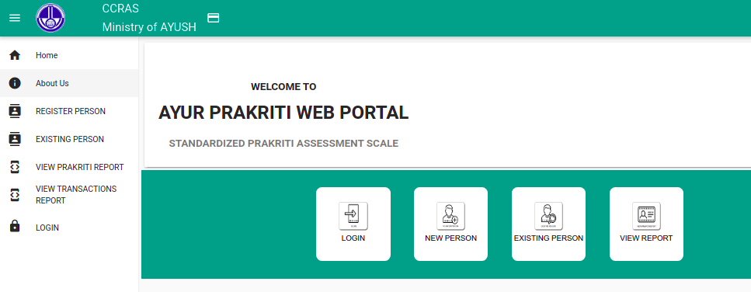
CCRAS – INFORMTION TECHNOLOGY INITIATIVES
Conferred Silver Award- Award for Excellence in IT in AYUSH Sector -2019
Ayurvedagranthasamuccaya – APTA Digital Library http://ccras.res.in/ccras_ebooks/
Ayur-Prakriti Web Portal http://ccras.res.in/ccras_pas/
Svasthya Assessment Scale http://ccras.res.in/ccras_sas/

Slide 53
IT INITIATIVES
 | Digital Dashboard with dynamic information on “Manuscripts of Ayurveda, Yoga, Unani, Siddha, Sowa Rigpa Manuscripts and catalogues” across India and other libraries and individual collections across the world
 | Authentic resource for showcasing Historical veracity of Ayurveda though primary sources such as Inscriptions, Archaeo-botanical Information, Sculptures, Philological sources and advanced Archaeogenetic studies.
 | Online public access catalog (OPAC) for more than 12000 Indian Medical Heritage book collection through “National Informatics Centre (NIC)’s e-Granthalaya” platform.
 | A one stop solution for Research and development for aspiring researchers who opted for Ayurveda based studies and Research guidance on request for free of cost by experienced Scientists, Clinicians dedicated for R&D in Ayurveda.

Slide 54
CAPACITY BUILDING

Slide 55
Panchakarma Training Course
Affiliated to Health Sector Skill Council (HSSC) – National Skill Development Corporation (NSDC)

Slide 56
AYUSH PhD Fellowship
Implemented in 2016
No. of Scholars: 25
AYUSH scholar: 19
Non-AYUSH :06
No. of Universities: 11

Slide 57
Research Publications: CCRAS (Total publications 3946)
Overall 12794 Publications in Ayurveda across 652 National and International Journals

Slide 58
THANK YOU

